Slide 1
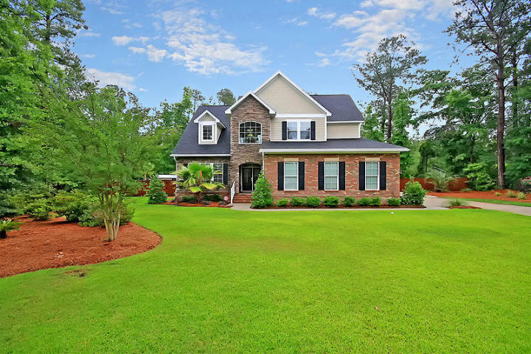
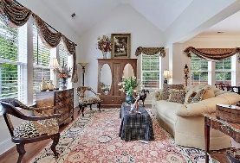
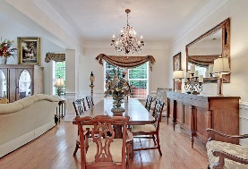
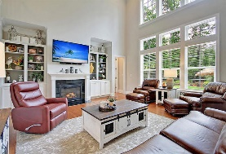
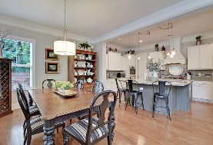
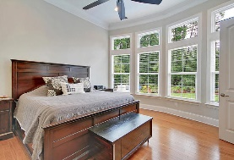
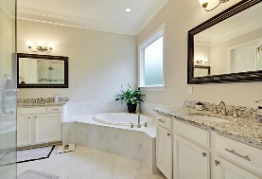
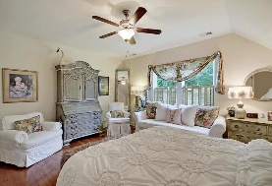
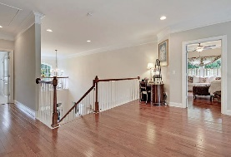
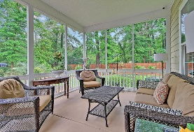
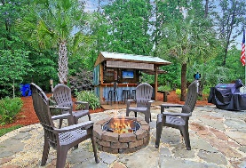
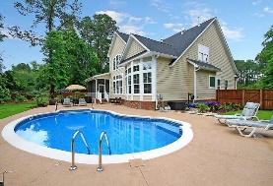
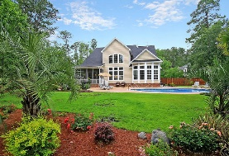
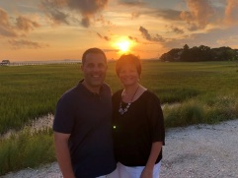

Inground Pool! Cul-de-sac! One Acre!
1009 King Mountain Drive
The Summit
Summerville, SC 29483
MLS# 20014112
$595,000
5 Bedrooms | 3½ Baths | 3,580 sf
This gorgeous, custom built, 3,580 Sq. Ft. home offers 5BR, 3.5BA and is in IMMACULATE condition! At the end of a private cul-de-sac and offering over 1 acre with an inground pool and professional landscaping, this home will not last long! The gourmet kitchen features a massive granite island and sitting bar, gas cooktop, custom backsplash, custom cabinetry, double ovens and stainless appliances. The eat-in kitchen area is open to the family room with vaulted ceilings, custom built-in cabinetry and a gas fireplace. The first floor also offers a dining room and formal living room or office. The master bedroom is also downstairs and has an attached master bathroom with glass shower, tub, dual vanities and a walk-in closet. Beautiful hardwood floors can be found throughout the 1st floor.
This is an awesome house to entertain guests! A screened-in porch overlooks a beautifully landscaped backyard with large patio and an inground pool! The backyard is fenced-in and also offers a pool bar / cabana with sitting bar and refrigerator as well as a fire pit. The home also features a large 3 car garage, lawn irrigation system, alarm system, tankless hot water heater, laundry room and spacious kitchen pantry. Upstairs buyers will find 4 more spacious bedrooms and two full bathrooms. There is extra storage in the attic and above the master bedroom. The Summit is within close proximity to downtown historic Summerville shops and restaurants and this home is a MUST SEE!
Larry & Kathy Mazalatis
Larry Cell 843-693-0529
Kathy Cell 843-693-0159
Office 843-871-9133
AGENTOWNED PREMIERE GROUP | 1800 TROLLEY RD | SUMMERVILLE, SC 29485

