Slide 1
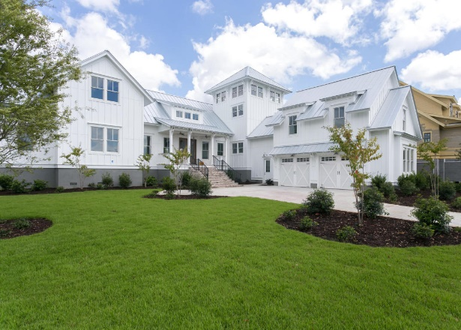
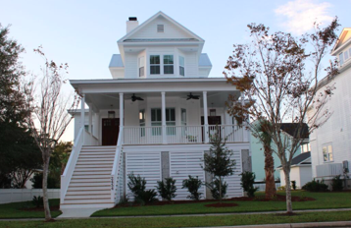
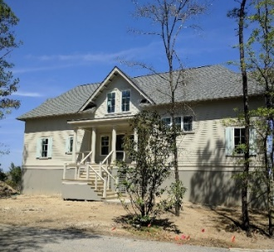
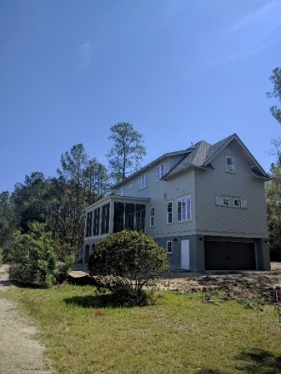
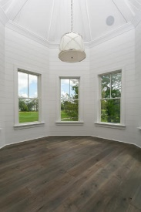
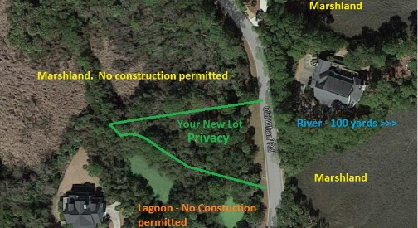
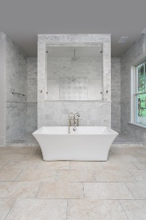
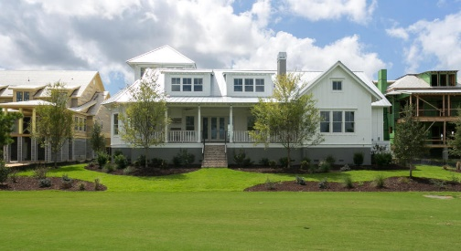
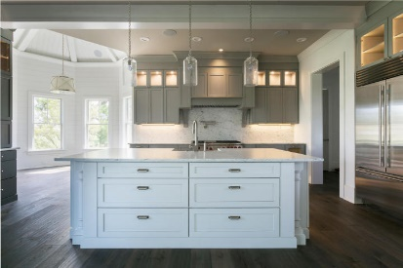
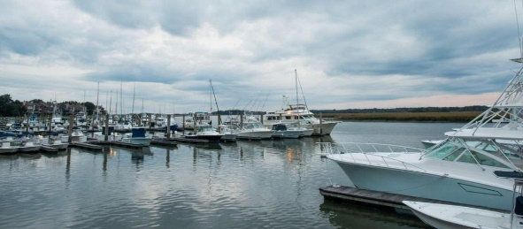


1009 Old Wharf Road Jenkins Point ~ Seabrook Island, SC 29455 MLS# 16007877 ~ $1,025,000
Your clients can custom build on the exclusive Jenkins Point at Seabrook Island, for around $1,000,000.
1
3
2
5
4
7
6
This is a Proposed Custom built home on a .51 acre lot in this beautiful secluded area of Seabrook Island. You will work closely with the builder to make this home the Dream Home you always wanted. It can be built within 9 Months (after Building Permit and Architecture review). It will have outstanding upgrades ● Hardwood seaside plank floors throughout ● 10'/9’ ceilings ● White Terra Bianca granite counter-tops ● Soft close cabinets with under-cabinet lighting ● Fireclay farmhouse sink ● Grohe touchless faucet ● Bosch stainless steel appliances ● Freestanding Drague master tub ● Undermount sinks ● Tankless hot water system ● Hurricane rated windows ● Pre-wired sound ● Cement board siding ● Multi-story decks
Gary Buchanan
(843) 647-7743
gary@garybuchananrealty.com
www.garybuchananrealty.com
AgentOwned Preferred Group | 824 Johnnie Dodds Blvd | Mt Pleasant, SC 29464

