Slide 1
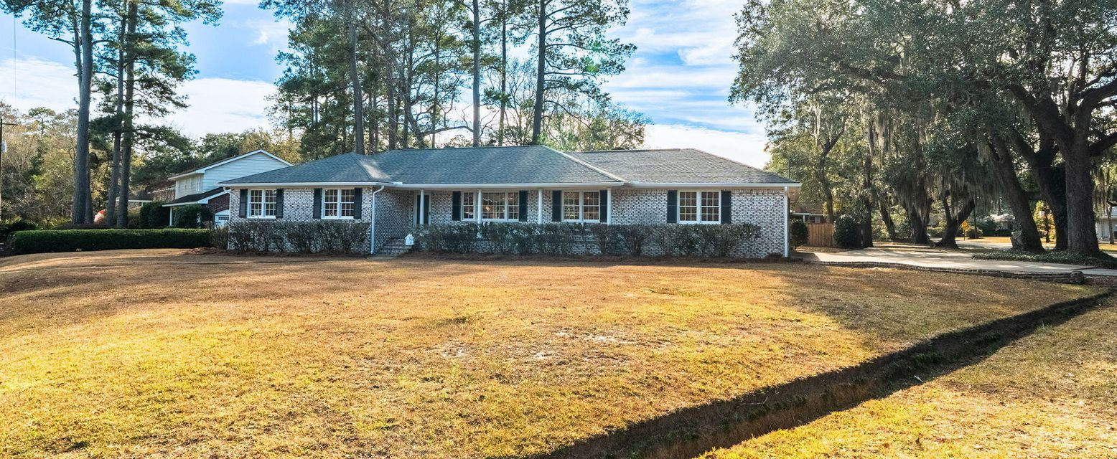
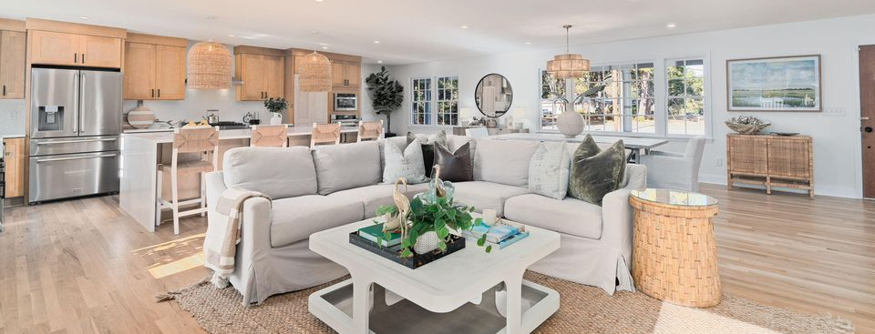
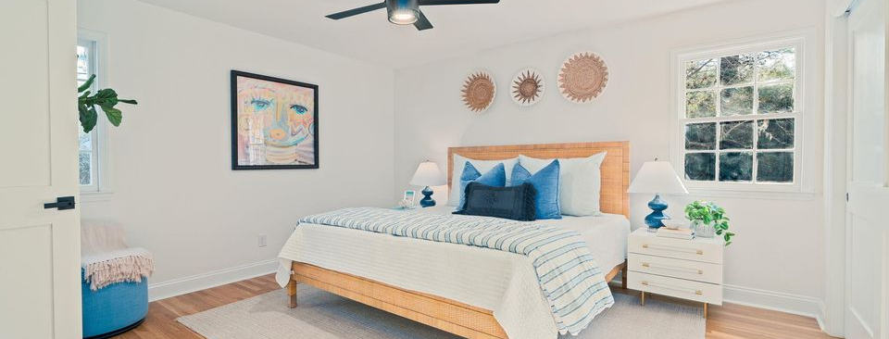

New Listing & Open House Saturday from 11-3
JUS
9714 ROSEBERRY STREE
MOTIVATED SELLER!
/
7
1/
ii
Set on a stately half-acre corner lot in the coveted Northbridge Terrace neighborhood of West Ashley, this home is anything but ordinary.
1009 Southgate Drive
Northbridge Terrace | Charleston, SC 29407 | MLS# 26000051
�
$1,100,000
4 BED
3 BATH
2,713 SQ FT
0.46 ACRES
With commanding curb appeal, a circular driveway framed by mature live oaks, and an elevated presence rarely found in West Ashley, this residence has been fully reimagined into a grand, luxury-caliber home. Ideally positioned less than a half mile from the transformative Ashley Landing redevelopment, soon to become West Ashley's premier destination hub for dining, shopping, a new Publix, and family-friendly greenspace. Inside, over 2,700 square feet of beautifully finished living space offers an expansive open layout designed for both everyday living and elegant entertaining. Refinished hardwood floors flow throughout, leading into a stunning chef's kitchen anchored by a 10-foot waterfall island and outfitted with ZLINE luxury stainless appliances, including a 36" gas range, secondary wall oven, built-in microwave, dishwasher, and counter-depth refrigerator. The thoughtfully designed floorplan includes four spacious bedrooms, highlighted by two private ensuites with large, spa-inspired tile showers, along with a third designer bath featuring a tub and tile surround. A 600+ square foot bonus room provides exceptional flexibility to use as a media room, playroom, executive office, or additional bedroom suite. Additional features include a dedicated laundry room, mudroom/stop-and-drop entry, and a large two-car garage.
Outdoors, enjoy a brand-new oversized deck overlooking the expansive backyard, perfect for entertaining, future pool potential, or simply enjoying the peaceful setting. No HOA, a family-friendly neighborhood, and a premier central West Ashley location complete this rare offering. This is a statement home-substantial, refined, and truly one of a kind. Must see. Schedule a showing today!
Scott Baskin
THE SCOTT BASKIN TEAM
843-324-4139
scott@explorecharlestonrealestate.com
SCOTT BASKIN TEAM

