Slide 1
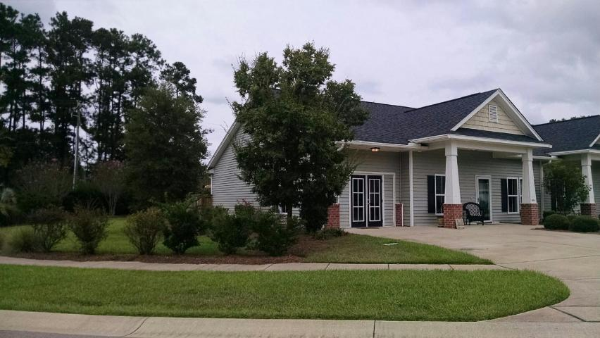
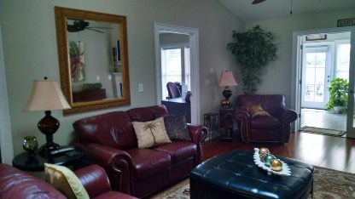
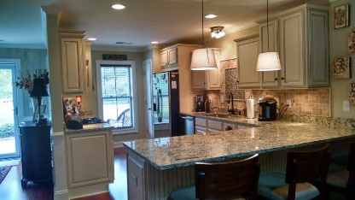
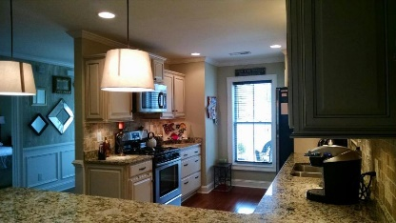
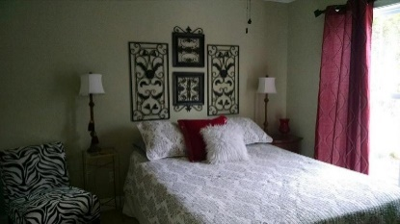
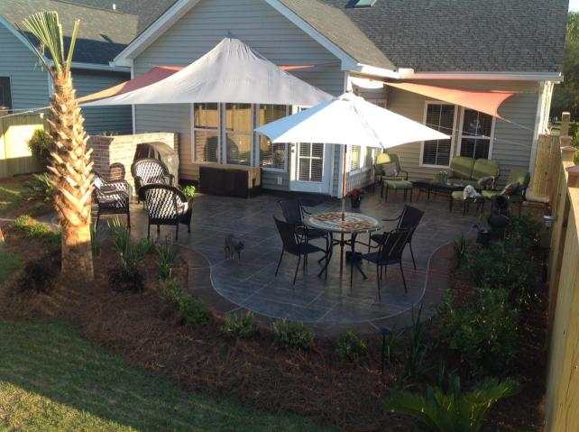
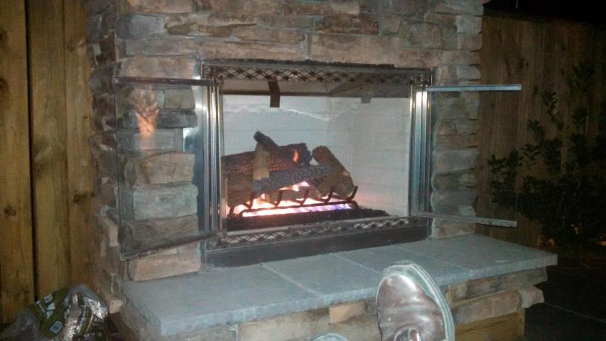



100A Stagecoach Ln
Carriage Hill | Summerville
MLS# 15023872 | $232,000
1,800 square feet | 3 bedroom | 2 baths
The Perfect Downsize
This is a 50+ age required townhome
Upgrades galore
Granite countertop, wood floors, tiled floors in bathrooms and laundry
Tiled sunroom
Lots of natural light
Back yard concrete patio with uplit landscaping, outdoor gas fireplace
Fenced back for privacy
Janis Flodin
843-729-0584 M
jflodin.bcd@gmail.com
B C D Properties LLC | 123 Piccadilly Loop | Summerville, SC 29483

