Slide 1
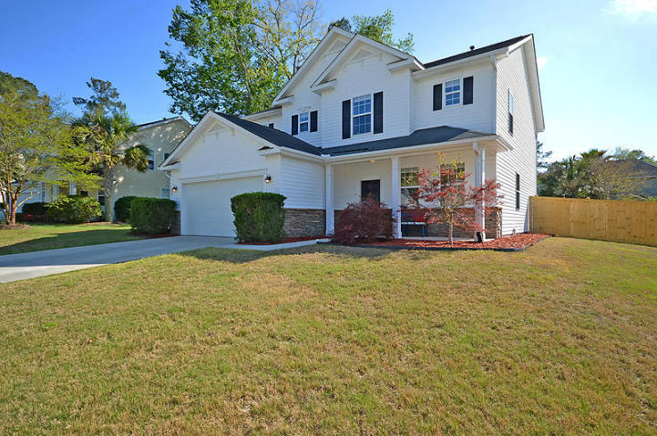
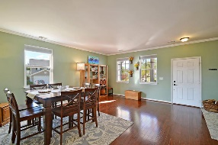
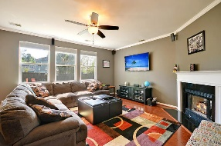
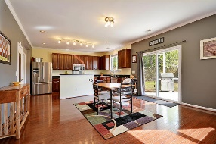
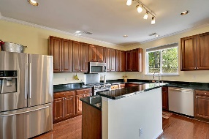
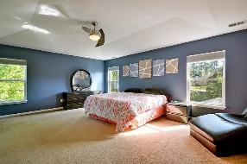
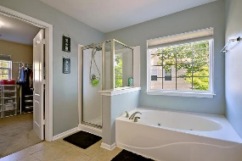
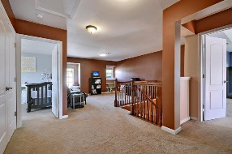
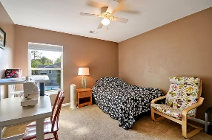
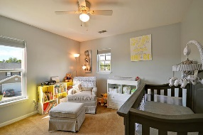
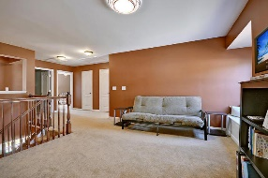
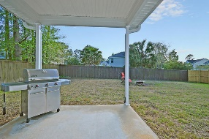
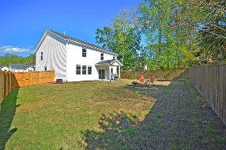


Dorchester District 2 Beauty Under $230k!
100 Arithmetic Circle
Eagle Run
Ladson, SC 29456
MLS# 17009744
$229,900
3 Bedrooms | 2½ Baths | 2,591 sf
You are sure to be impressed when you walk in to this beauty of a home! True pride in ownership shows in every nook and cranny! Owners created tons of storage throughout the home! Upon entering, you'll immediately notice the beautiful wood floors. There is a combination living room/ dining room, perfect for entertaining! The family room is a great size offering a gas fireplace and open to the kitchen. The kitchen is a cooks delight! Gas range, stainless steel appliances, island, tons of cabinets and a huge pantry! Off the eat in area is access to the completely fenced in backyard! Back in the house, both the laundry room and garage have built in cabinets and shelves. You'll never be without storage in this home! Upstairs you'll find a great loft/flex space. This can be your game room, office, you name it! If needed, this area can easily be turned in to a 4th bedroom! There are two more bedrooms upstairs that share a full bath in the hall. The master bedroom is HUGE! You can have a sitting area in it, a nursery, office space,... there's plenty of room! The master bath has dual vanities, a shower with a separate tub and a very large walk in closet. This home is a must see and close to it all! Walking distance to great Dorchester District 2 schools, close to shopping, Palmetto Commerce Parkway. An ideal location!! New windows, new hot water heater, new fence....this home is ready for you to move right in!!
Larry & Kathy Mazalatis
Larry Cell 843-693-0529
Kathy Cell 843-693-0159
Office 843-871-9133
AGENTOWNED PREMIERE GROUP | 1800 TROLLEY RD | SUMMERVILLE, SC 29485

