Slide 1
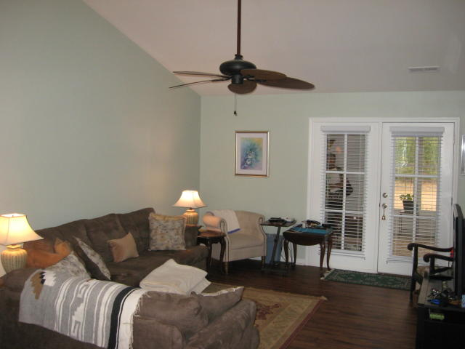
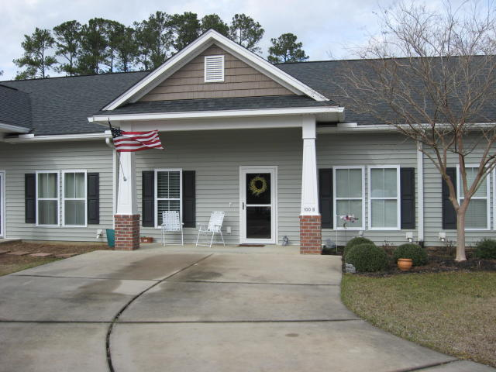
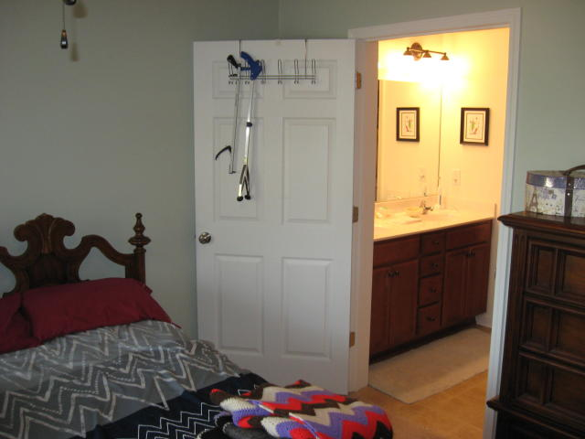
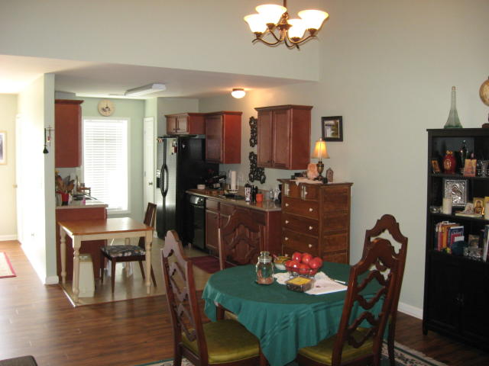
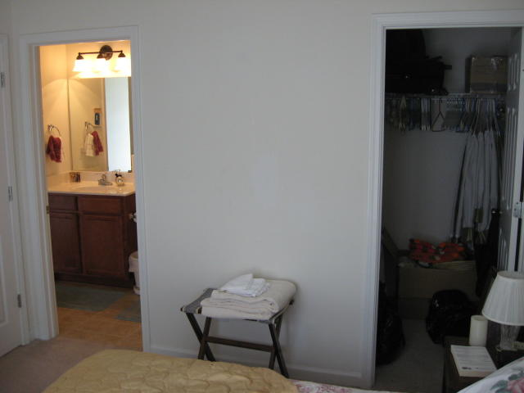
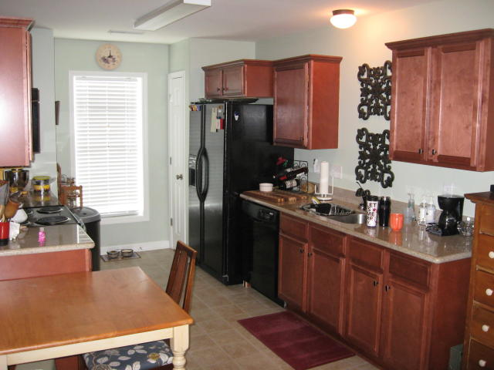
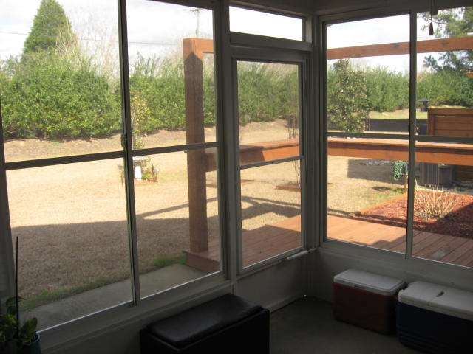
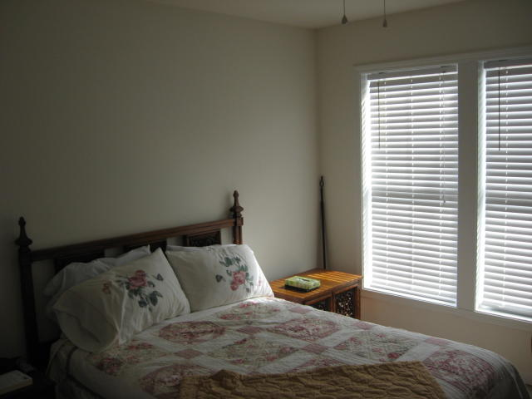
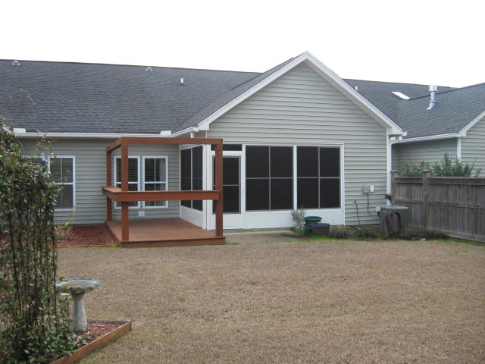


55+ Age Restricted Town Home
Buy.......Build.....Begin
100 Stagecoach Lane B
Carriage Hill | Summerville, SC 29483
MLS# 19004566 | $165,000
Carriage Hill Townhome is an upscale style townhome and age restricted to 55+ and perfect for empty nesters and downsizing. Totally ADA adaptable. Nice open floor plan and gleaming laminate floors, vaulted smooth ceilings. The spacious living area includes a beautiful kitchen with granite countertops. The master bedroom is large with dual vanity bathroom, shower unit and walk-in closet. The HOA fee includes lawn maintenance, garbage pickup. annual power washing of building exterior, and termite bond. Enclosed back porch can be used as a sun room. There is a nice deck to the side of the back porch.
Maria Latto
REALTOR, GRI
M (843) 327-1025 | O (843) 769-5100
maria@agentownedrealty.com | www.agentowned.com
The AgentOwned Realty Co. • 902 Savannah Hwy. • Charleston, SC 29407
Real Estate • Mortgage • Insurance

