Slide 1
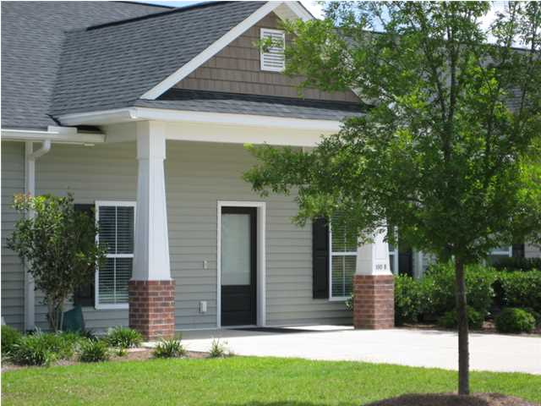
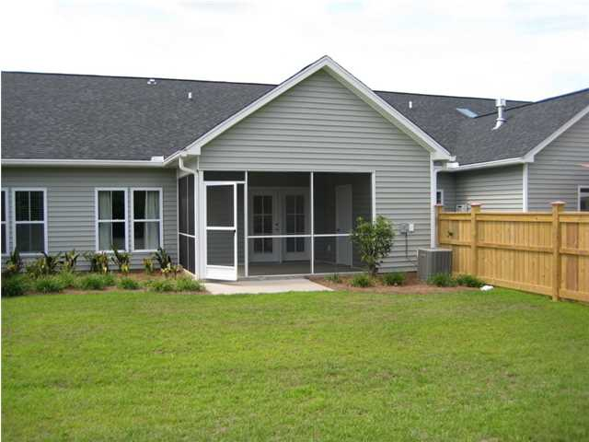
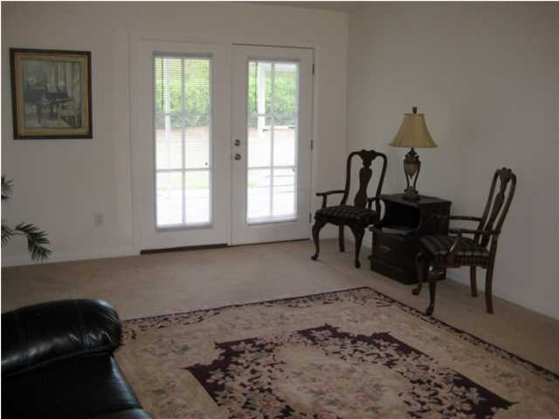
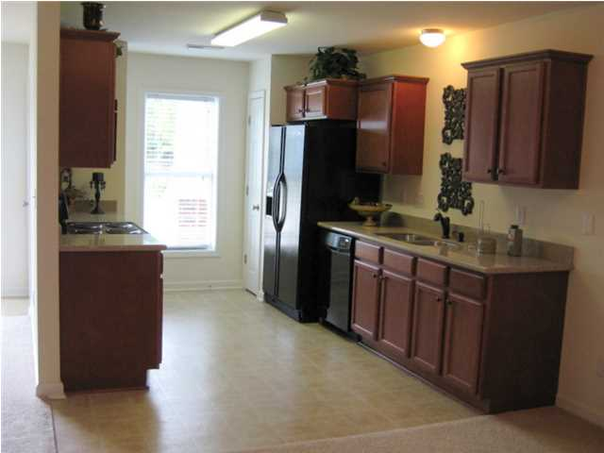
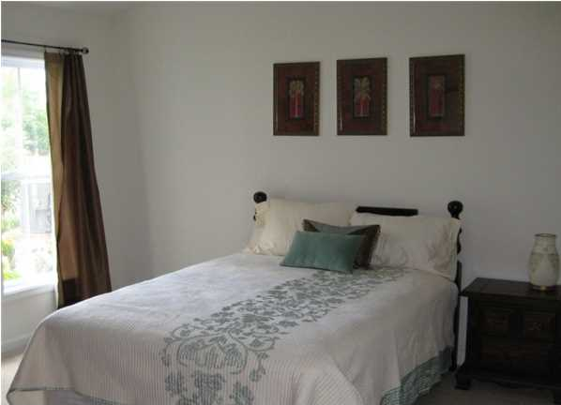
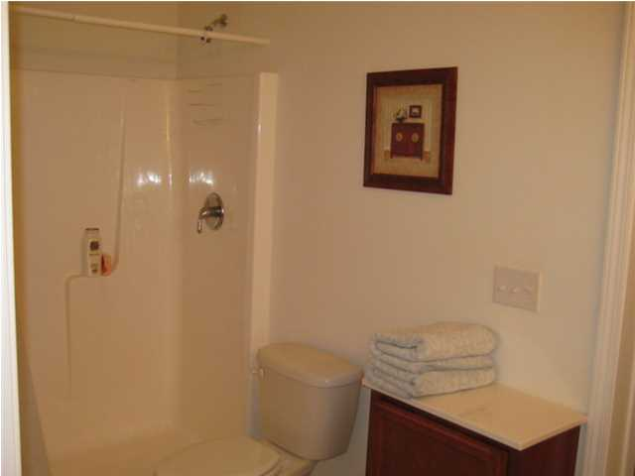

100B Stagecoach Ln Carriage Hill Summerville, SC MLS# 1414941 Just LISTED AT $129,000
Carriage Hill Town Homes is an age-restricted 50+ community, perfect for the busy working professional looking for a simpler home environment, or for empty nesters ready to downsize. The spacious living area includes a beautiful kitchen with granite countertops, dining area and living room with French doors leading to screened porch and private back yard. The master bedroom is large with dual vanity bathroom, shower unit, and walk in closet. The second bedroom also has entry to second bathroom. Parking area and driveway for two cars. Meticulously maintained and built for energy efficiency. 2x6 exterior walls and double insulation of shared walls providing additional sound barrier. The HOA fee includes irrigation and lawn maintenance, garbage pickup, annual power washing of building exterior, termite bond. This is a must see!
B C D Properties LLC
123 Piccadilly Loop
Summerville, SC 29483
Janis Flodin
843-729-0584 M
jflodin.bcd@gmail.com

