Slide 1
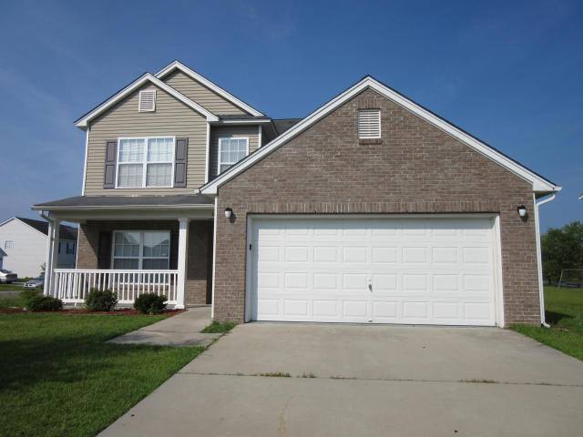
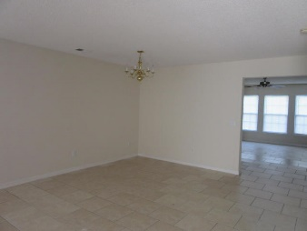
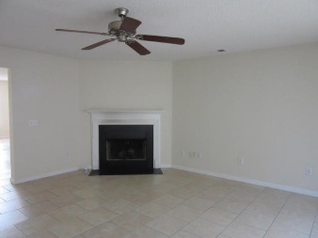
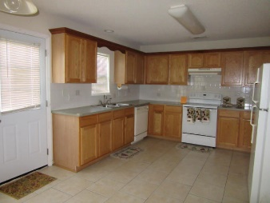
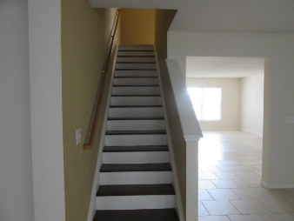
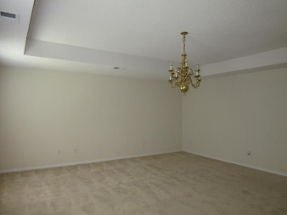
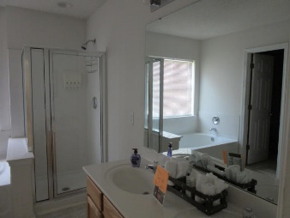
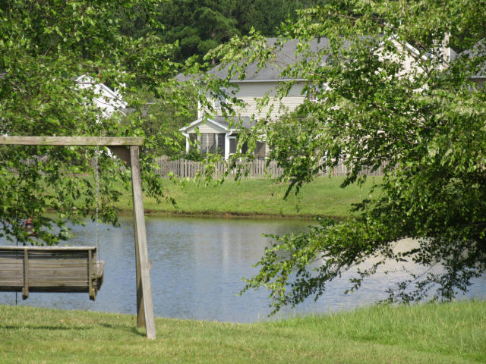


100 Buckfield Lane
Weatherstone
Summerville, SC 29483
MLS# 15017114
$215,000
5 Bedrooms | 2½ Baths | 2,730 sf
Beautiful large home on nice corner lot. This home goes on forever. Five (5) bedrooms and 2.5 baths give plenty of room. A spacious living/dining room will provide all the space you need for family or guests. The family has a lovely fireplace and plenty of space for reading, relaxing and TV. The eat-in kitchen has plenty of cabinets, an electric cook top stove and refrigerator. Guest bedroom downstairs is convenient and private with half bath close by. Upstairs find 4 more bedrooms and two full baths. The Master bedroom is huge and the master bath is well equipped with stand-up shower, tub and huge walk-in closet. The lot is nicely landscaped and the home has a nice front porch. A 2 car garage and the backyard view of the pond complete the home.
Move in ready!
Susan Hogan
(843) 810-0266
smhogan2@comcast.net
www.cbunited.com
Coldwell Banker United, Realtors | 205 St James Ave # 5 | Goose Creek, SC 29445

