Slide 1
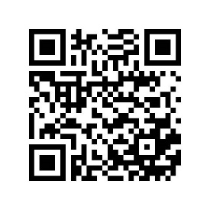
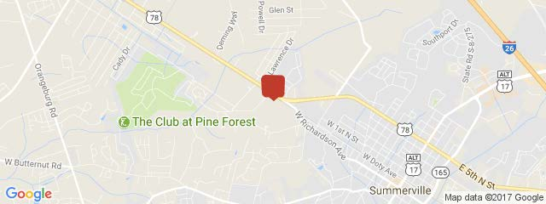
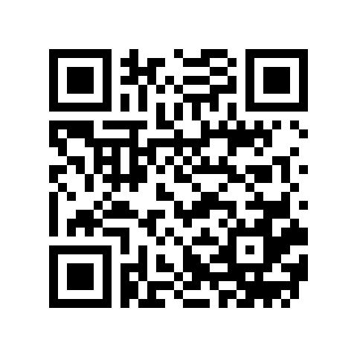
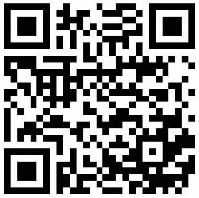
Summerville
Zoned Light Industrial
$100,000/acre
1-4.5 Acres Available ~ MLS #30174403
$40,000
Price Reduction!
100 Corporate Way ~ Summerville, SC 29483
This property to be subdivided from an existing parcel, 100 Corporate Way. Owner will subdivide into smaller parcels. Access from 2 different roads. 100 Corporate Way is Summit Rubber Company and its just over the railroad tracks after turning onto Industrial Rd. from Highway 78. Just past the intersection of West Richardson and Highway 78. Property is accessed from road closest to RR tracks.
Scan the QR code to see the listing sheet
Rick Willis
843-327-3017 Rick@RickWillis.com The Group, LLC

