Slide 1


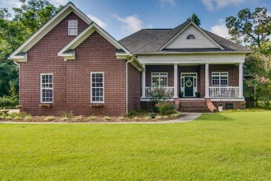
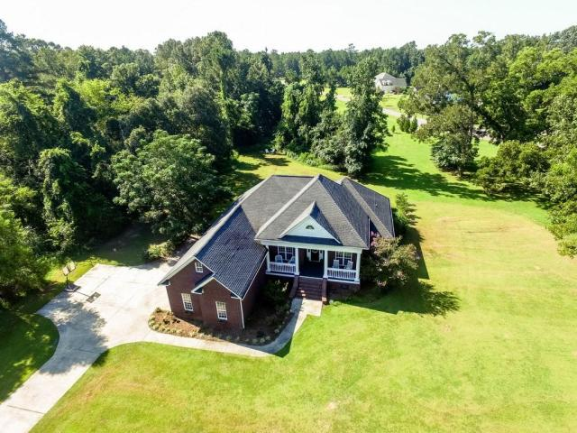
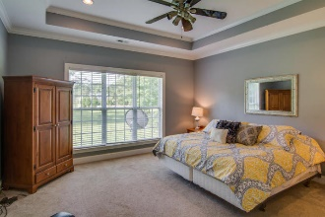
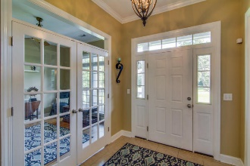
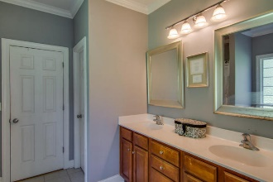
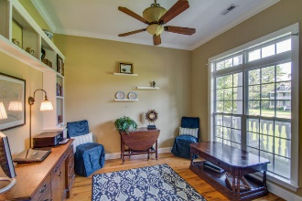
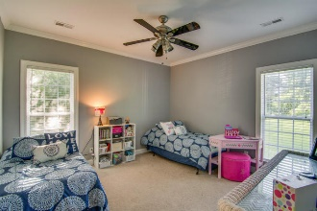
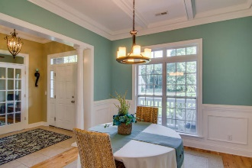
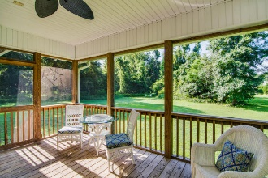
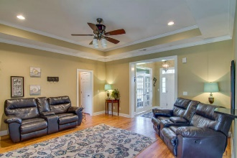
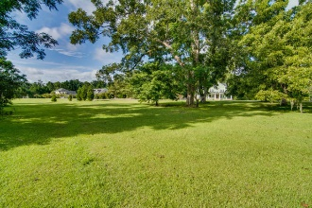
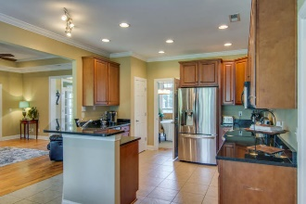
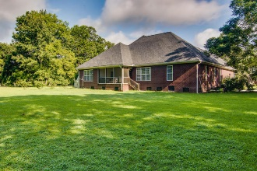

Agent Open House Thursday 11a-1p Almost 2 Acres! 2-Gift cards!
100 Dirocco Lane
Boyle Plantation ~ Summerville
MLS# 16021342 ~ $389,900
Just Reduced!
Tired of sitting on top of your neighbors? Need a little elbow room? Welcome to your new home! Almost 2 acres of usable land, with beautiful Live Oak trees, open areas to play, and lots of privacy. This gated community is an easy drive to conveniences, but far enough from the bumper to bumper in town. All brick ranch home with 3 nice size bedrooms and a bonus room being used as 4th bedroom. Master on right, others on left(all 3 bedrooms have new carpet). Enter the foyer to formal dining room on the left and the study on the right. Close the french doors for a quiet office space. Family room is open to the spacious kitchen with granite counters and stainless appliances. Lots of counter space for preparing for family meals or to entertain your friends living in cookie cutter neighborhoods and looking for trees. The screened in porch allows you to continue the entertaining area to the outdoors. Located in highly desirable Dorchester II schools, even better, its zoned for Palmettos Finest Beech Hill elementary and Ashley Ridge High School! Call today to view this beautiful home, You will feel your body start to relax as soon as you drive into the neighborhood.
Laurie A Loparo, ABR laurieloparo@gmail.com
lauriesellscharleston.com
Golden Bear Realty | 654 Coleman Blvd, Suite 100 | Mt Pleasant , SC 29464
Cell (843) 442-1290 | Office (855) 352-9088 | Fax (561) 721-3311

