Slide 1
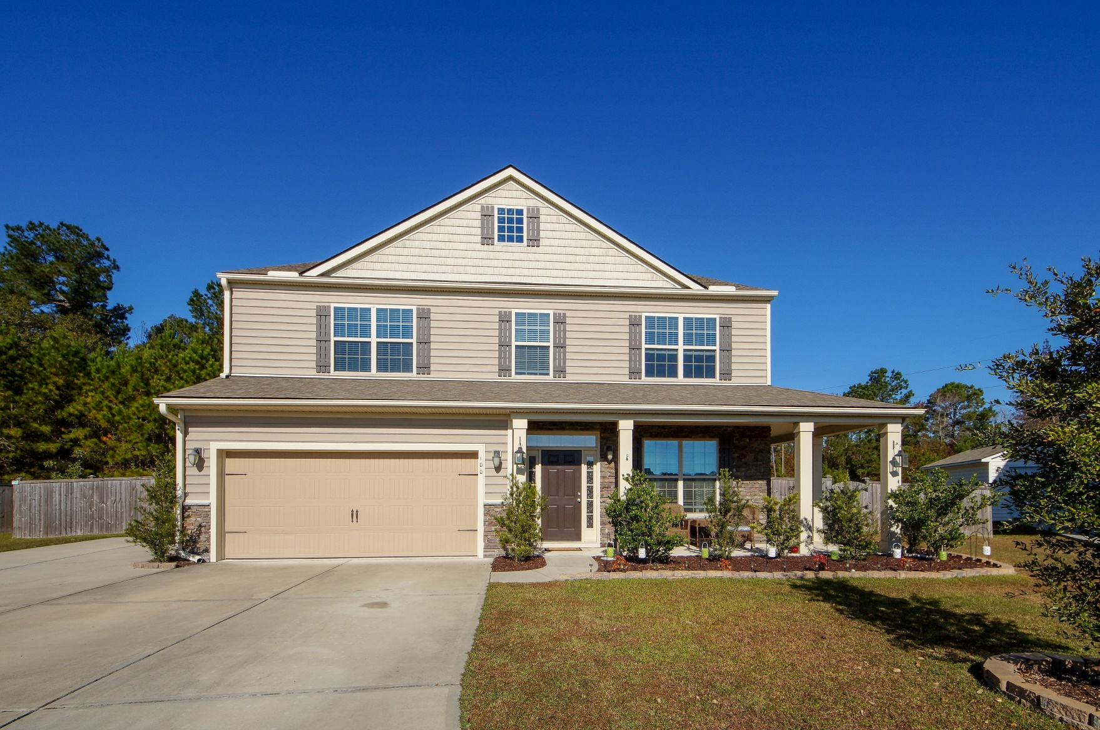
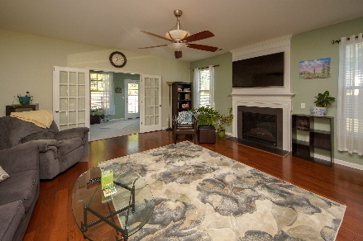
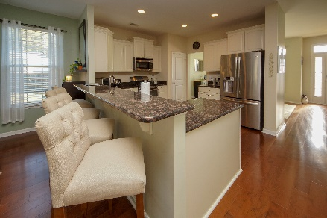
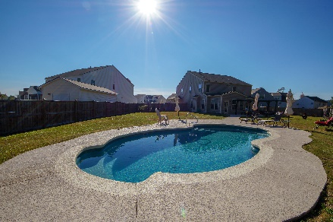


100 Endicott Court Summerville, SC 29486 MLS# 18031841 :: $439,900 5 Bed / 3½ Bath
Just Listed in Carriage Lane Summerville
Just Reduced!
Stunning 5 bedroom 3.5 bath home with Upgrades Galore!!!! Seller choose all the luxuries a new buyer could desire to include wood flooring, gas fire place, recessed lighting, granite counter tops, white staggered kitchen cabinets & stainless appliances. Master bedroom is down stairs with custom closet system. Master bath boasts separate vanities with garden tub and shower. Upstairs are four spacious bedrooms, over sized loft with a second master suite! We don't stop there! Sunroom over looks extended patios, double pergolas and a crystal clear fiber glass salt water in ground swimming pool. Private, over sized yard makes this home an owners paradise!!!! The seller is willing to leave the 60'' flat screen TV over fireplace & patio furniture.
Connie White, Broker
843-532-3356
connie@chrepros.com · conniewhiterealestate.com
Charleston Homes · 597 Old Mt. Holly Road · Suite 301 · Goose Creek, SC 29445

