Slide 1
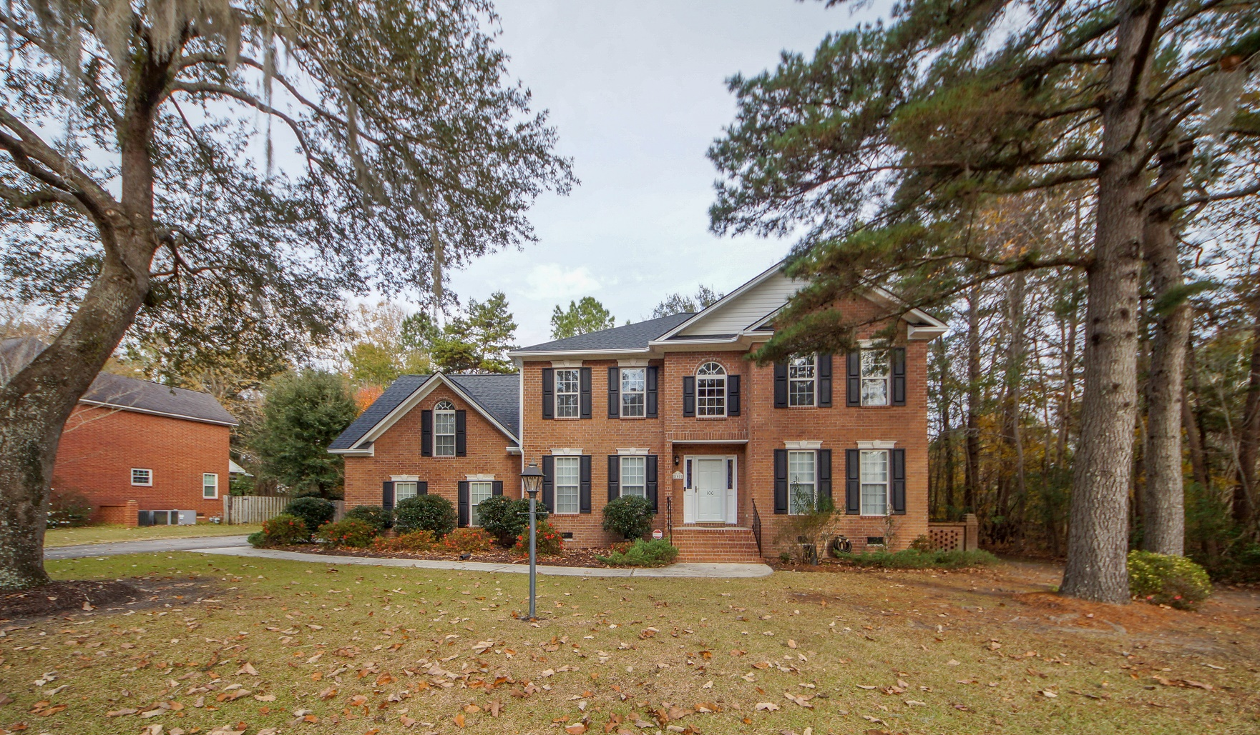
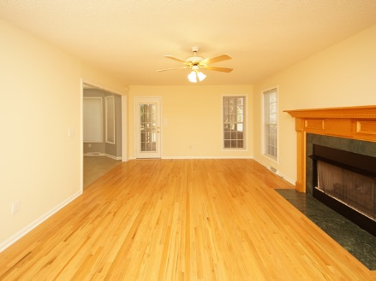
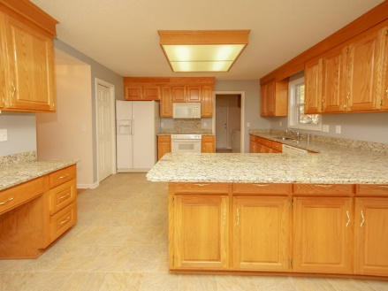
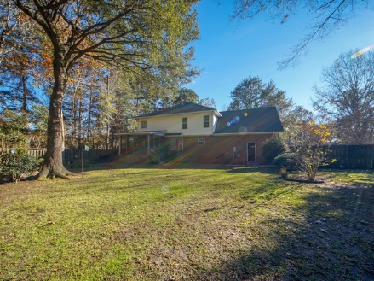


100 Iken Circle Crowfield Plantation :: Goose Creek, SC 29445 MLS# 18033103 :: $398,000 4 Bed / 2½ Bath
Stately 1-Owner Home In The Hamlets!
2.67 Acres!
This stunning brick home is very well maintained. Formal living, formal dining, family room with gas fire place, eat in kitchen with plenty of granite counter and cabinet space. Master suite is spacious and master bath has dual vanities, granite counters, generous walk in closet, and soaking tub with a new extended shower. Fourth bedroom over garage makes a perfect extending living area, play room or private bedroom. Screened porch over looks a private back yard with a double gate on one side and single gate on the opposite side. New Roof, New leaf guard gutter system, New vapor barrier with Newer heating and air make this rare one owner home a new buyers dream!!!
Connie White, Broker
843-532-3356
connie@chrepros.com · conniewhiterealestate.com
Charleston Homes · 597 Old Mt. Holly Road · Suite 301 · Goose Creek, SC 29445

