Slide 1

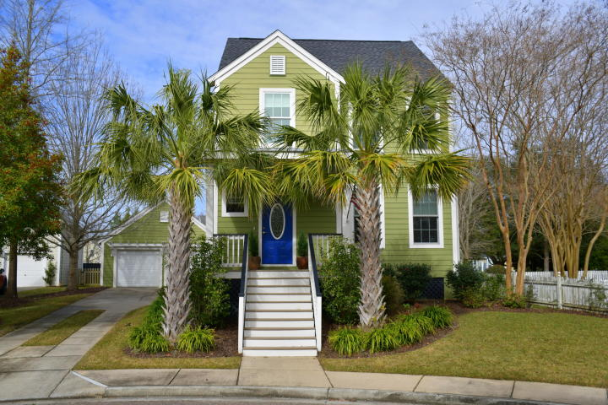
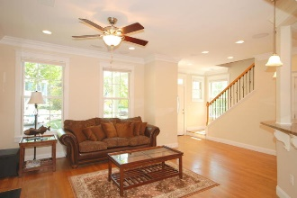
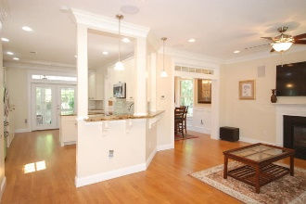
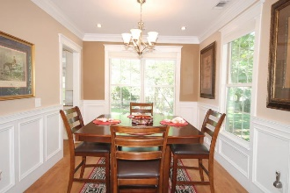
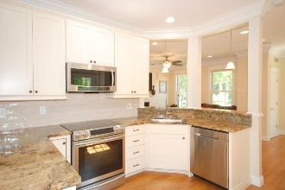
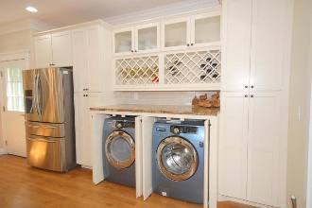

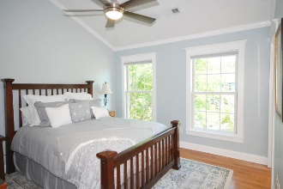
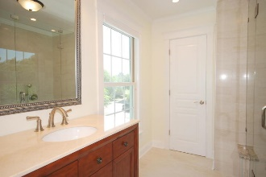
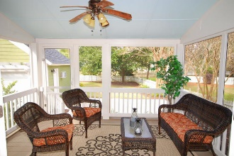
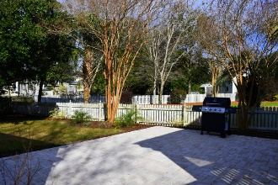
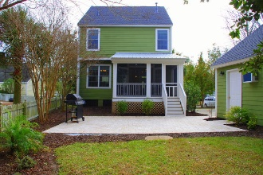
Debbie Cromer
ABR, RSPS, REALTOR, CRS
(843) 437-6342
debbie@debbiecromer.com
www.mylowcountryhomes.com
Over $100,000
In Renovations!
100 Jordan Court
Daniel Island | Charleston, SC 29492 | MLS# 19021302 | $539,000
If you are looking for a true renovation with no flood insurance required, this is it. All of the big ticket items have been taken care of as well as the cosmetic. New roof, new AC unit, new tankless water heater, new custom wood windows, new screen porch, new garage doors and new stone paver patio. The interior upgrades are second to none featuring site finished hardwood floors throughout, completely remodeled kitchen featuring new kitchen cabinets, granite countertops and high end kitchen appliances, stunningly renovated master bath and fully renovated guest bath, extensive interior recessed lighting and custom trim throughout, not to mention the 7.2 surround sound system, all on a beautiful lot with mature landscaping, irrigation and landscape lighting.
Century 21 Properties Plus | 1090 Park West Blvd; Ste 3 | Mount Pleasant, SC 29466

