Slide 1

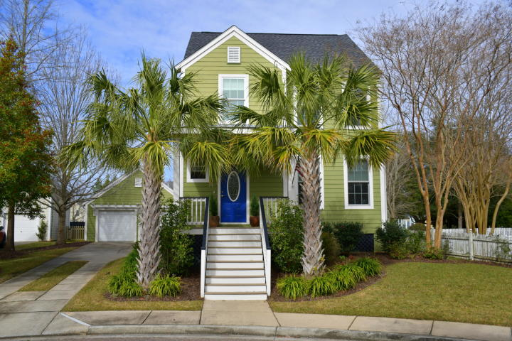
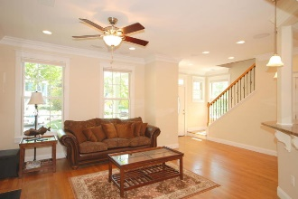
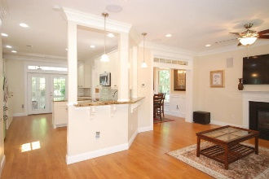
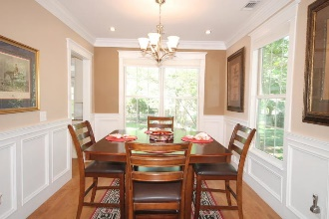
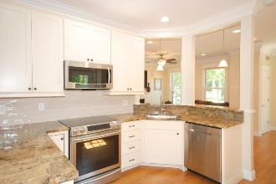
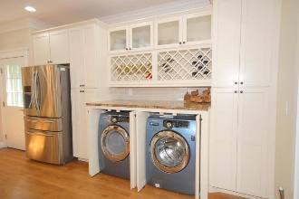

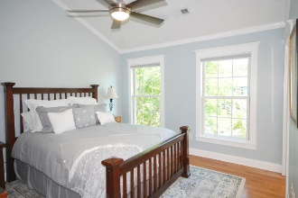
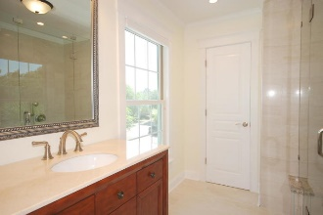
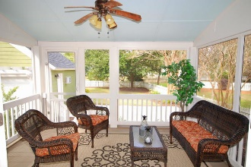
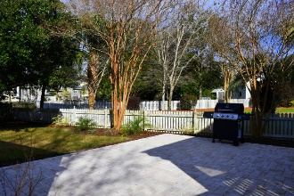
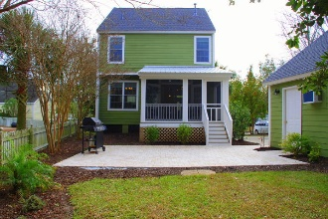
Debbie Cromer
ABR, RSPS, REALTOR, CRS
(843) 437-6342
debbie@debbiecromer.com
www.mylowcountryhomes.com
Over $100,000
In Renovations!
100 Jordan Court
Daniel Island | Charleston, SC 29492 | MLS# 19021302 | $535,000
NOT a partial renovation. This is a COMPLETE RENOVATION from roof to back yard.
If quality over quantity is your goal, this is the perfect house for you! Over $100,000 in renovations! New roof, new AC unit, new tankless water heater, new custom wood windows, new screen porch, new garage doors and new stone paver patio. Floors throughout are site finished oak (no carpet in sight). New cabinetry, granite countertops and steel appliances in the kitchen. Master bath stunningly renovated. Wait until you see the shower! Hall bath features new fixtures and vanity as well as tub with tile surround. Custom wood work throughout! Mature landscaping with irrigation and landscape lighting! Owner states that the garage can be extended 12 ft and a second story put on. No flood insurance required.
Century 21 Properties Plus | 1090 Park West Blvd; Ste 3 | Mount Pleasant, SC 29466

