Slide 1
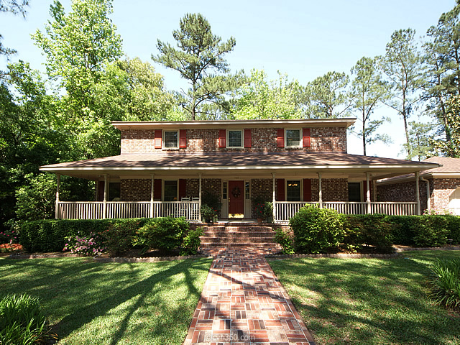
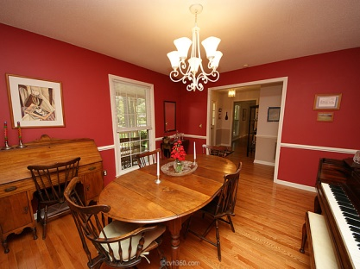
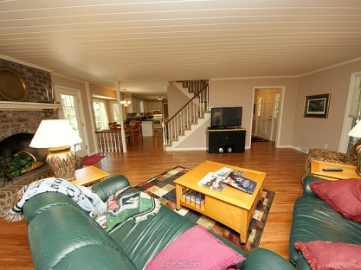
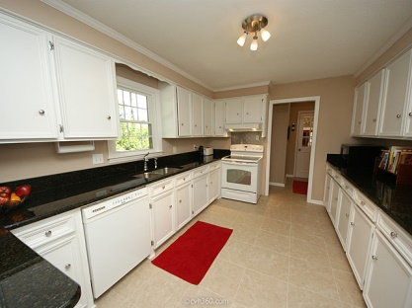
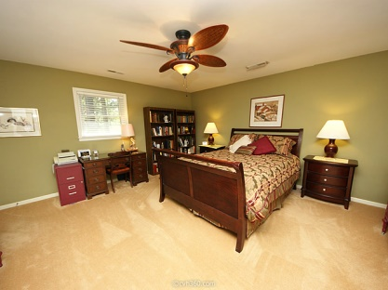
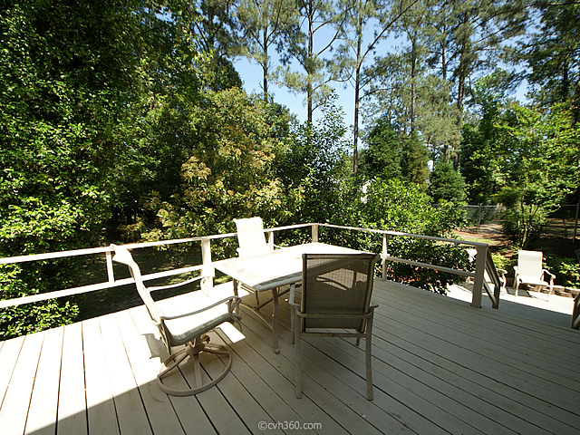
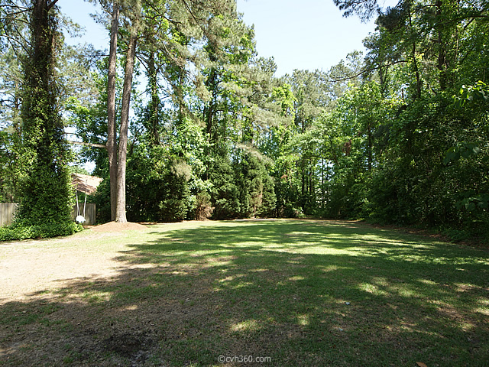

100 King Charles Ct Newington Plantation Summerville, SC 29485 MLS# 15011283 $249,900 2,385 Sq Ft - 3 Bedroom - 2½ Bath
Accepting Back-up Offers
Immaculate all brick 3 bedroom / 2.5 bath home on large lot in Newington Plantation. Home is located on a very quite cul-de-sac (with only one other home). This stately low country style home has a full front porch overlooking a large front treed yard and sits on a half acre bordering a vacant lot. The large back deck overlooks a spacious landscaped & fenced yard. Hardwood floors in the entrance foyer, great room and formal dinning room. A fireplace, skylights and unique architectural designed wood slat ceiling highlights the great room which is open to eat-in kitchen with a dinning area overlooking the two level deck and back yard. The updated kitchen with granite counter tops has a custom tile floor that continues into the spacious laundry / mud room. All kitchen appliances convey.
The laundry/ mud room opens to a covered breezeway to the 2 car garage. A half bath is also conveniently located on the first floor. Upstairs has 3 nice size bedrooms and 2 baths. The master bedroom has its own bath and a nice size walk in closet and a built in vanity. This home is in outstanding condition with many upgrades and maintenance improvements. The following is just a partial list:
All windows were replace in 2009 with vinyl energy efficient windows.
Hardwood floors refinished in 2015
30 year architectural shingles were installed in 2009
Dual electric heat pumps for each floor
Second floor ceilings were refinished to smooth
Bill Milo
Mobile: 843-412-0052
Bill@southernshoresre.com
Southern Shores Real Estate
1050 St. Andrews Blvd
Charleston, SC 29407

