Slide 1

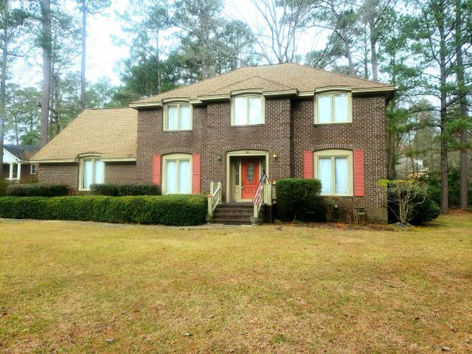


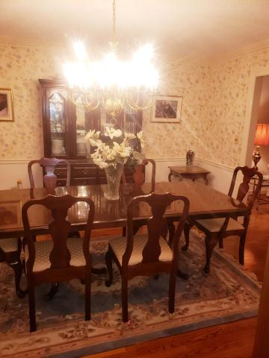
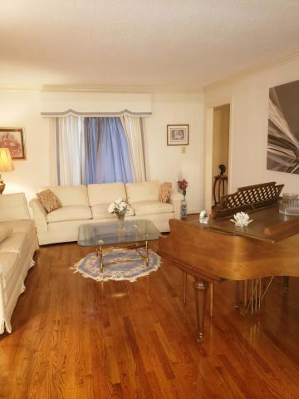
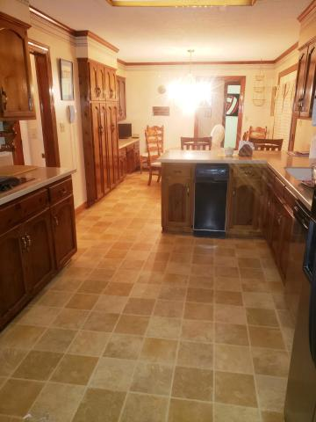
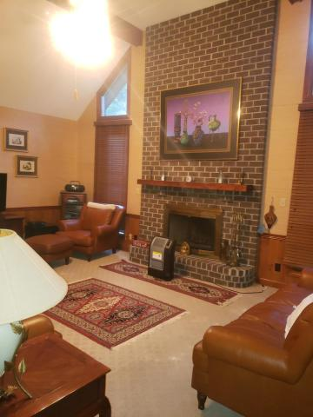
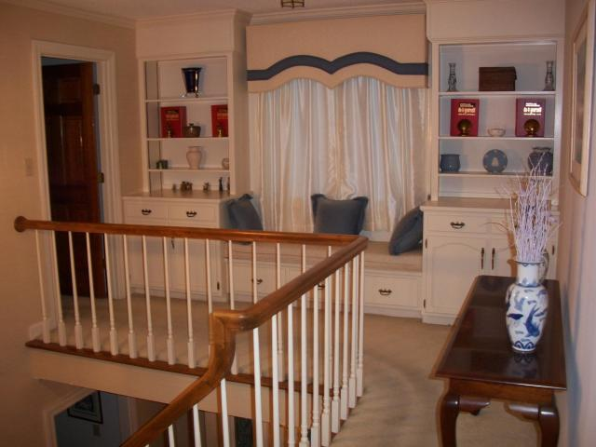

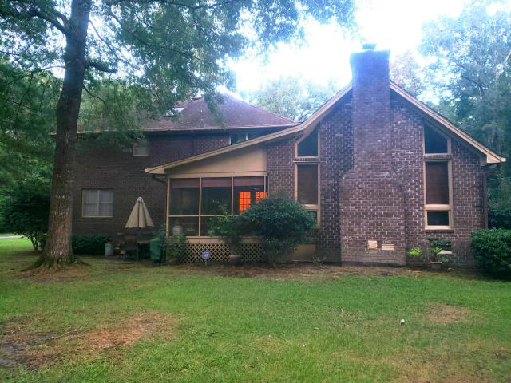

Beautiful Home With Reduced Price
DRAFT
100 Lucretia Lane
Tea Farm
Summerville, SC 29483
MLS# 19024267
$405,000
Price has been reduced and the seller is motivated! Home is priced to sell quickly. Nestled on a large corner lot in a nice private and quaint neighborhood, this custom built home is a gem. The home boasts beautiful hardwood flooring as you enter the home with beautiful molding throughout. There is one bedroom that is downstairs with a full bathroom. The rear screened porch gives you privacy and a beautiful view of the 3rd tee of the Miler Country Club. The yard has many ornamental shrubs with azaleas situated around the property. The FROG bonus room can be used as a 5th bedroom, play room, office, or etc. This home also has a grand family room with high ceilings and fireplace. The home is being sold "as-is".
Access Realty LLC
1678 Old Military Rd
Charleston, SC 29412
Robert Brown
Office - (843) 745-4200
Mobile - (843) 870-0128
robertbrownaccessrealtyllc@mail.com

