Slide 1
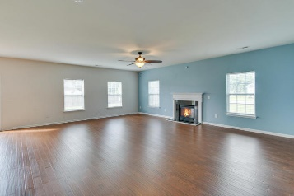
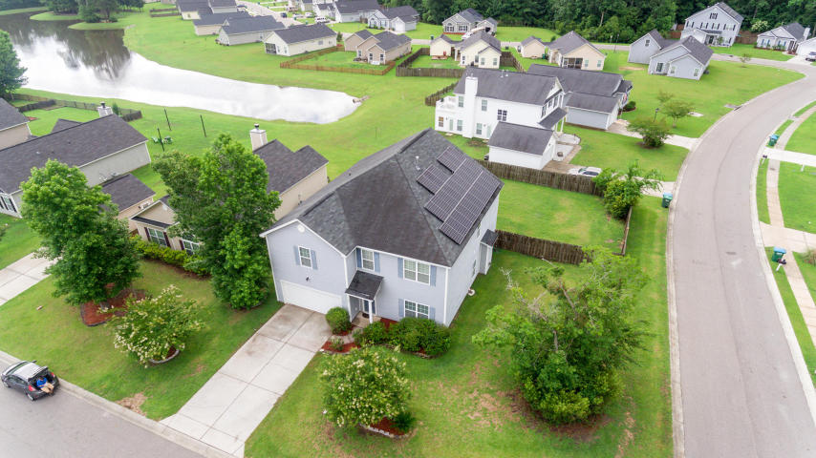
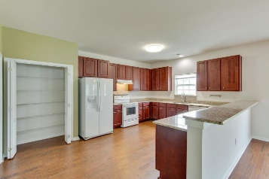
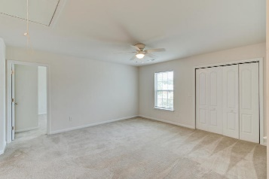
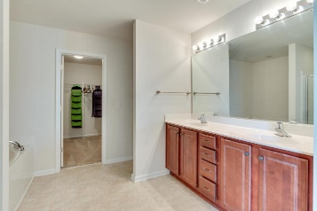
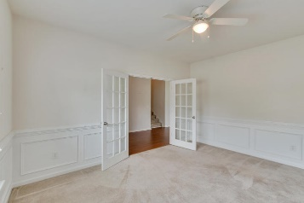
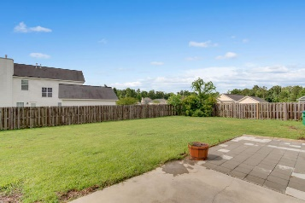
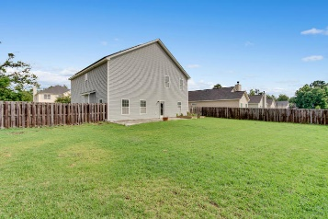
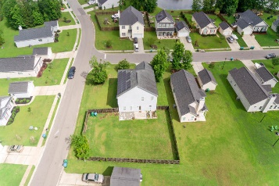


100 Pacolet Street Lakes of Summerville ~ Summerville, SC 29485 MLS# 18014991 ~ $280,000
Open House Lunch ~ Friday, Oct 3 from 11 - 1
Handyman Special… Bring your hard hats!
Priced to Sell!
Unique opportunity to own a 3100+ home with power bills under $50/month the last 2 months. Home has solar panels that will be paid off at closing.
This large open floor home is a one owner home with no pets having been inside. The home sits on a large corner lot. Bamboo flooring on the 1st level and carpet upstairs in the bedrooms.
This home has 4 bedrooms but could easily be converted to 5 bedrooms. There is also a private office on the 1st floor. There is also a gas fireplace in the family room for those cool winter nights.
Come see this home NOW, sellers are motivated and home is priced to sell. Copies of the recent power bills are attached in the documents section.
Ernest Govan
(702) 350-3522 egovan@rogcoastal.com | www.ernestsellscharleston.com
Realty ONE Group Coastal | 1510 Trolley Rd | Summerville, SC 29485

