Slide 1
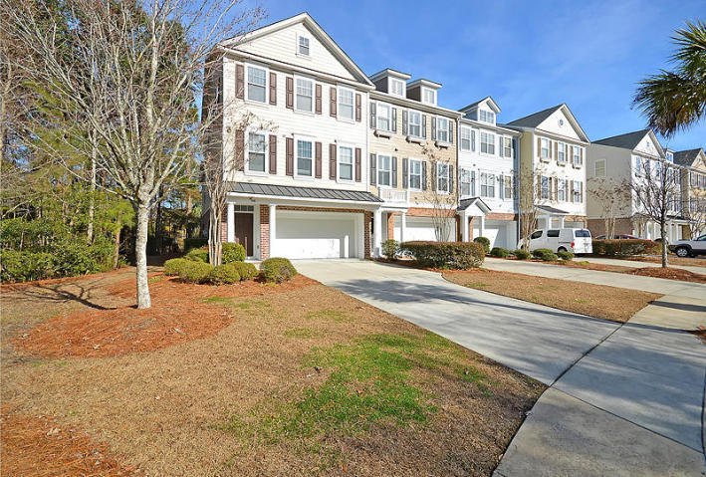
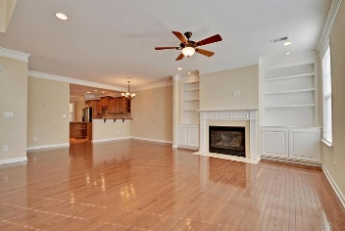
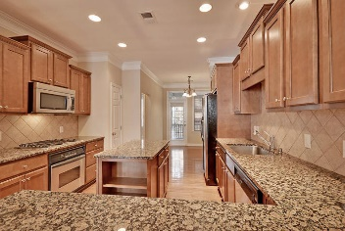
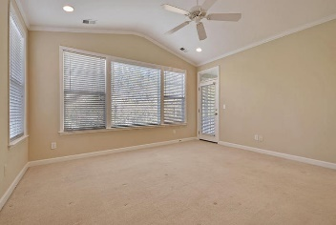
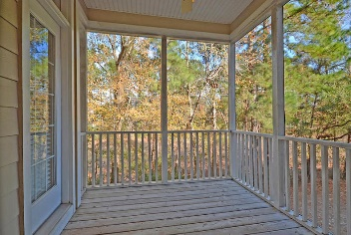
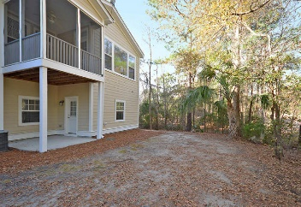


READY TO MOVE-IN!
100 Palm Cove Way
Dunes West
Mt Pleasant, SC 29466
MLS# 18001321
$359,500
This beautiful end unit is a premium location. Relax on your private screened porch while listening to the peaceful sounds of the water fountain trickling into the pond, Tranquil views. Master suite is on the main floor with private screened porch. Large master bath,custom tile, jacuzzi tub, double vanity,walkin closet. Kitchen opens to a family room, granite counters, tile backsplash, stainless steel appliances, gas cooktop, recessed lighting. Breakfast nook with built-in shelves. Family room boasts Gas fireplace surrounded by custom built-ins.Top floor has two nice size bedrooms and open area. The downstairs area that is unfinished could be used as storage or finished off to be used as an office, playroom, mother-in-law suite or any other room that may fit your needs.
Dunes West is one of the most sought after communities in the Charleston area. Conveniently located near fine shopping, beaches, Historic Downtown Charleston. Age, sqft, acreage, taxes, schools, hoa & regime fees are approx. buyer to verify any and all information deemed necessary.
Vel Thurber Everett
Broker/Owner
Mobile - (843) 297-0459
Office - (843) 576-2713
vel@velhomes.com
Mason Thurber
Realtor
Mobile - (843) 709-5109
Office - (843) 576-2699
mason@theeverettgroup.net
RE/MAX Pro Realty, 9209 University Blvd, Charleston, SC 29406

