Slide 1
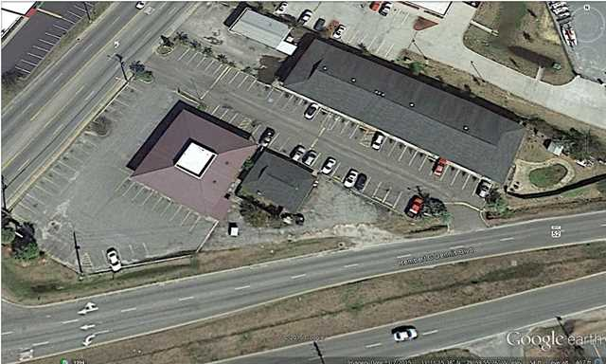
100 S Highway 52
Moncks Corner ~ MLS# 1500207 ~ Lease Rate $14.00 NNN
Close in Deep Water Lot
DRAFT
$5,000 toward buyer's closing cost.
$5000 agent bonus w/ BIC approval.
Free standing brick veneer building on a corner lot with high visibility...
Once a restaurant, now an office building... also a great retail location.
Over 40 parking spaces.
Upgraded a few years ago including cat. 5 wiring throughout. Existing lease until 10/31/16 but tenant can be out in 30 days.
APPOINTMENT ONLY!!! CALL
Doug Wells
Mobile - (843) 452-5553
dwells.cds@gmail.com
Harbourtowne Real Estate | 672 Marina Drive, Ste 110 | Daniel Island, SC 29492

