Slide 1
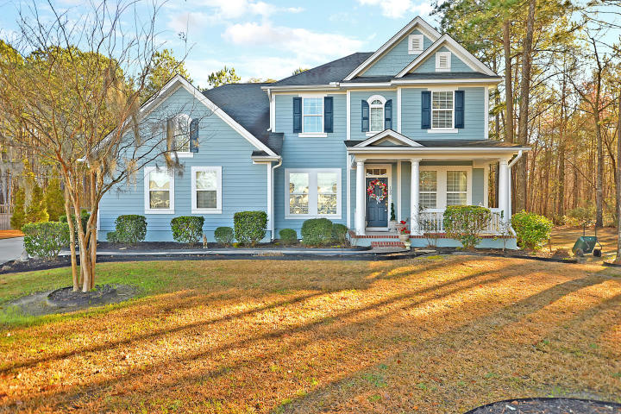
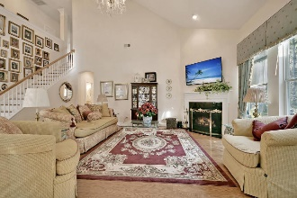
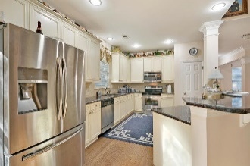
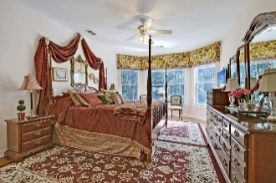
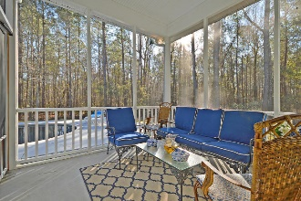
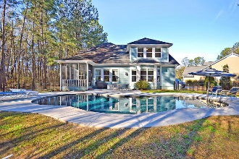


THE ORIGINAL IS IRREPLACEABLE!
$15,000 Agent Bonus
with ratified contract by 4/15/18
100 Saluda Drive
Foxbank Plantation
Moncks Corner, SC 29461
MLS# 19004800
$399,950
$12,100 Under
Recent Appraised Value
This Amazing fully detached traditional 2 story home is situated on a quiet tree-lined street and is surrounded by a large .4 acre landscaped yard. This Sensational home with selected wood flooring, upscale lighting fixtures and ceiling fans and 9 + ft. smooth ceilings offers 4 large bedrooms upstairs and the spacious downstairs master bedroom suite with selected wood flooring, smooth 9+ FT. ceilings, large bay window that provides private views of the landscaped back yard and the professionally installed salt water, heated gunite/concrete in-ground pool. The master bedroom suite also offers a Hollywood Style master bathroom with ceramic flooring, a huge separate walk-in shower and a relaxing soaking tub. There are several large rooms on the main floor including an Elegant Formal Dining Room with beautiful wood flooring, the formal living room with classic wood flooring is perfect for a formal entertaining or can be used for a private office, the Stunning Family room with genuine wood floors, a cozy fireplace, remarkable vaulted smooth ceilings and multiple windows that fill the room with natural light and offer gorgeous views of the in-ground pool and private back yard, the modern kitchen with quality wood flooring, is a chef's delight and offers an abundance of 42 inch Crafted cabinets, Distinctive Granite counter tops, stainless built-in appliances, pantry for storage and the important breakfast room is perfectly located adjacent to the kitchen, is perfect for breakfast, lunch or just enjoying a morning coffee. There is a private walk-out to the Valuable Screened-in Porch and continue to the back yard Oasis including the private over-sized patio, the in-ground pool, pool decking and the remaining yard provides room for cook-outs and playing catch with the kids. The Offering of this Magnificent home is a Rare Opportunity! Are you Smart Enough to Recognize this Value and Opportunity? A pre-listing appraisal value of $402,000.00 and pre-listing home inspection are available upon request.
Bring your Check Book! Age, sqft, taxes, acreage, HOA dues, flood zone and schools are approximate, buyer to verify any and all information deemed necessary.
William R Everett, Jr
(843) 693-8539– C
(843) 576-2701 – O
bill@theeverettgroup.net
RE/MAX Pro Realty, 9209 University Blvd, Charleston, SC 29406

