Slide 1
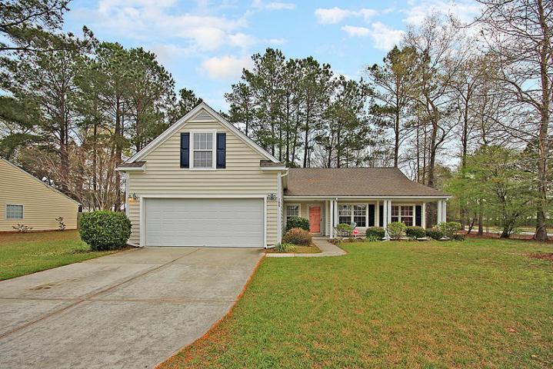
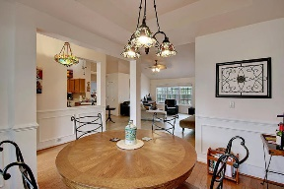
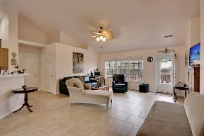
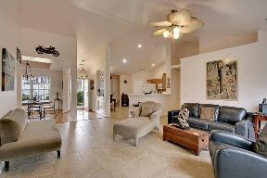
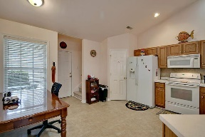
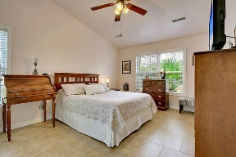
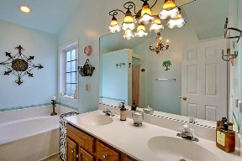
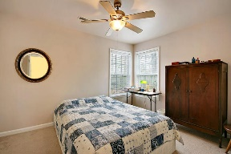
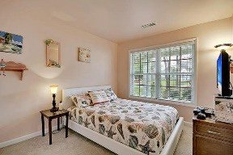
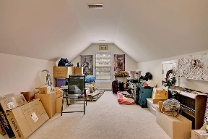
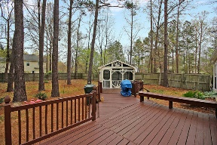
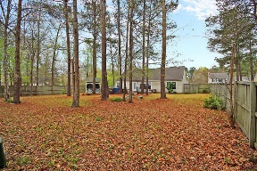
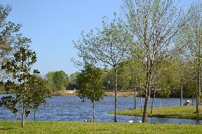


One Story Living At Its Best!
100 Thousand Oaks Circle
Crowfield Plantation
Goose Creek, SC 29445
MLS# 17007119
$223,000
3 Bedrooms | 2 Baths | 1,835 sf
One story living at its best! Get ready to be impressed as soon as you pull up to this home! Welcoming front porch and large corner lot! Walk on in and immediately notice the gorgeous wood and tiled floors. Tons of natural light and a great view of the large backyard from the beautiful living room windows. The open floor plan is ideal with the master bedroom on one side of the home and two bedrooms sharing a hall bath on the opposite side of the home. The dining room and kitchen are open to the family room, great for entertaining! The kitchen has tons of cabinet space and overlooks the family room. The family room is a great size and offers access to the great outdoor living area! Huge deck with built in seating, screened in gazebo, plus a huge fenced in backyard!
The master bedroom is very large and has a great master bath with separate shower and garden tub, dual vanities and a large walk in closet. Upstairs, enjoy your bonus room! This room offers tons of storage off of it and can be used as a media room, toy room or another bedroom if needed! This home is conveniently located in the gorgeous golf course community of Crowfield Plantation which offers golf, tennis, walking trails and neighborhood pools! Just minutes from I26, this home is perfect for a commuter! Come see this home today!
Larry & Kathy Mazalatis
Larry Cell 843-693-0529
Kathy Cell 843-693-0159
Office 843-871-9133
AGENTOWNED PREMIERE GROUP | 1800 TROLLEY RD | SUMMERVILLE, SC 29485

