Slide 1
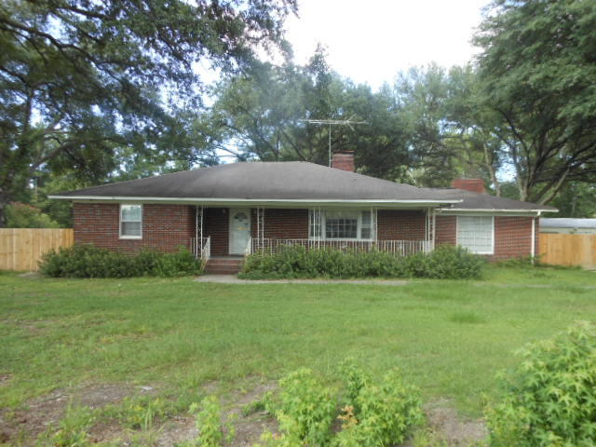
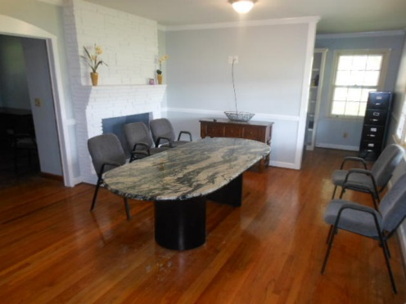
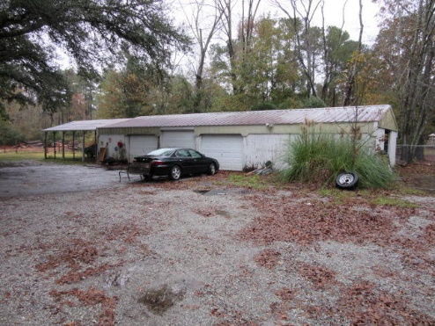
Unique Opportunity
Property Can Be Used For A
Residence, Office, Or Other Business
$40,000
Price Reduction!
Summerville 2.36 Acres Total
Owner Willing To Subdivide
100 W Butternut Road ~ MLS# 18031509 ~ $339,000 (0.83 Acres)
100 W Butternut Road A ~ MLS# 18032434 ~ $299,000 (0.65 Acres)
100 W Butternut Road B ~ MLS# 18032637 ~ $489,000 (2.36 Acres)
Unique opportunity...property can be used for a residence, office, or other business. Property has .85 Acres, with additional 1.51 Acres available for a total of 2.36 Acres, with a 6-8 foot privacy fence in the rear yard. The rear yard also has a 6-8 car garage/warehouse (1,500 sq.ft.) that was used in the past as storage for a home repair contractor. This is and ideal property for someone who wants/needs a home/office or for someone that has lots of ''stuff'' who needs lots of storage. The property has several large oak trees and parking for a dozen cars/trucks. There are no covenants/restriction or HOA fees! Inside there is a huge family room with a huge wall fireplace plus another living room with a fireplace. The property in in the process of being updated/upgraded with a new roof, new wood replacement around roof and replacement of wood rot on the house and garage.
Rick Willis
843-327-3017 Rick@RickWillis.com The Group, LLC

