Slide 1
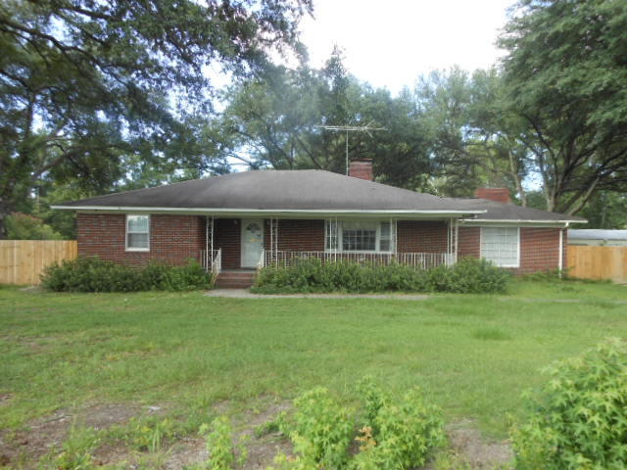
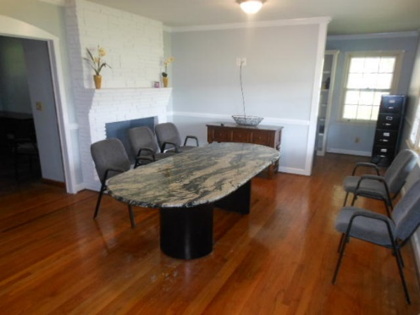
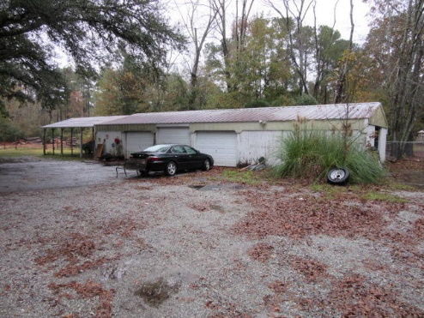
Unique Opportunity
Property Can Be Used For A
Residence, Office, Or Other Business
$40,000
Price Reduction!
100 W Butternut Road
MLS# 20004023 ~ $379,000
0.85 Acres
100 W Butternut Road ~ MLS# 20004023 ~ $379,000 (0.85Acres)
Unique opportunity...property can be used for a residence, office, or other business. Property has .85 Acres, with a 6-8 foot privacy fence in the rear yard. The rear yard also has a 6-8 car garage/warehouse (2,000 sq.ft.) that was used in the past as storage for a home repair contractor. This is an ideal property for someone who wants/needs a home/office or for someone that has lots of "stuff" who needs lots of storage. The property has several large oak trees and parking for a dozen cars/trucks. There are no covenants/restriction or HOA fees! Inside there is a huge family room with a huge wall fireplace plus another living room with a fireplace. The property has had lots of upgrades/updates to include the existing full bath, new full bath addition, new roof and HVAC unit. The property is zoned CN which permits a variety of Business, Retail, Office and Professional Services and property can have additional buildings placed onto it including subdividing into lots as small as 5,000 sq.ft. (for non-residential uses).
Rick Willis
843-327-3017 Rick@RickWillis.com The Group, LLC

