Slide 1
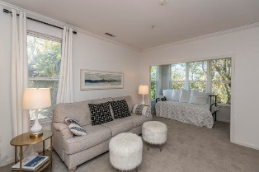
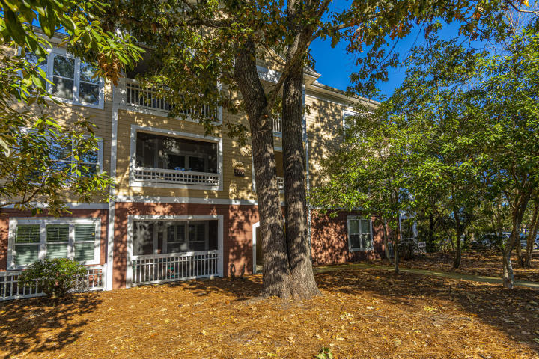
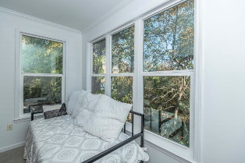
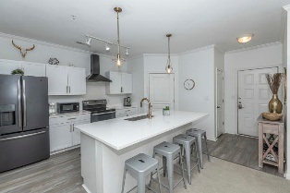
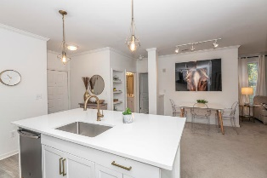
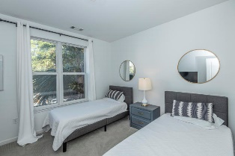
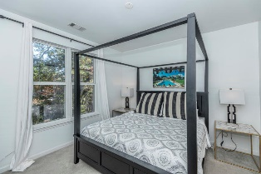
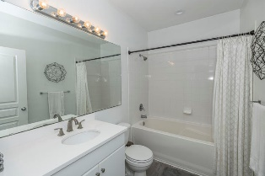
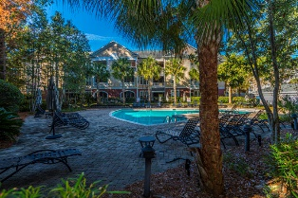
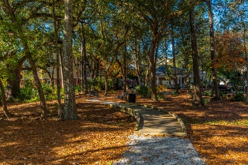


100 Bucksley Lane #206 254 Seven Farms Drive ~ Charleston, SC 29492 MLS# 19033139 ~ $225,000
Seller Says Sell!
Fully renovated second floor condo with a private, wooded view, in the desirable location of 254 Seven Farms Drive on Daniel Island! Don't miss out on the 2 bedroom, 2 bathroom condo that now has a beautiful, modern feel! This great floor plan features an open living/dining area along with the stunning new kitchen with ample barstool seating. The condo also features the master bedroom with ensuite bath, a larger secondary bedroom and full hall bath, and extra bonus area perfect for an office, kid's play space, or daybed for guests.
A $1000 lender credit is available and will be applied towards the buyer's closing costs if the buyer chooses the seller's preferred lender. This credit is in addition to any other negotiated seller concessions.
Kristin Schatmeyer
Cell - (843) 697-7370
kristin.schatmeyer@carolinaone.com
www.KristinSchatmeyer.com
Carolina One Real Estate
2713 Highway 17 North
Mt. Pleasant, SC 29466

