Slide 1
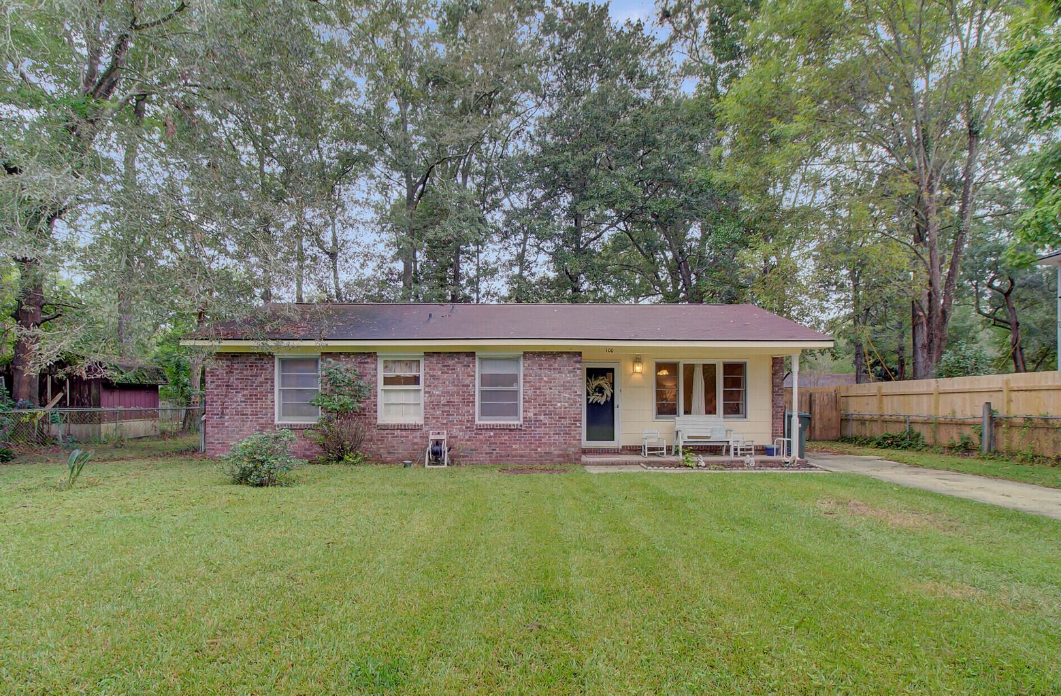
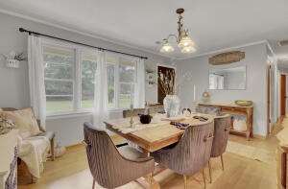
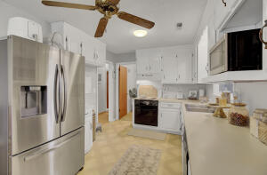
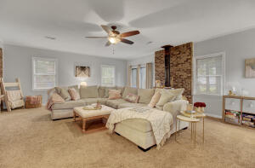
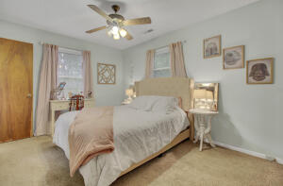
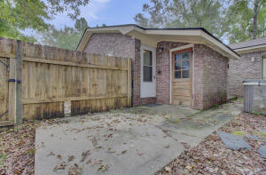
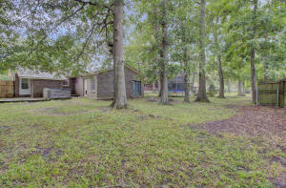


BEAUTIFUL BRICK RANCH
100 Dodd Lane
West Greenview Acres
Goose Creek, SC 29445
MLS# 21027405
$230,000
CHARLESTON SINGLE STYLE HOME
4 BEDS/2.5 BATHS/LOFT
MASTER BEDROOM DOWN
YARD W/PRIVACY FENCE
HARDIPLANK SIDING
HOME ONLY 2 YEARS OLD
QUARTZ COUNTERTOPS
STAINLESS APPLIANCES
REFRIGERATOR INCLUDED
COVERED PORCH
PERFECT JOHNS ISLAND LOCATION
1 MILE FROM SEVERAL RESTAURANTS/SHOPS
BLINDS AND WASHER/DRYER INCLUDED
LESS THAN 10 MILES TO DOWNTOWN CHARLESTON
12 MILES TO KIAWAH OR FOLLY BEACH
Located on a nice private lot with a long private unpaved driveway, lots of parking!
This is a perfect first-time home or investor property! Owners are waiting on their new home to be built and want to rent back after closing until Feb 2022. Last owners put in a 22.5x19.5 Great room with a wood burning stove to keep cozy in the winter! Wonderful space! Fiberoptic is run to the home and there is also a gas line gives you the option for a gas stove if wanted. Walk to a play park and small pond. Home has a large yard for the kids to play! The blinds are included - not the curtains. Roof was replaced in Dec 2016. There is 2 Sheds in the backyard for Extra storage, one is used for storage of furniture presently.
Pam Bosart
843-452-0757
pam@awsellshomes.com
Adler Wayman Real Estate
1247 Nexton PKWY Ste 201
Summerville, SC 29483
www.adlerrealtychs.com

