Slide 1
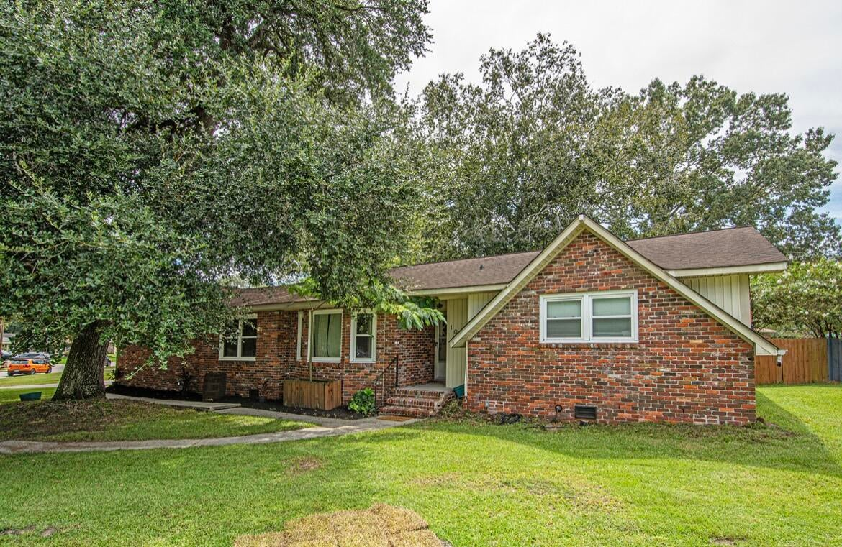
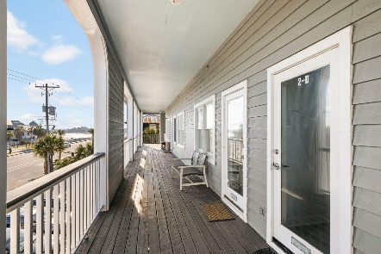
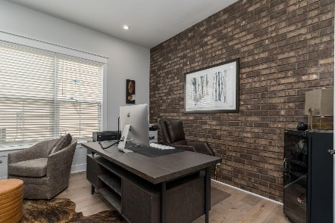
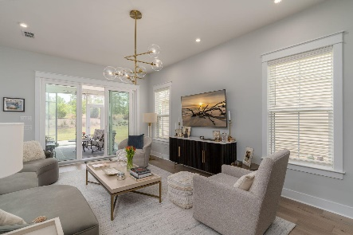

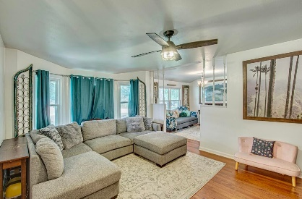
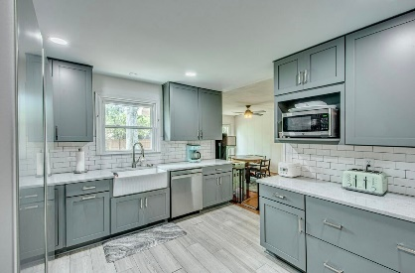
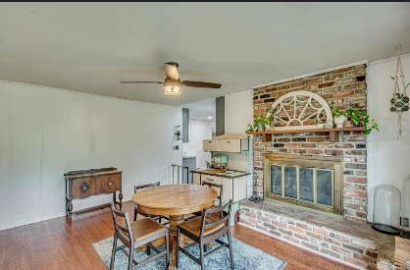
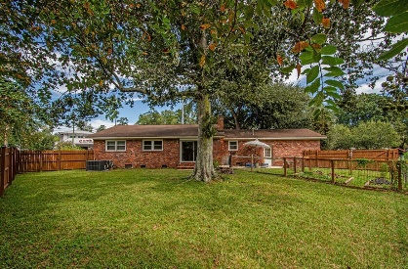
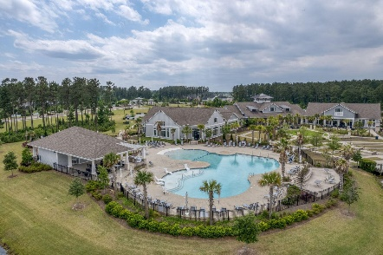
100 Jackson Road North Tranquil Acres | Ladson, SC 29456 | MLS# 23020781 | $304,999
Darrell Creek Elevated Home With Elevator & Salt Pool
Brick Ranch with Beautiful Kitchen
Co-sponsored by
Offering $3000
Lender Credit
If you are looking for a great home and some help from the seller, look no further. Seller offering $5,000 towards buyer closing costs or for rate buy down. This stunning three bedroom, two bath home is situated on a corner lot and features an entry side garage. The family room, dining room with fireplace, and updated beautiful kitchen create a warm and inviting atmosphere. The brick exterior gives the home a classic, timeless feel and the updated kitchen and amenities provide modern convenience. Whether entertaining or simply enjoying the peace and quiet of home, this property offers everything needed for a comfortable and enjoyable lifestyle. NO HOA and central location. HVAC is only 4 years old and all new ductwork done in Aug 2023.
Rochelle Rennert
843-847-9694 | rochellesellscharleston@gmail.com | www.RochelleSellsCharleston.com
AgentOwned Premiere Group, Inc. | 219 N Highway 52 Ste A | Moncks Corner, SC 29461-3926

