Slide 1
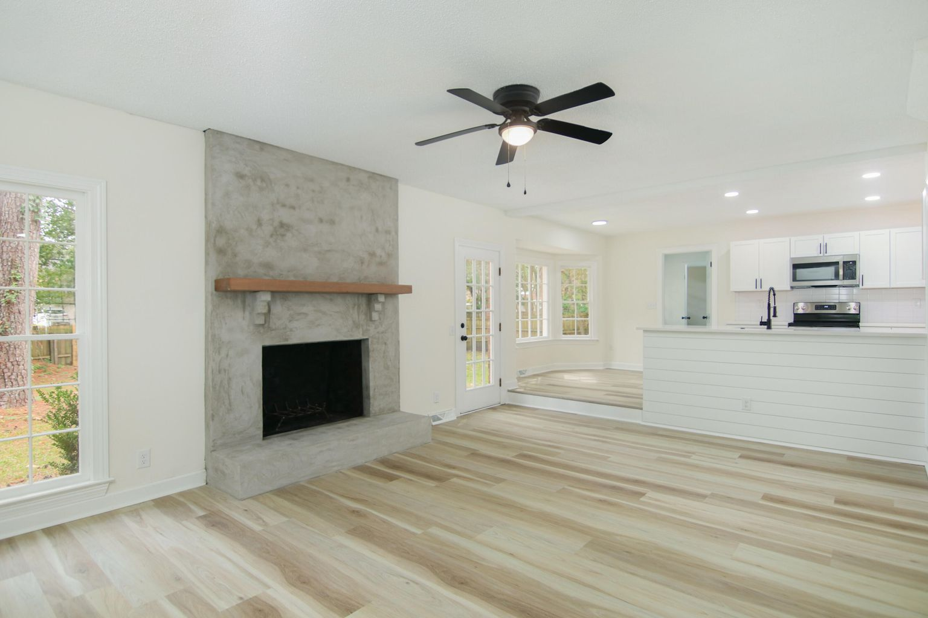
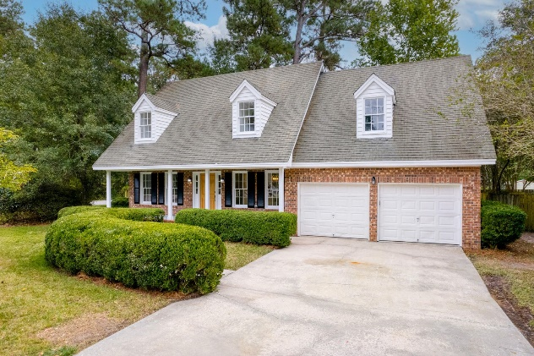
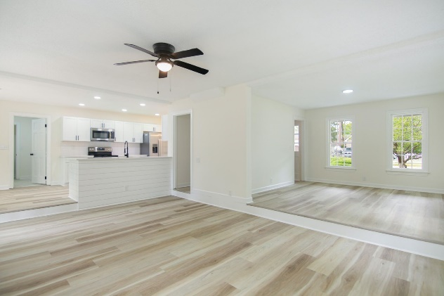
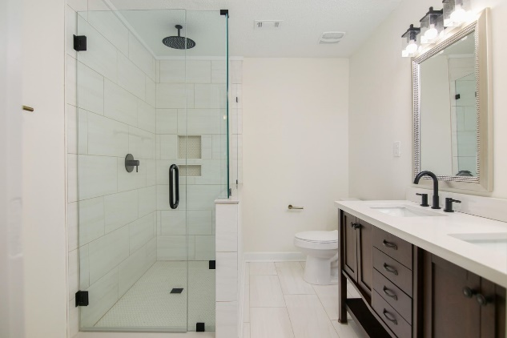


Price Reduction! Tons Of Updates
100 Towhee Drive
Oak Knoll | Summerville, SC 29485
MLS# 22025453 | $412,000
Gorgeous renovated home, in a quiet well maintained neighborhood, in a great part of Summerville. Opened up floor plan with a stunning custom concrete fireplace/mantel that ties the downstairs living spaces together. Tons of updates; new flooring throughout home, new plumbing pressure lines, new ductwork and a new HVAC. Totally new kitchen with quartz counters, all new bathrooms, master bath has a rain shower head and custom glass shower door, as well as a walk in closet. Huge flex space/FROG serves as fourth bedroom on this versatile home. Fully fenced yard and DD2 school district. All this with four ways to get to downtown Charleston easily, plus only five minutes to downtown Historic Summerville. New parks nearby, walking and biking trails nearby, lots of green space around.
Justin Natale
843-437-9739 | jnatale1982@gmail.com
www.theblvdcompany.com
The Boulevard Company, LLC | 806 Johnnie Dodds Blvd Ste 100 | Mt Pleasant, SC 29464

