Slide 1
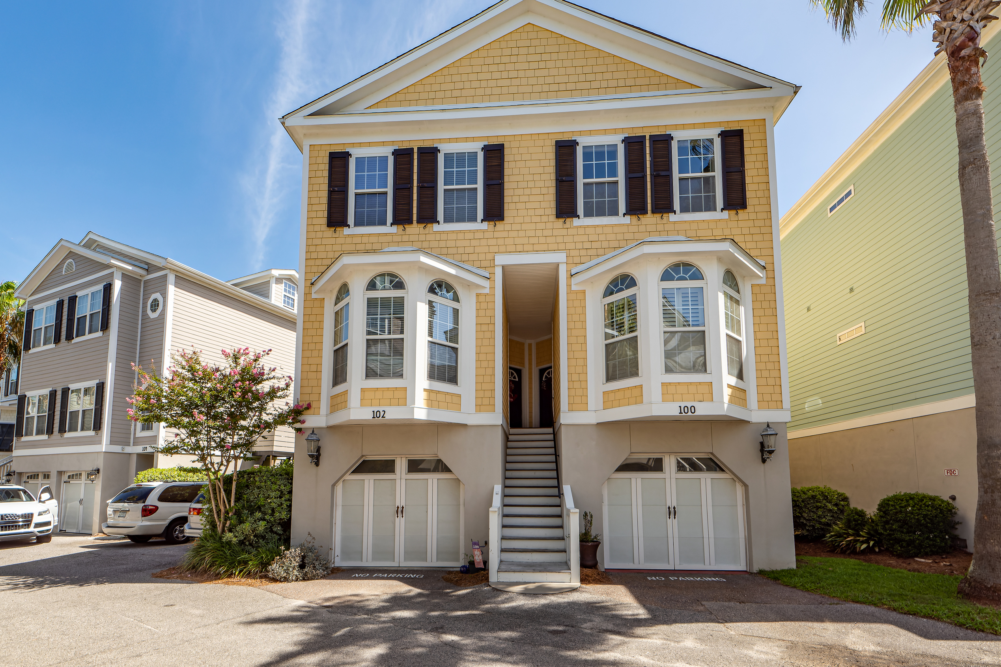
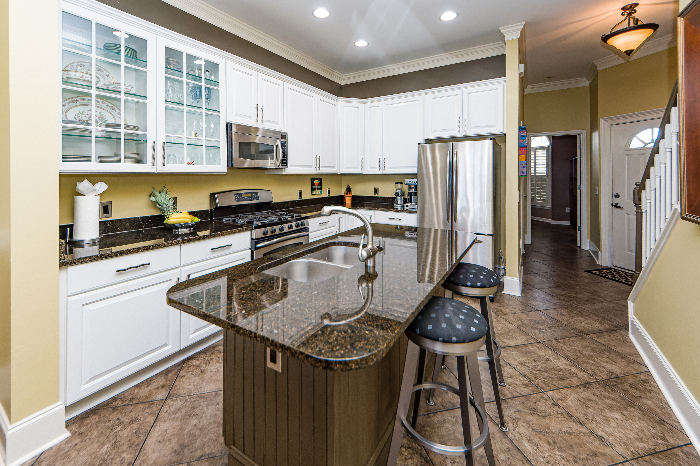
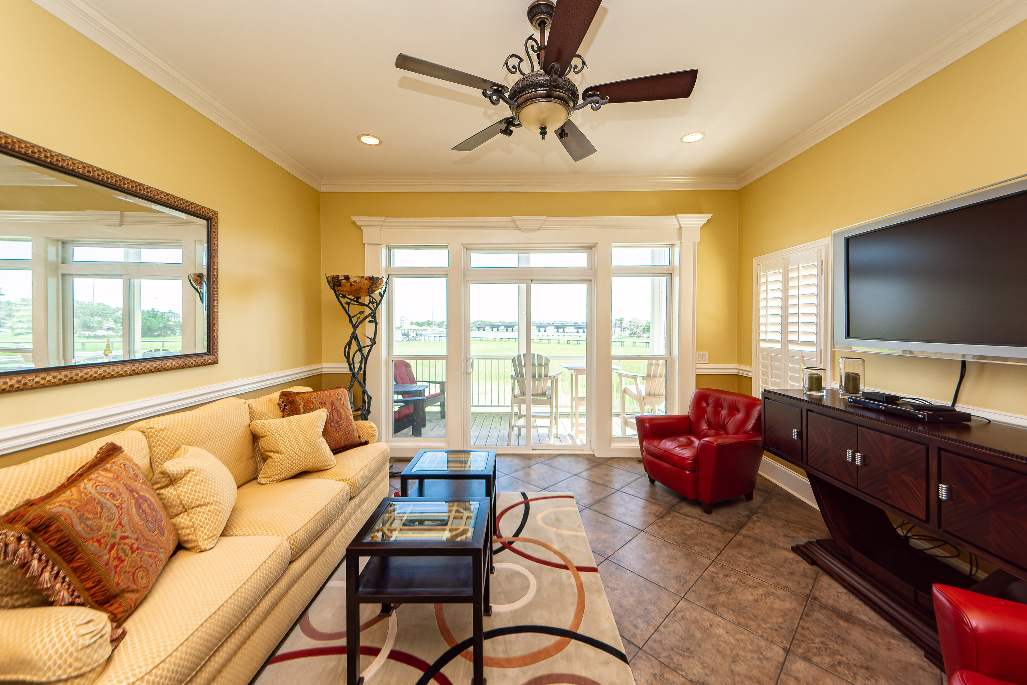
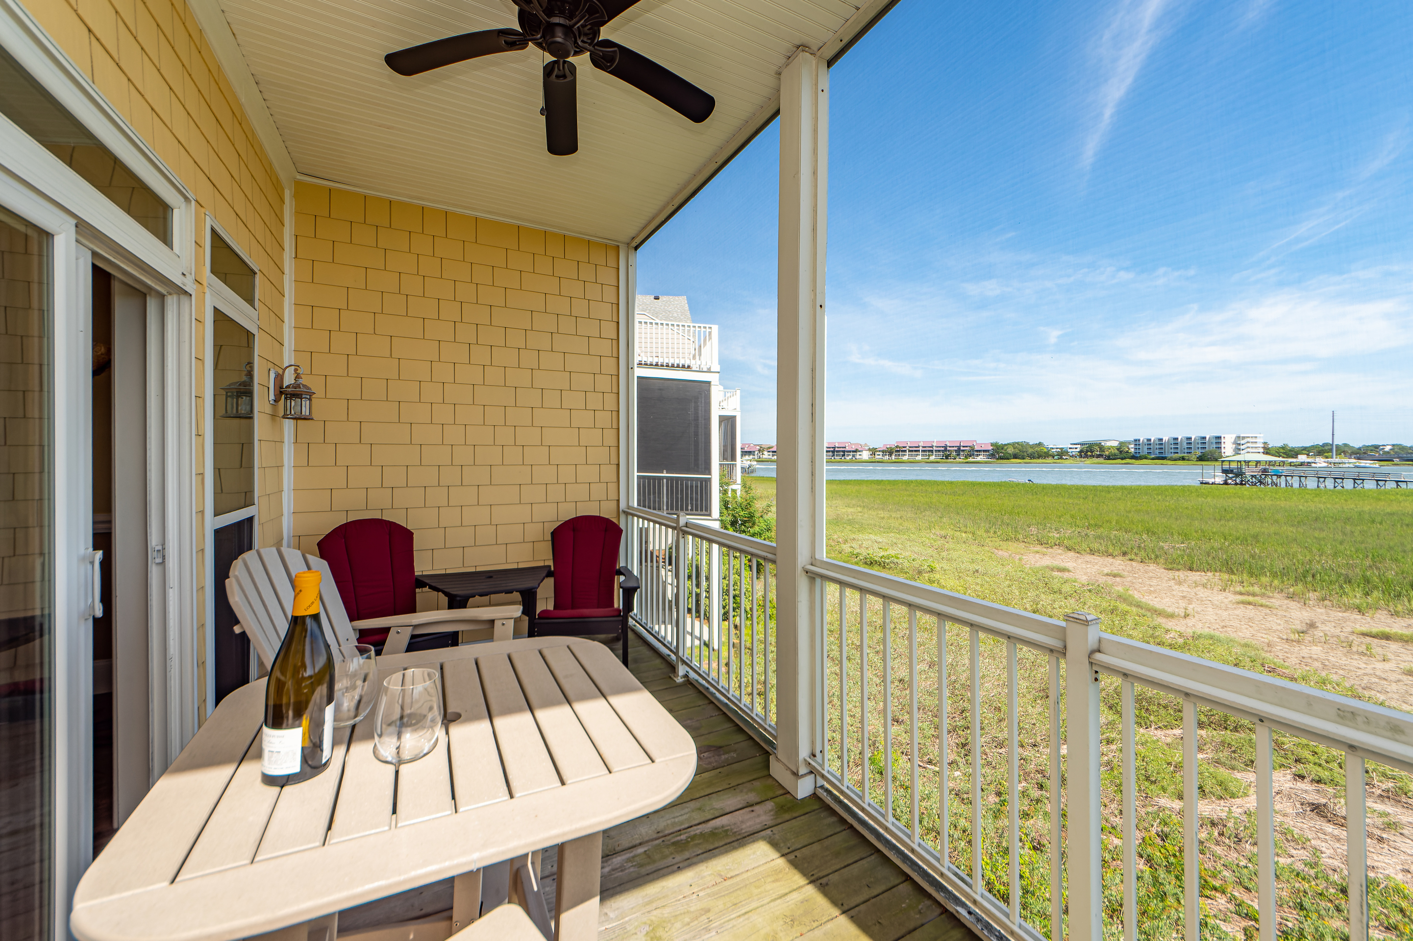
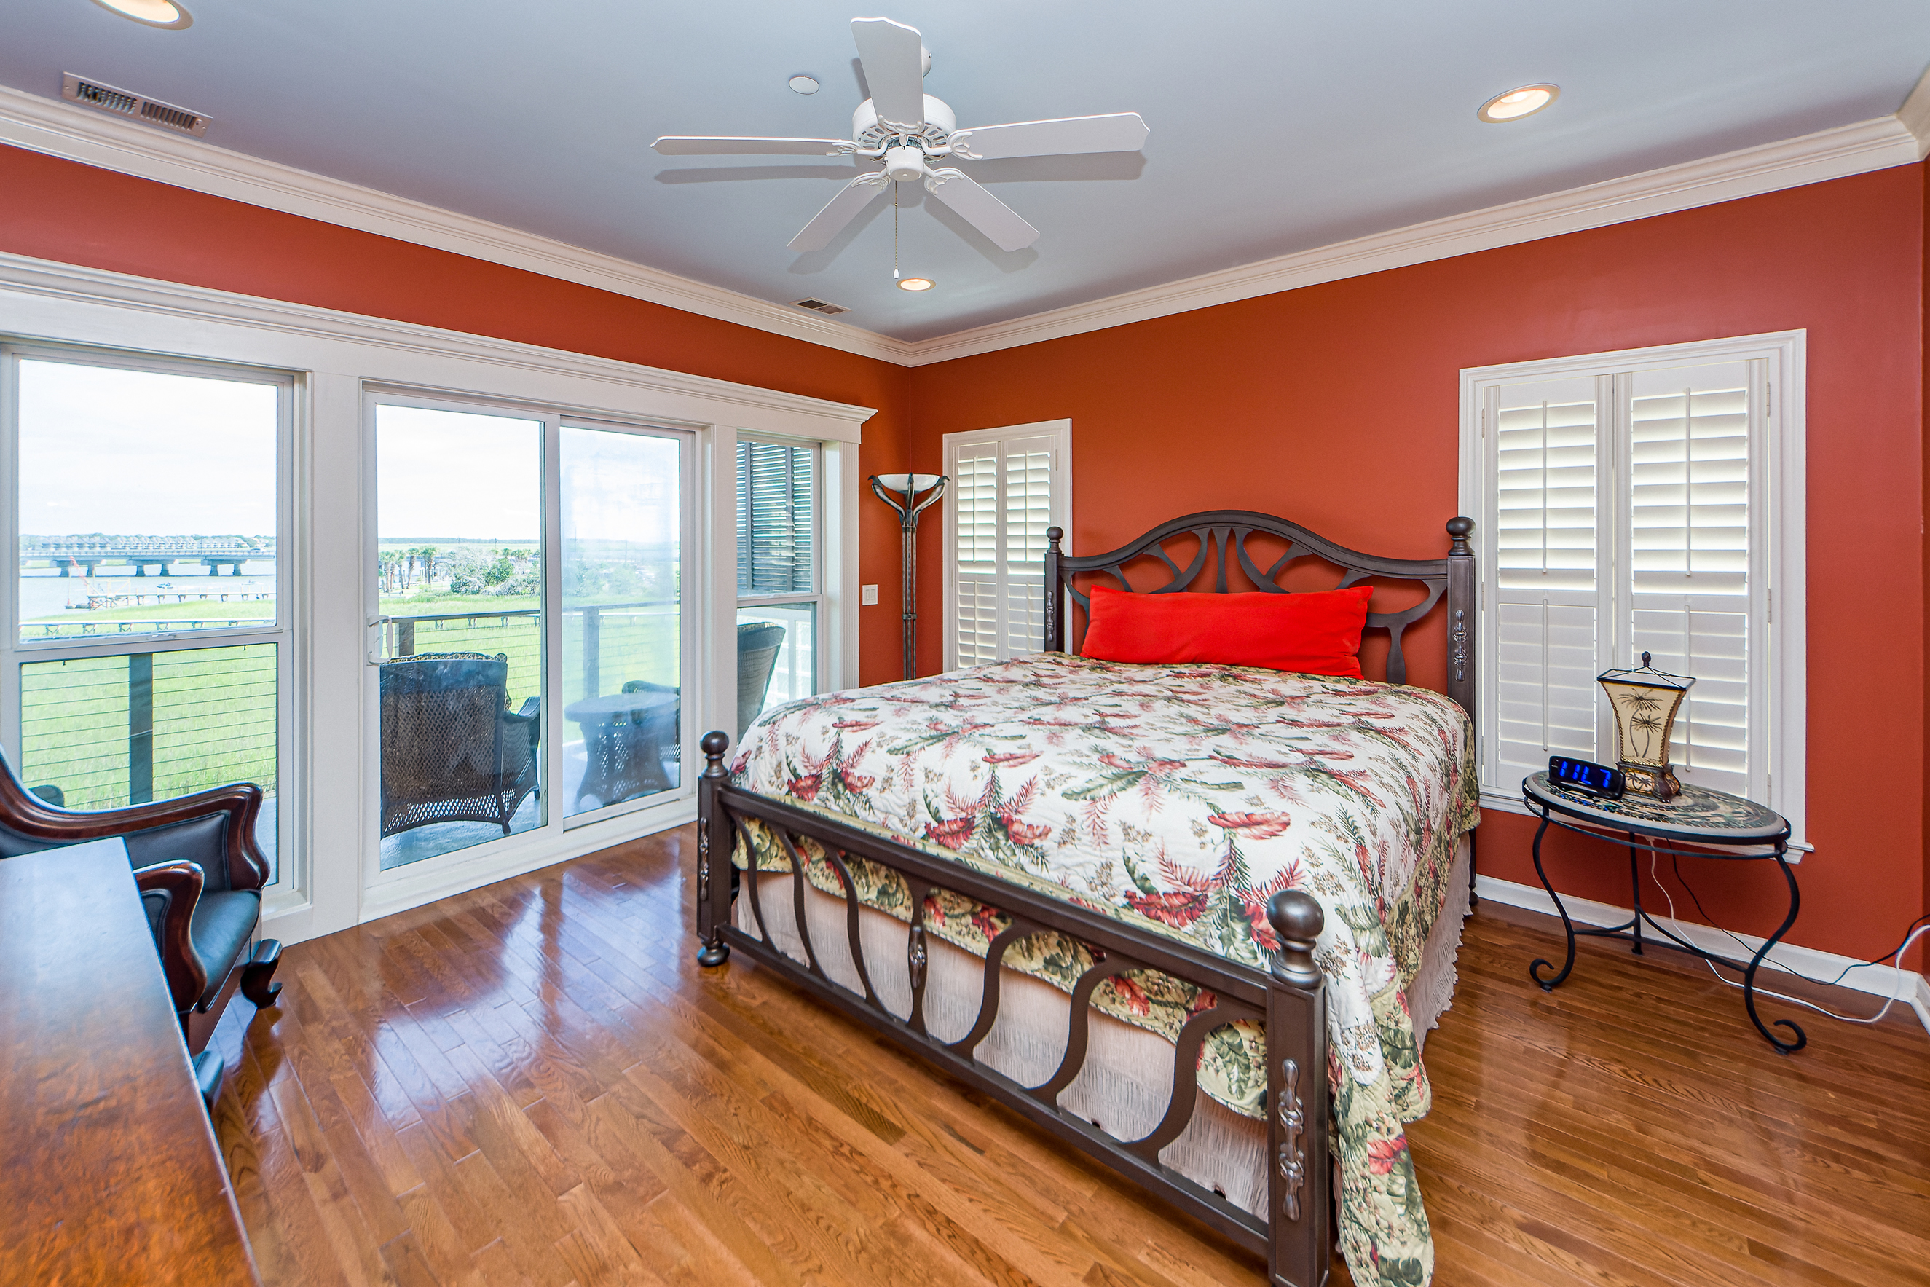
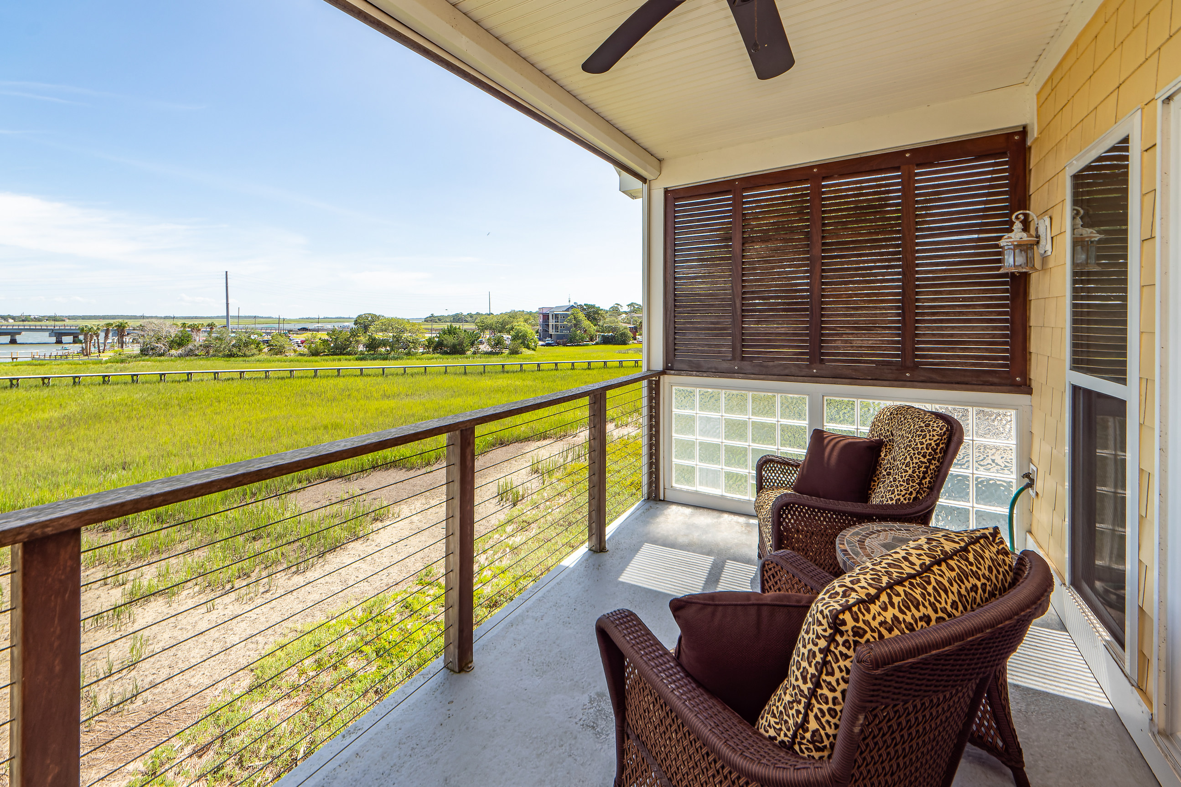
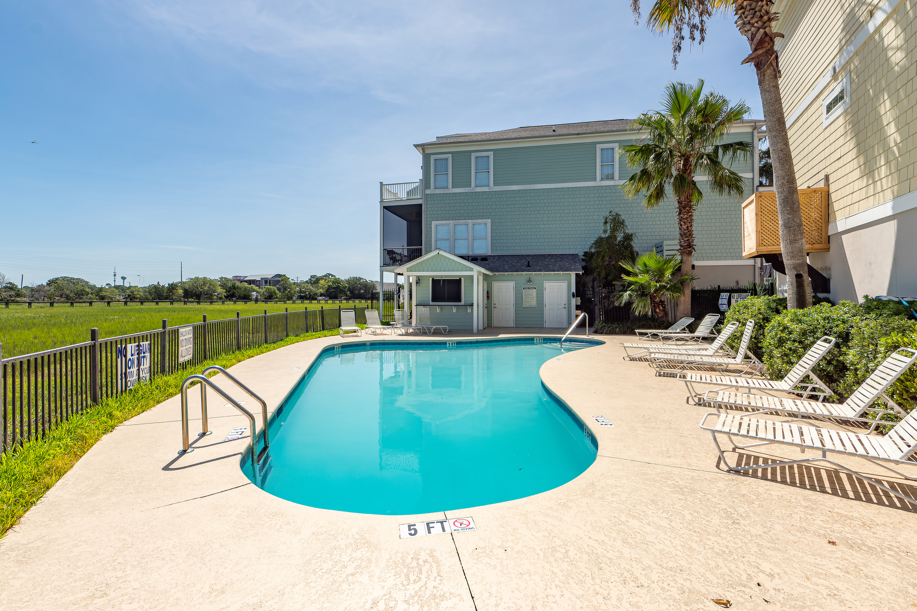
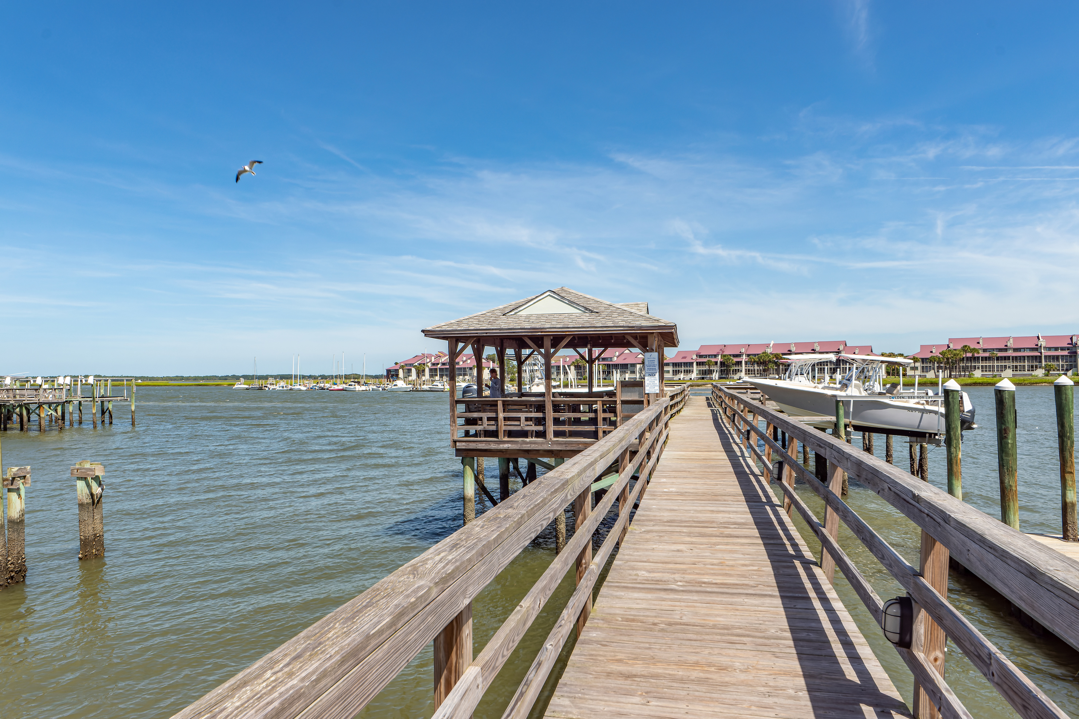
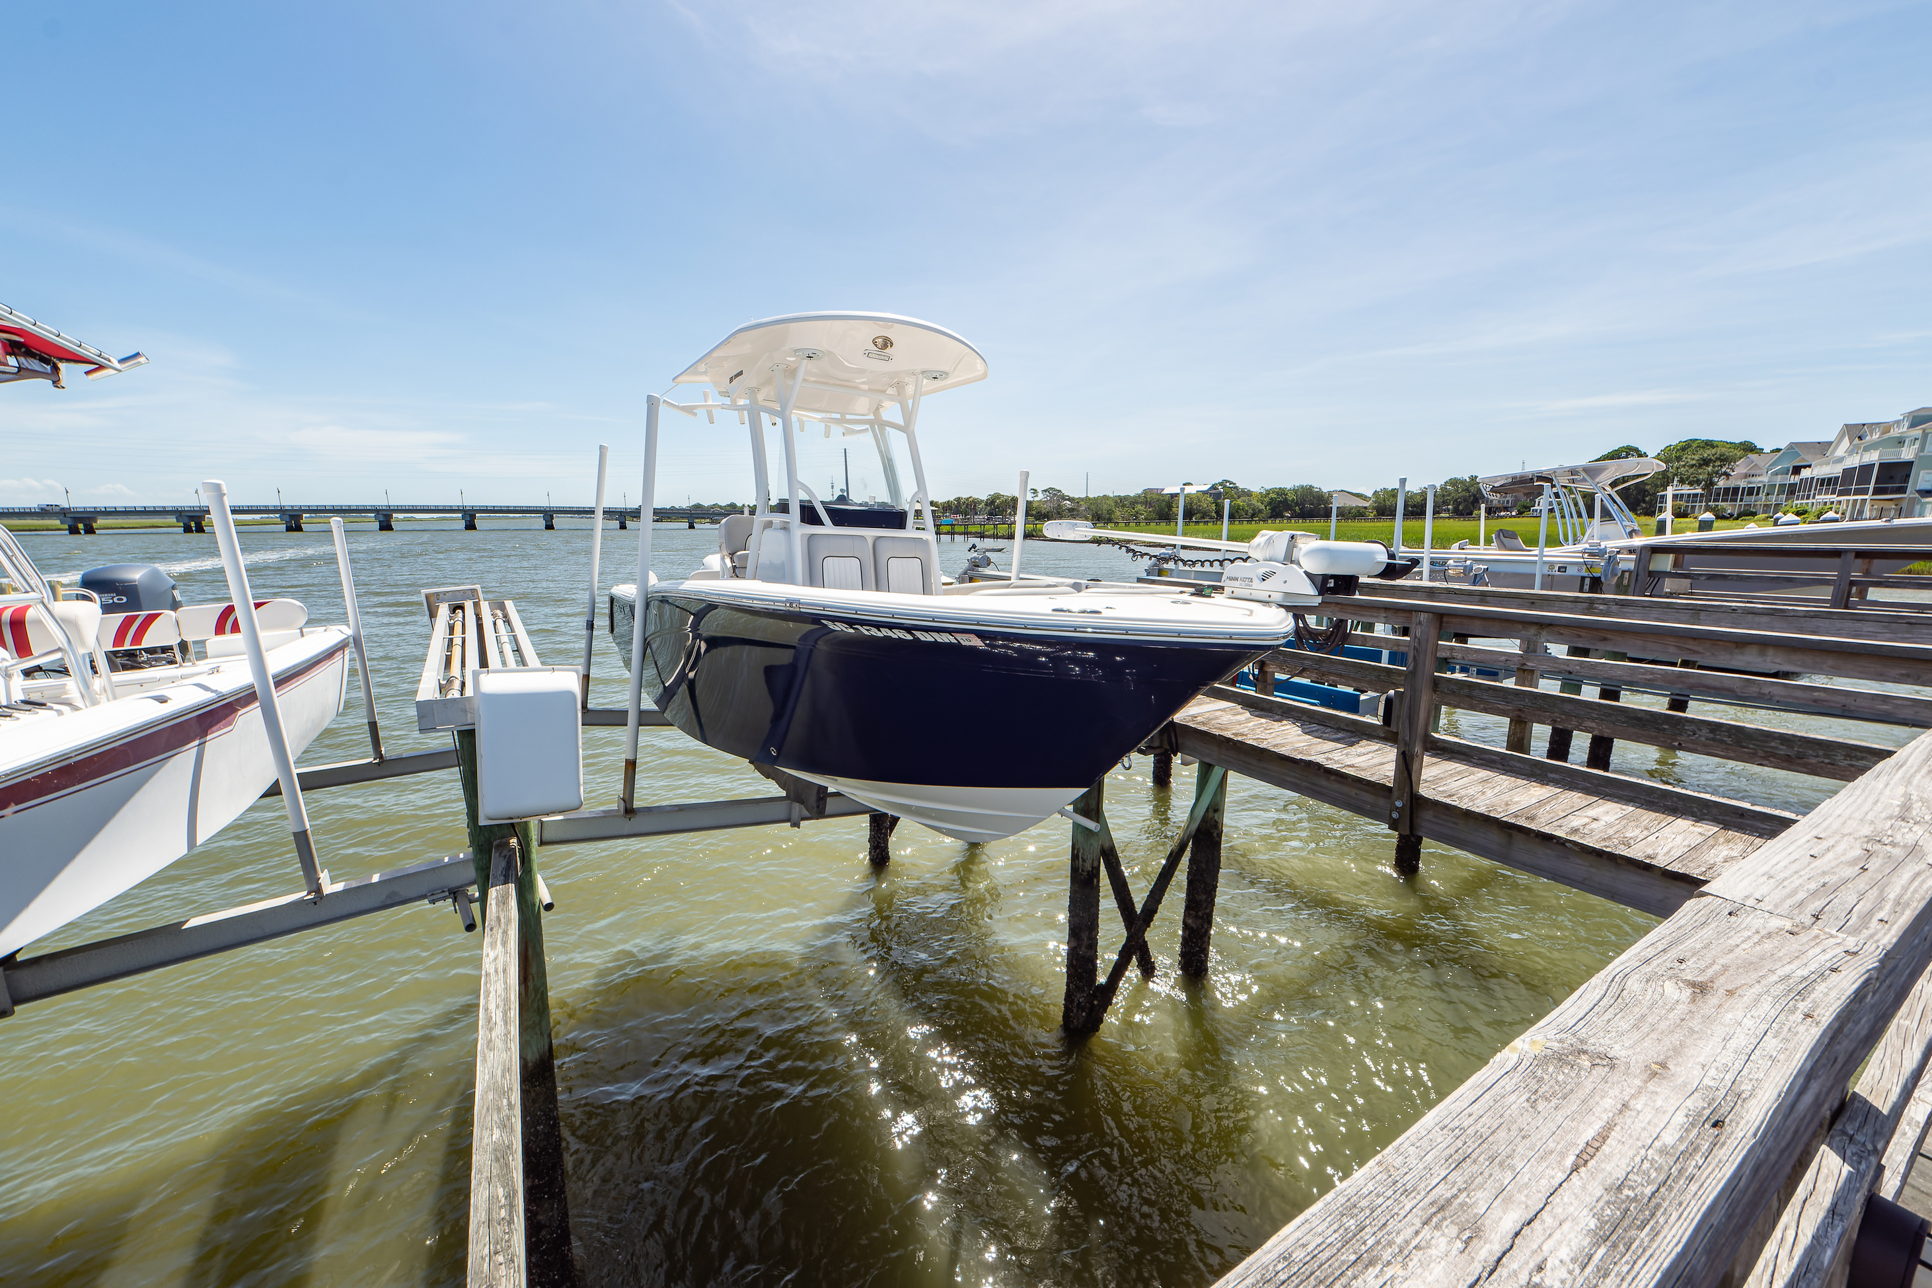
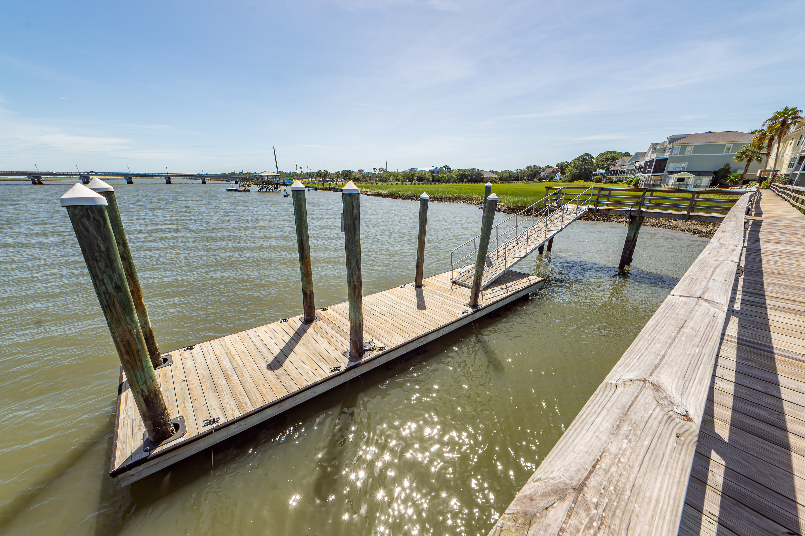
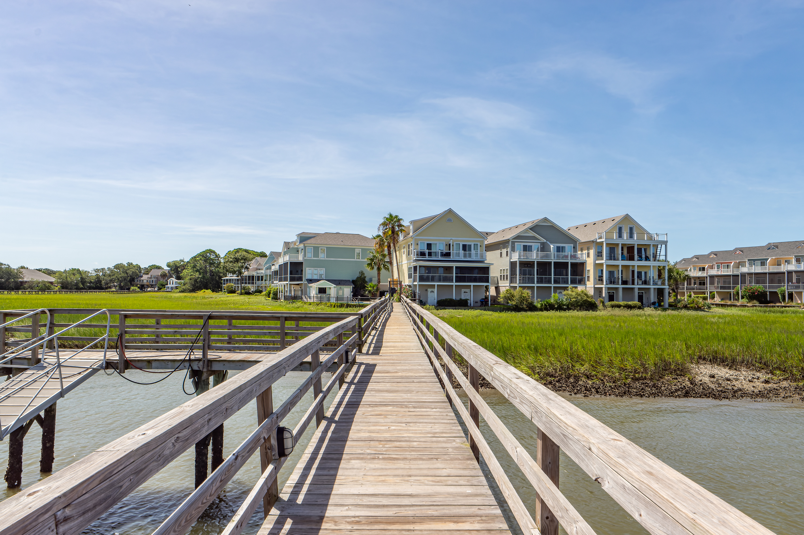
Dedicated Deep Water Boat Slip With Lift
100 W 2nd Street
Waters Edge
Folly Beach, SC 29439
MLS# 22019897 | $1,295,000
Short Term Rental (STR) qualified
On the Edge of America, a true gem of a property * offering this 3 bedroom, 3 full bath, 1668 asqft townhome overlooking the Folly River, one of the prettiest stretches of water around * pair that with an owner’s deep water (at all times) dock and one of only 10 dedicated boat slips with a power boatlift that can handle up to a 24 foot boat and you have a real winning combination * the elevated construction offers plenty of space (55 feet) under the home for up to 3 cars plus additional storage * up the stairs and the first floor offers a bedroom up front with a bay window and nice closet * this bedroom is adjacent to a full bathroom * next is a very nice and functional kitchen with granite countertops, stainless steel appliances, a center island, pantry and plenty of storage * adjacent is the dining area and the cozy family room * all of this looks out through the high impact, full glass wall onto the Folly River * open the sliding doors and sit and enjoy the wonderful view along with the breeze that always seems to be there * the balcony is a covered balcony which offers a respite from the sun * Seller took a personal hand in this construction and had added heavy crown moulding and casements to the doors and windows and crown moulding * the 10 ft ceilings sure make this space feel very large and open * moving upstairs you will find the 2 additional bedrooms including the master which offers a private, covered balcony that also overlooks the river (the covered part of this balcony is a non-standard feature) * what a place to watch the stars * master bath and closet are upgraded and offer plenty of space * at the front of the home, the third bedroom mirrors the first floor but with its own private full bath * upstairs offers 9 foot ceilings and the same heavy mouldings * now we move all the way to the garage level and this one is as neat as a pin * custom, stainless steel sink for those odd jobs where you need an outside area * the shut-offs for the outside water and rain shower are inside the garage on the back wall ( a little security feature) * outdoor shower for leaving the sand outside * high strength backdoor that is basically bulletproof * now, for some other goodies * this home has never been rented but can be on the STR program through VRBO and Airbnb * there are several units in this complex that are currently being utilized in this fashion and generate very good income * hardi-plank exterior, new roof in 2020, new HVAC in 2019 but that boat slip is a HOME RUN!!
Take a virtual tour: https://charlestonvirtualhomes.com/2220304
Fudgy Brabham
(843) 568-1241
fudgy@hbrtwn.com
www.hbrtwn.com
Harbourtowne Real Estate
672 Marina Drive, Ste 110
Daniel Island, SC 29492
Harbourtowne Real Estate | 672 Marina Drive, Ste 110 | Daniel Island, SC 29492

