Slide 1
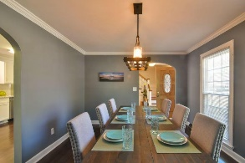
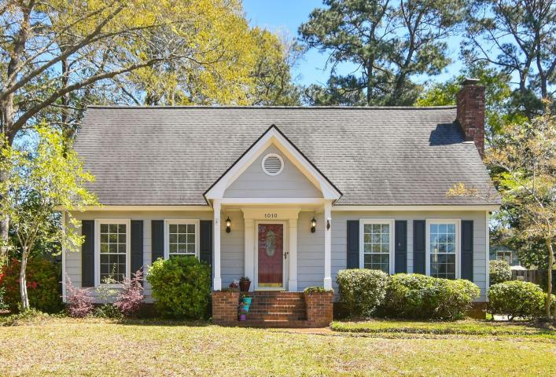
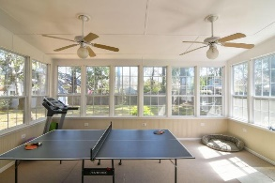
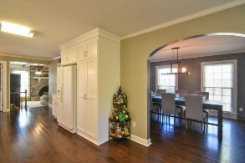
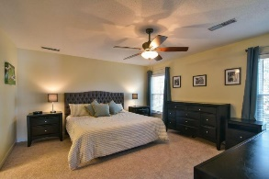
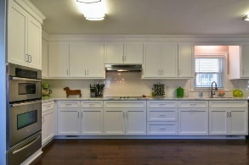
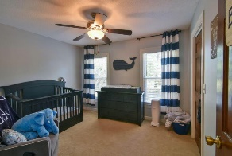
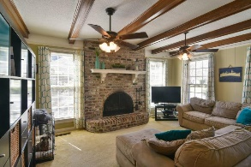
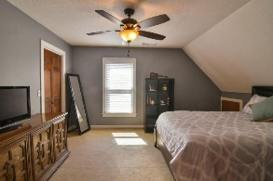
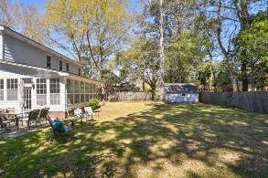
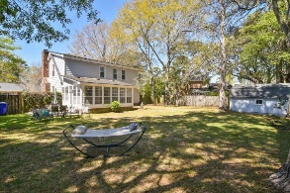
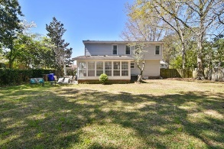
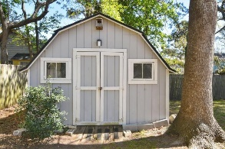
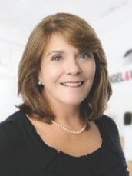

1010 Grand Concourse Street Harbor Woods ~ Charleston, SC 29412 MLS# 18008082 ~ $399,900
Open House Saturday, March 31st
11am – 3pm
Welcome Home! Wonderfully well-maintained home with fully renovated kitchen in highly desirable Harbor Woods is just what you have been looking for! When you enter the foyer, there is a lovely dining room to the left with new lighting fixture, dentil molding and arched opening. Then you will find an amazing, completely renovated kitchen with all new cabinetry; stainless steel oven w/warming drawer and microwave; cooktop; and dishwasher; marble counter tops and subway tile backsplash. The layout and size of the kitchen is terrific! The den boasts wooden beams with a gas fireplace (could be converted to wood burning). To round out the first floor you will find a nicely appointed powder room, utility room, and very large 320 SqFt Florida Room surrounded by windows allowing massive amount of natural light. This room would also be great for a large den and/or office, game room or playroom--your choice, depending upon your needs. You will enjoy additional storage in the huge closet in the Florida Room. There is a split HVAC system- downstairs is a gas pack while the new unit downstairs is a heat pump. The stairwell has wood steps and the hallway upstairs has cherry hardwood floors. The owner's suite has a ceiling fan with walk in closet and ensuite bath with vanity. There is also attic access from the owner's closet. The other 2 bedrooms are good size with large walk-in closets. You will be pleased with the beautifully landscaped front yard, and the large .29 acres backyard with privacy fence and double gate access. With a BBQ patio just outside the Florida Room, a 12.5 x 15.5 shed with electricity, and an irrigation system supplied by a well to cut water costs, you will enjoy outdoor living!
This home is NOT in a flood zone. There is a transferable termite bond, and there are NO HOA fees. All information is deemed correct; however, buyer is to confirm anything of relevance.
Kimberly Roberts
(843) 687-1246
kimberly.roberts@evusa.com
www.kimberly.roberts.evusa.com
Engel & Volkers Charleston Mt. Pleasant | 629 Johnnie Dodds Blvd., Suite 100, Mt Pleasant, SC 29464

