Slide 1
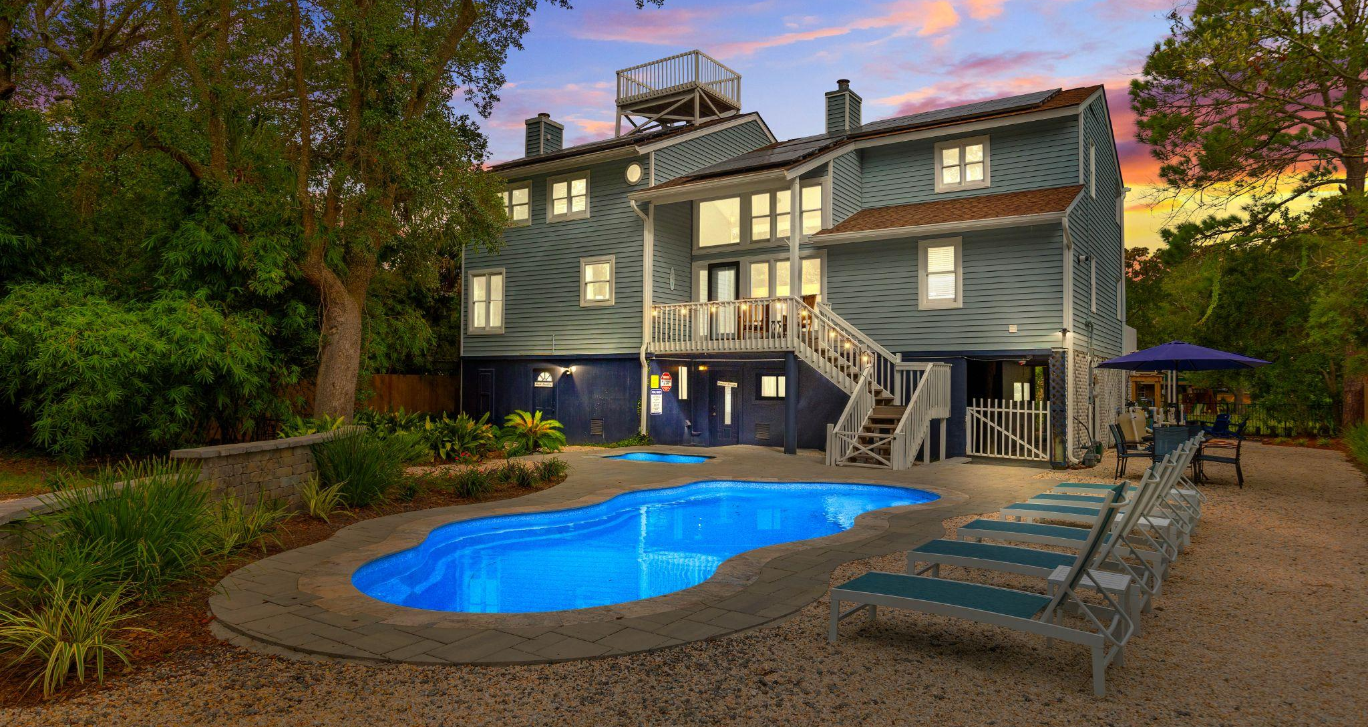
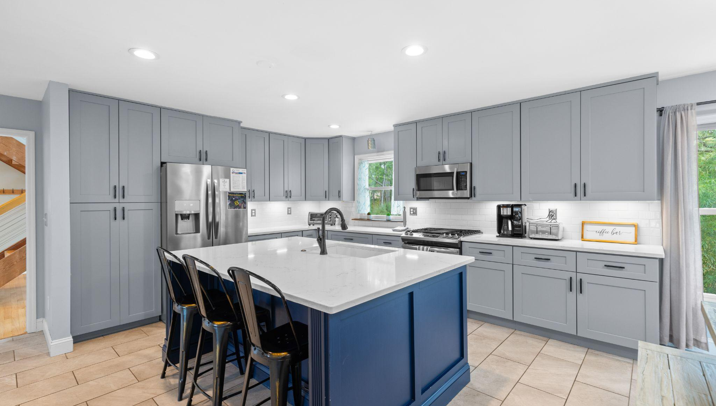
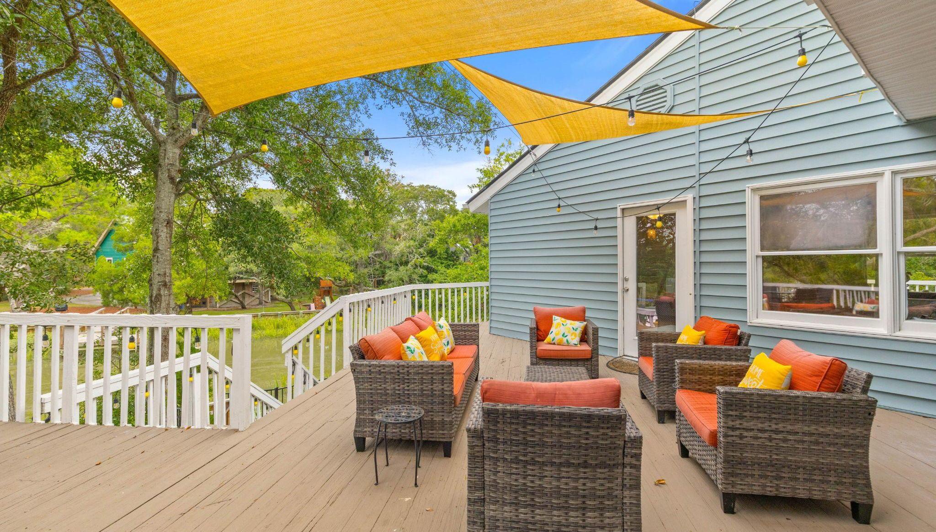
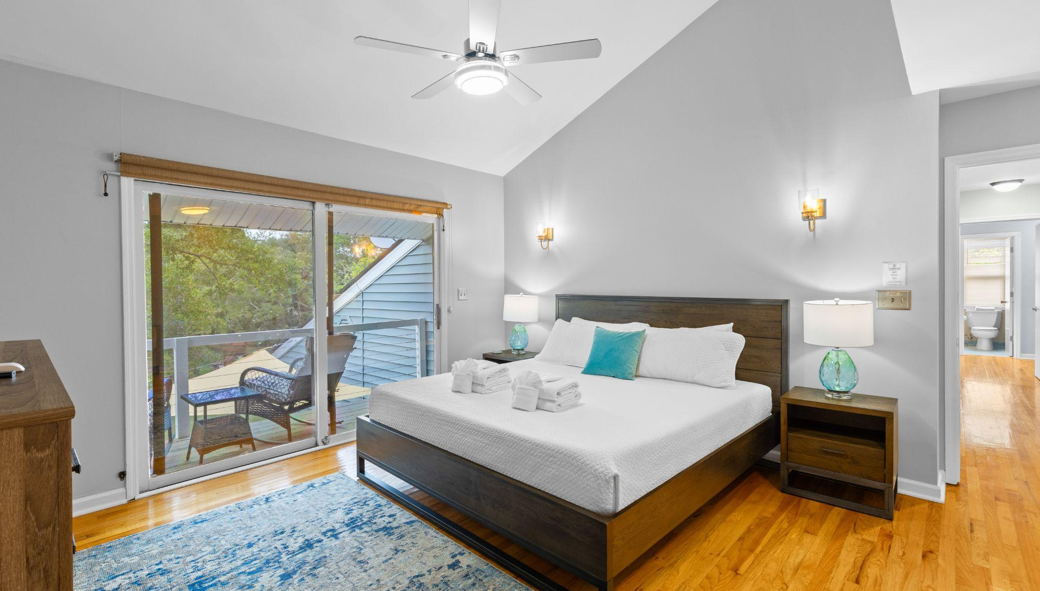








1010 E. Erie Avenue
Folly Beach, SC 29439
Price Improved to $1,999,999
Leave this side area, it will not interfere with the download or printing. See bottom panel for instructions and editing tips.
Fonts used: Times New Roman
~ On Tidal Creek ~ 3 Bedrooms ~ 3.5 Bathrooms ~ 2,479 SqFt ~ ~ Fully Furnished ~ Blocks From The Beach ~ Plenty of Storage ~ Recent Renovations ~ Tons of Outdoor Living Space ~ ~ Plus 1 Bedroom Apartment on Bottom Floor ~ MLS # 24023056
Ashley Melton,
REALTOR®
843-670-2333
Ashley.Melton@AgentOwned.com
CharlestonPalmettoHomes.com
Helping Buyers & Sellers with every aspect of Real Estate since 1992
Real Estate • Mortgage • Insurance • Business Brokerage • Property Management
Notes:
To get started: From the Menu, select File / Make a Copy / Entire presentation, then Rename the copy to the Property Address.
To maintain the structure of this template, please follow these Guidelines. *If you alter the layout beyond images or text, your file may not be printed.
Do not change the size of any image holding box, or the color of any image boxes.
Do not change the font styles, or the color of the fonts, or the size of the text holding box.
To change images: Right-Click on the image, then Replace Image, then Upload from Computer.
To adjust the new image: Click once, then select the Crop tool, you will see a black border line and a blue border line. Use the blue border line toggle points to adjust the placement. (do not adjust the black holding box)
To edit text: Click on any text, and type. If you run out of room, highlight all the text and adjust the font size from the menu. (do not adjust the blue holding box)
Important: Do not remove any company logos or company information. *If you remove logos or company text, your file will not be printed.

