Slide 1

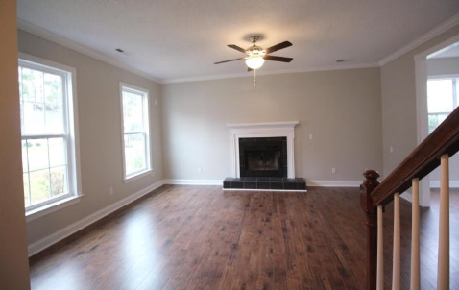
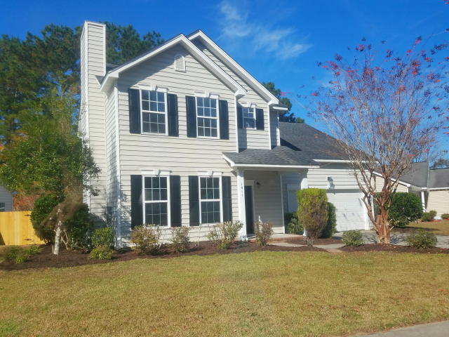
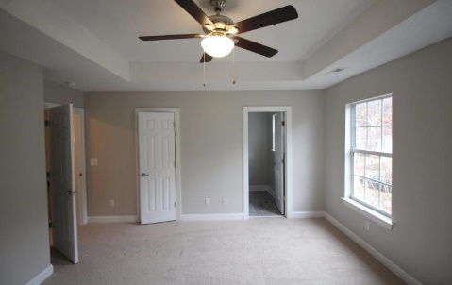
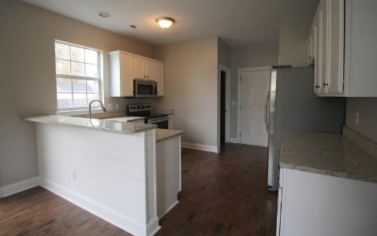
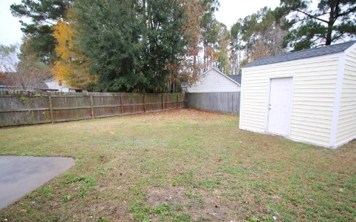


$2,000 Agent Bonus For This Updated Move-in-ready Family Home
1011 Providence Way
Providence Place ~ Summerville ~ MLS# 17033625 ~ $223,500
Welcome to 1011 Providence Way, your newly renovated home in the sought-after Dorchester district II. Upon arrival, you're greeted with all new flooring, fixtures, paint, fireplace, and high ceilings. Walking past the foyer is the kitchen with the dining area separated by a shiplap breakfast counter with all new upgraded granite countertops. The kitchen is well appointed with all brand new Samsung appliances with fridge included!! Plenty of kitchen storage in pantry & closet. Upstairs, you'll find a large finished room over the garage that would be a perfect play area or game room for a family. Across the house is the remodeled bath with new tile and the granite. The master suite with tray ceiling, WI closet & New bath is it's own sanctuary. Fenced in BY, & HVAC is 1 yr old!
Peter Stanley
M 843-300-8251 | O 843-885-6199
petermstanleyjr@gmail.com
Colony & Craft LLC
716 Meeting St Charleston SC 29403

