Slide 1
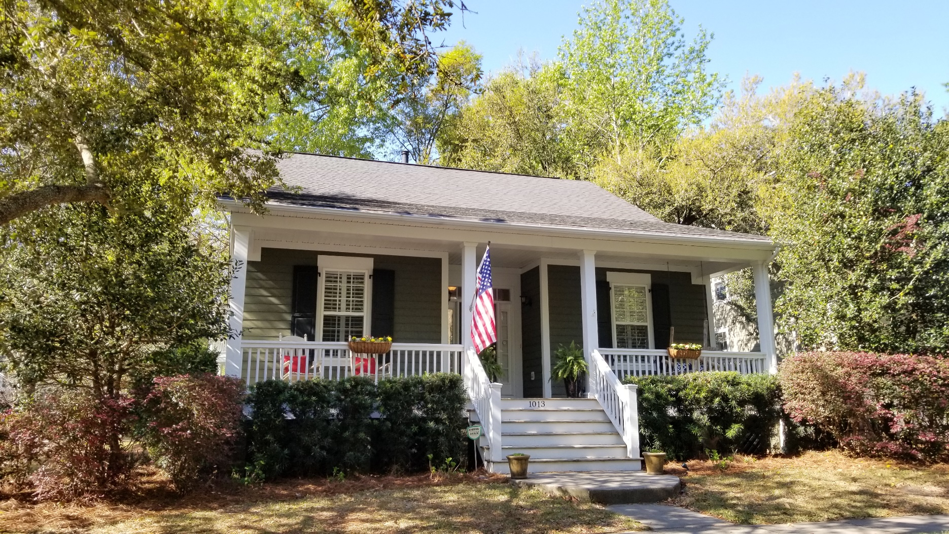
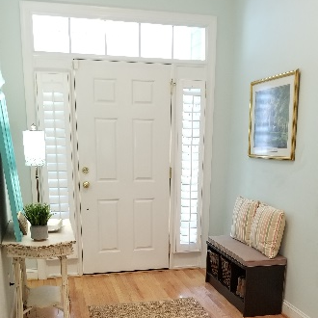
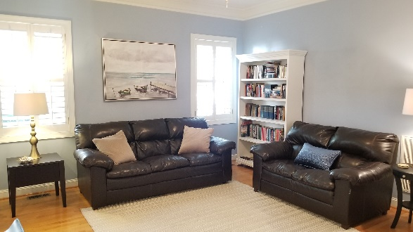
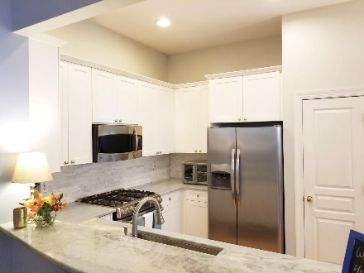
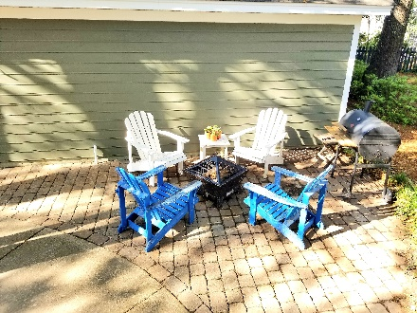



Coming Soon on Daniel Island
Broker's Open - Thursday April 11th from 10-12
Lowest price per square foot home currently available in Jamestowne Village! This wonderful home has 10' ceilings, an open floor plan, spacious backyard that is fully fenced in and a two car garage. Centrally located only minutes to downtown Charleston or Folly Beach. This home is a great value and in a wonderful neighborhood. Seller offering a $2000 credit towards flooring at closing with acceptable offer. Easy to show! Motivated sellers! ~$1650 lender credit is available and will be applied towards buyer's closing costs and pre-paids if the buyer chooses to use Carolina One Mortgage. This credit is in addition to any negotiated seller concessions.
1013 Barfield Street 3 Bedrooms | 2 Baths | 1,400sf | $525,000
Whitley Boyd
(843) 324-4761
WBoyd@CarolinaOne.com
www.PropertiesofCHS.com
Carolina One Real Estate | 628 Long Point Rd. | Mt Pleasant, SC 29464-3032

