Slide 1
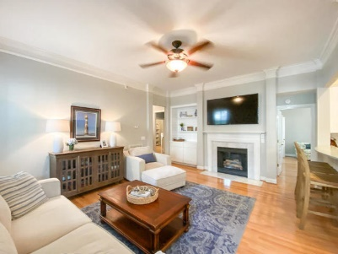
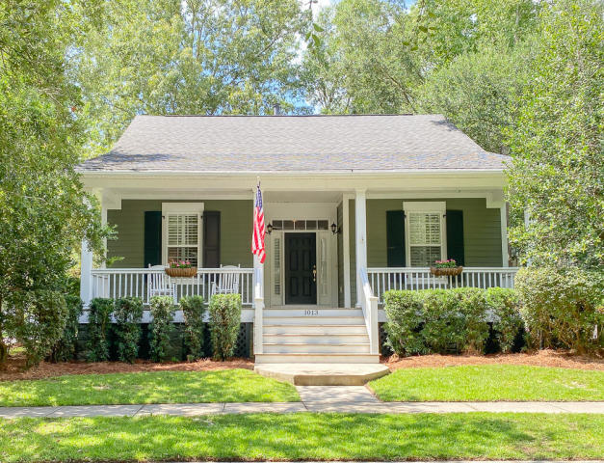
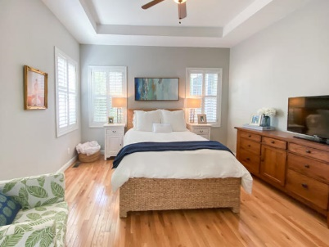
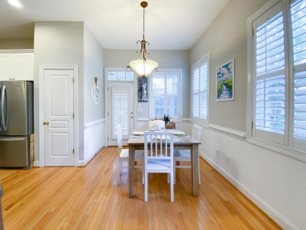
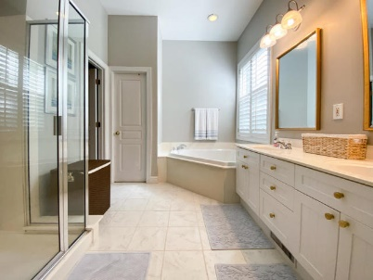
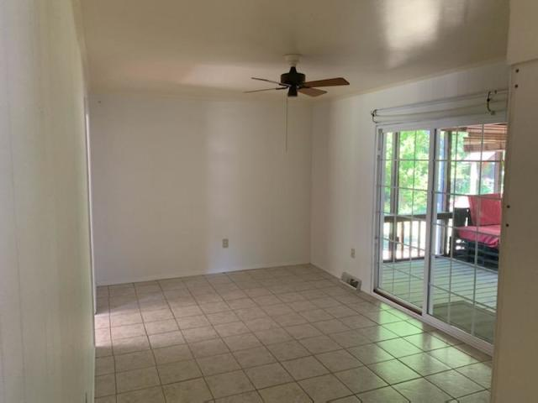
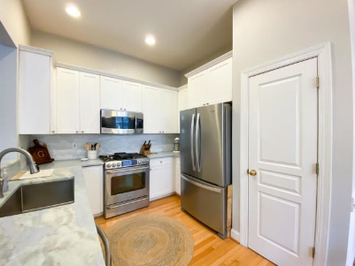
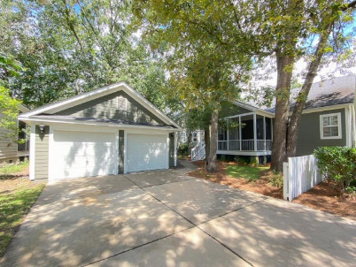
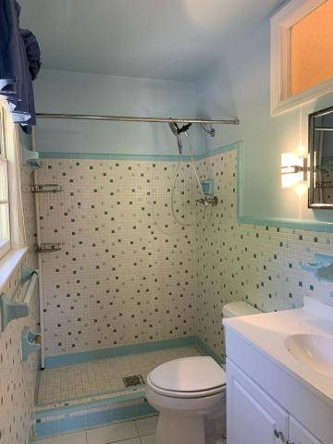
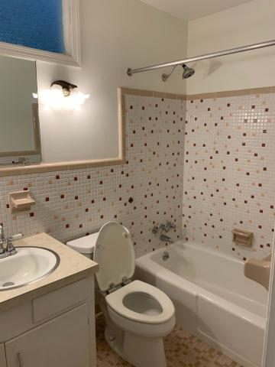


Great Price on Daniel Island!!!
1013 Barfield Street
Charleston, SC 29492 · MLS# 20021865 · $595,000
Michael Dew
O 843-769-5100
M 843-870-7000
michaeledew@gmail.com
www.michaeldewrealestate.com
Situated on a highly desirable corner lot, this charming one-story home is surrounded by plush landscaping and conveniently located to the neighborhood parks and schools. The welcoming front porch is perfect for relaxing or gathering with friends. Enter into the foyer with unique built-in shelving before heading into the spacious living area. Ten foot high ceilings compliment the open floor plan and showcase the special details including beautiful plantation shutters, ample natural lighting and a lovely fireplace. Recent updates include oak hardwood floors throughout living areas and bedrooms. New tile floors in bathrooms. Kitchen upgrades include, a stainless steel appliance package with a gas range, stunning quartzite counter tops, pull-down stainless steel faucet and a tile backsplash. The private Master suite features tray ceilings, a spacious walk-in closet, a large garden tub, a separate shower and a dual vanity sink. The two additional bedrooms are near the front of the house and share a bathroom that opens to the hallway. At the back of the home you can enjoy the screened porch while overlooking the shaded backyard. Outside, there is a newly paved patio area that is ideal for fire pit gatherings and cookouts. Additionally, there is a detached two car garage that is accessible from the side-street.
Enjoy all that Daniel Island has to offer including three neighborhood pools, multiple parks, walking and biking paths, award-winning golf courses, Family Circle Tennis Center, a professional soccer stadium, rivers, creeks, docks and boat ramps.
AgentOwned Charleston Group
902 Savannah Hwy
Charleston, SC 29407
Real Estate ● Mortgage Insurance ● Business Brokerage

