Slide 1
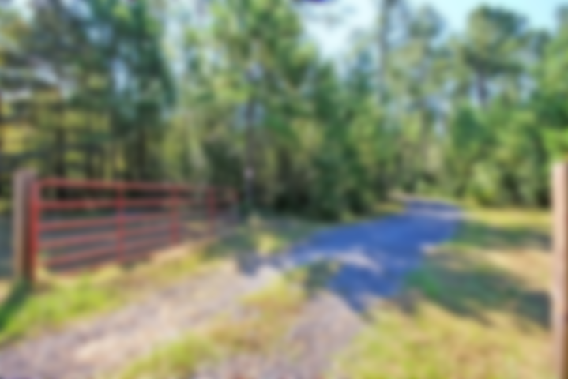
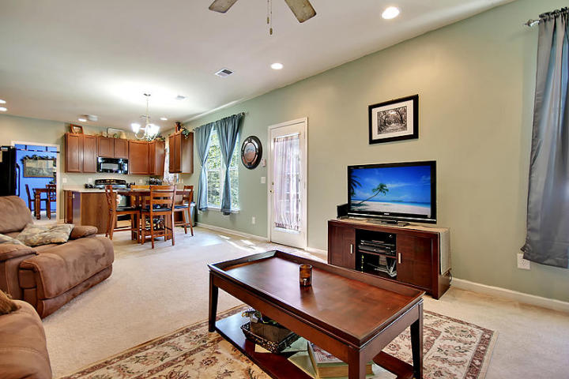
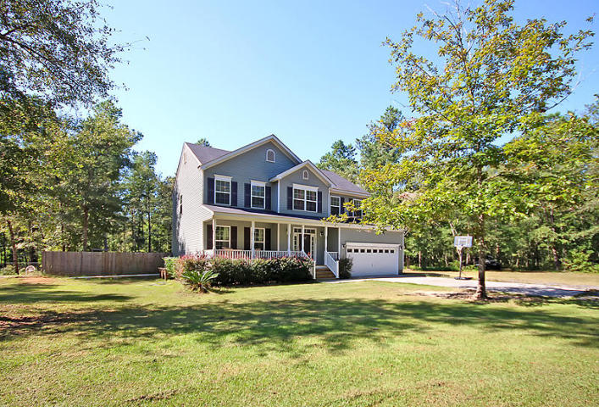
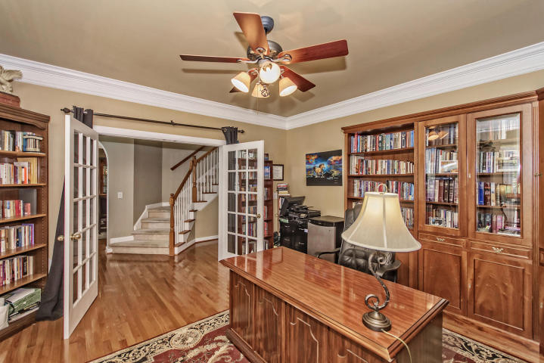
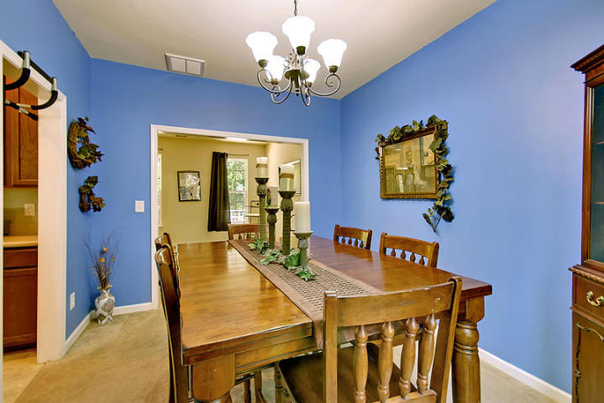
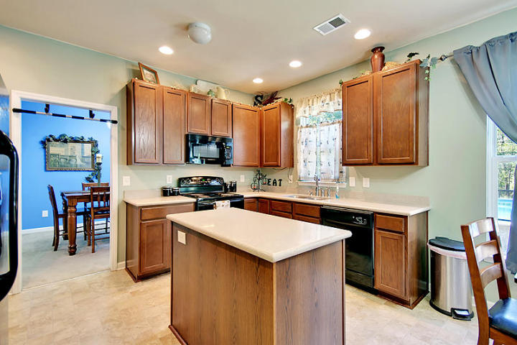
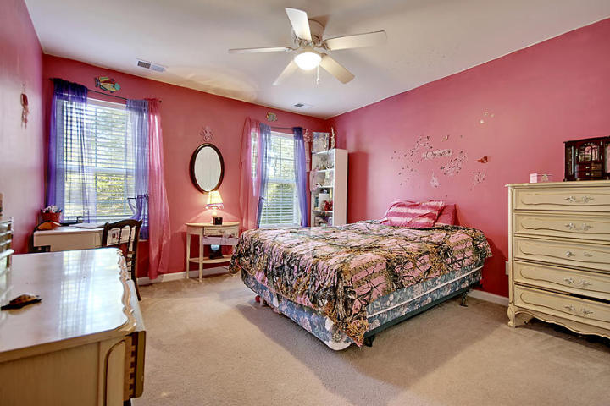
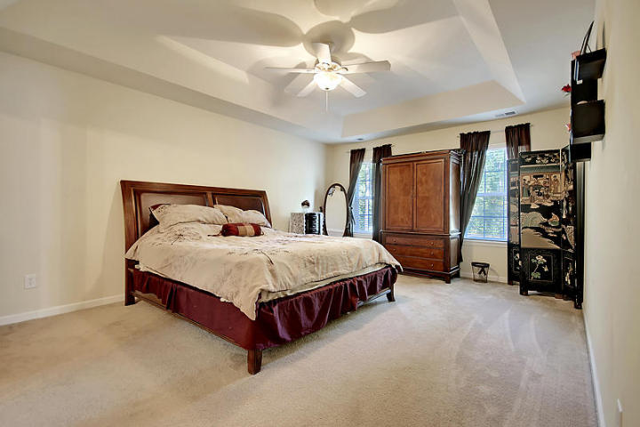
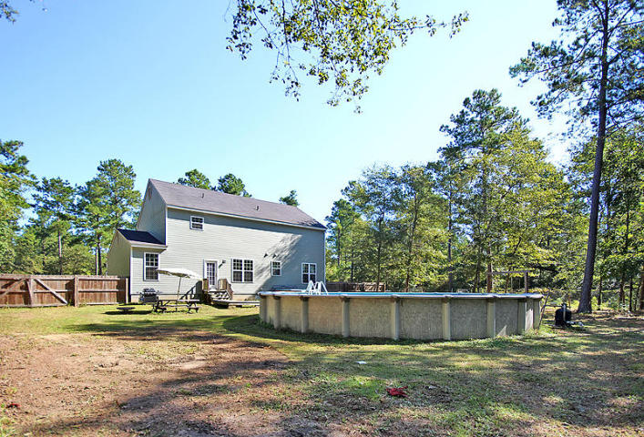

LOOKING FOR A HOME IN THE HEART OF THE COUNTRY?
1013 Gravel Hill Road
MLS# 17025935 ~ $334,900
4 Bedrooms ~ 2½ Bathrooms
LOOKING FOR A HOME IN THE HEART OF THE COUNTRY? 4 bedroom, 2.5 bathroom country home on a 10+ acre ultra-private lot. This custom-built home is a treasure trove of Southern charm from the covered front porch to the expansive back yard complete with a huge above-ground sparkling pool. Off the beaten path and not visible from the road, this home is truly its own little world. This home features a casual, open floor plan where the country eat-in kitchen flows into a large great room. Yet, for more formal occasions there is a stately separate dining room. The bedrooms are spacious with the centerpiece being an oversized master bedroom complete with spa-like master bath with dual vanities. Country living at its best can be ALL YOURS for the BEST VALUE PRICE in Bonneau.
Chip Walsh
843-822-4663
chipwalsh@gmail.com
The Boulevard Company, LLC
35 Broad Street
Charleston, SC 29401
www.TeamWalshRealEstate.com

