Slide 1
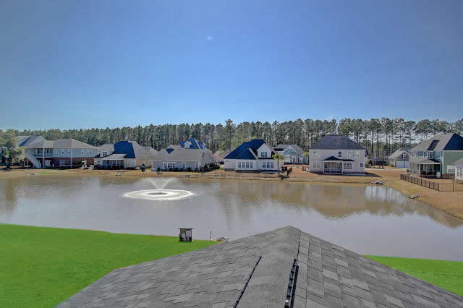
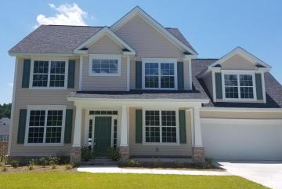
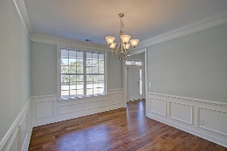
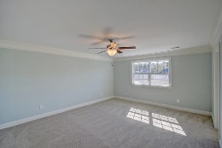
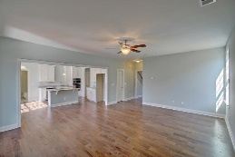
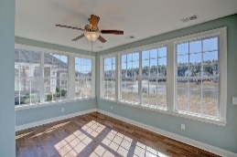
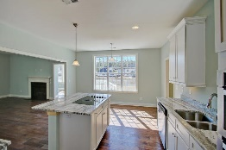

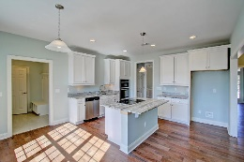
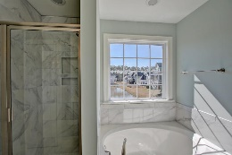
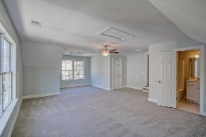
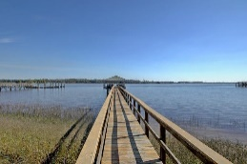
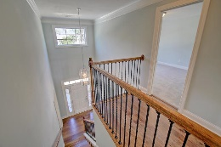
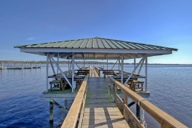


Waterfront Community With Dock On The Wando
New Construction * Lake Lot * Sunroom
1013 Jervey Point Road
River Reach Pointe ~ Wando ~ MLS# 16004532 ~ $474,900
Beautiful new construction in small enclave neighborhood with community dock & gazebo on the Wando River! Very Southern!
Brand new state of the art schools nearby & scheduled to open in 2016
Gorgeous sunny Carolina Room/sunroom overlooking sparkling lake
Great kitchen, mud room, separate Dining room & fireplace in family room
Large Master with en suite bath
4th bedroom/bonus room has private bath
Short walk to the dock for fishing, crabbing or lounging on the Wando River & salt marsh teeming with salt life!
It's the lifestyle...
Sheila Romanosky
(843) 224-0242
sromanosky@carolinaone.com

