Slide 1
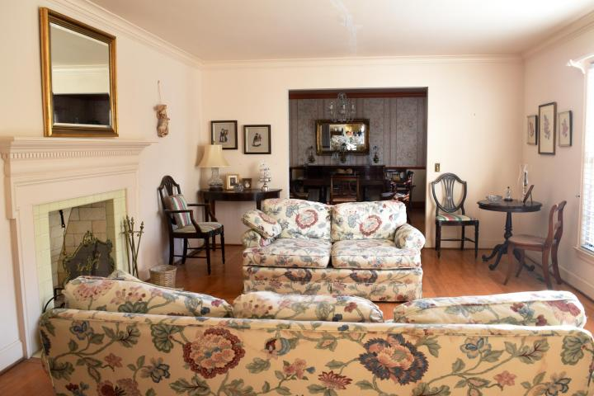
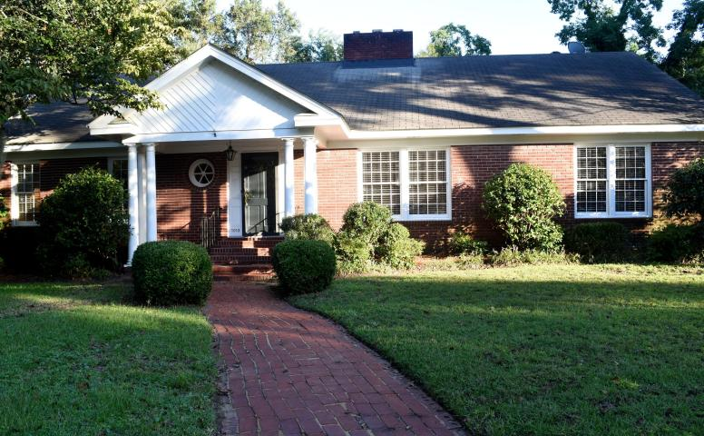
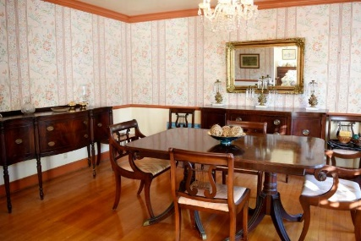
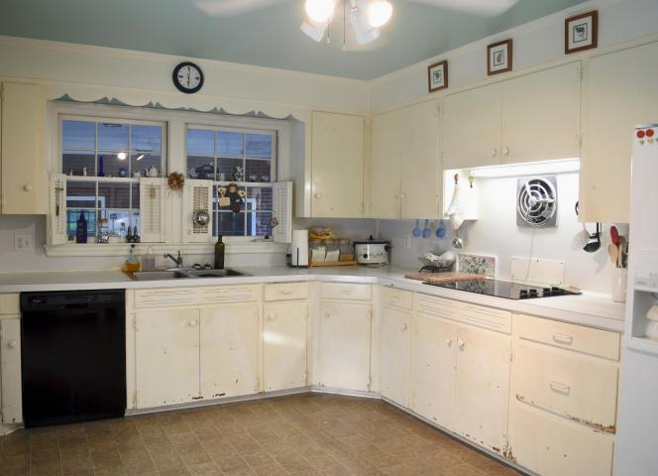
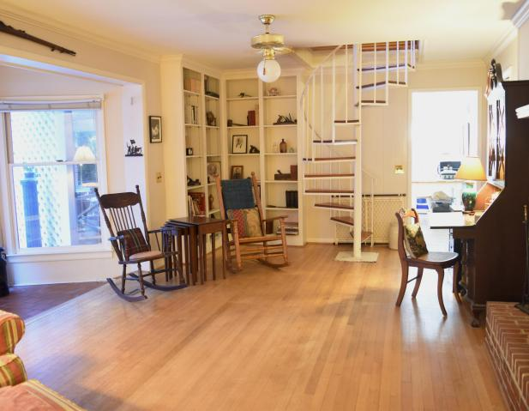
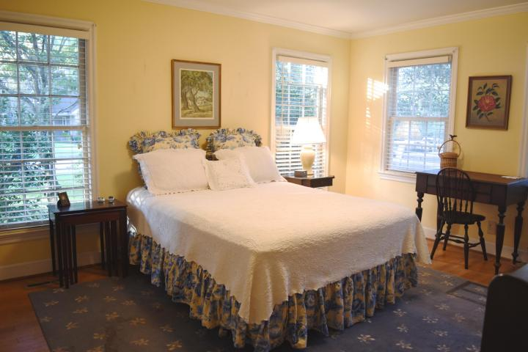
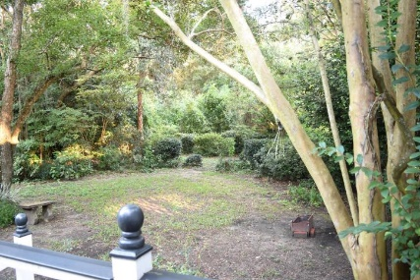
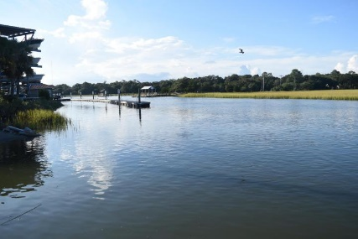


1013 S Shem Drive Shemwood ~ Mount Pleasant MLS# 16026123 ~ $629,000
Agent Open Thurs 10/13 ~ 11:30-1:00
Open House previously scheduled for 9/15/16 Has been rescheduled due to bad weather
This is your opportunity to own a 5 Bedroom/3 Bath home with a bonus room and full of real hardwood floors in Mount Pleasant's Shemwood. Shemwood is an established neighborhood with gorgeous trees that is within walking distance of the Farmers' Market, Moultrie Middle School, shopping, and restaurants. Kitchens and baths need renovation but some updates have been made to the home including a new Trane AC unit in 2011, new ductwork in 2011, new returns downstairs, new wastewater lines under home in 2011, new water line from house to street in 2013, and replacement of almost all windows in 2000. The home also has 2 wood fireplaces, sprinkler system/well, and beautifully treed backyard. Homeowner has not been required to purchase flood insurance. Home is being sold in as-is condition. Home is part of an estate but can close quickly.
Cheryll Woods-Flowers
ABR, e-Certified, SHS
(843) 442-2219
www.woodsflowers.com

