Slide 1
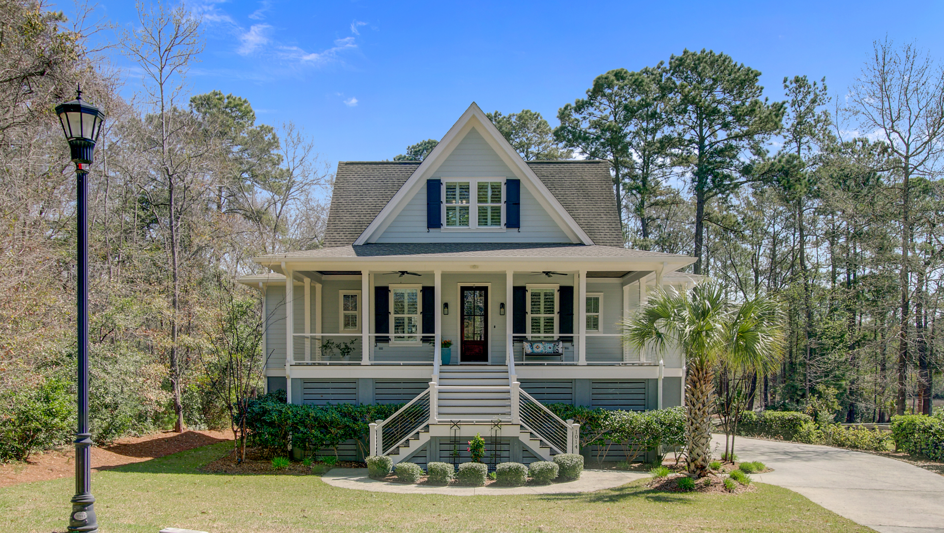


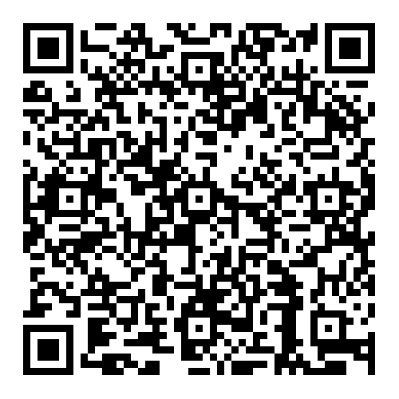

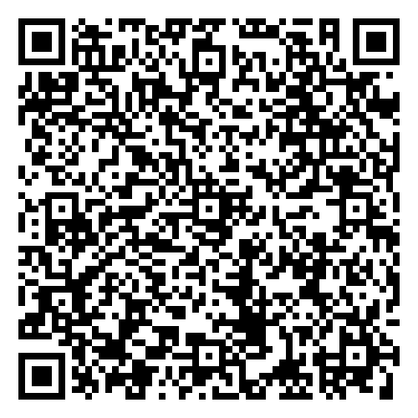

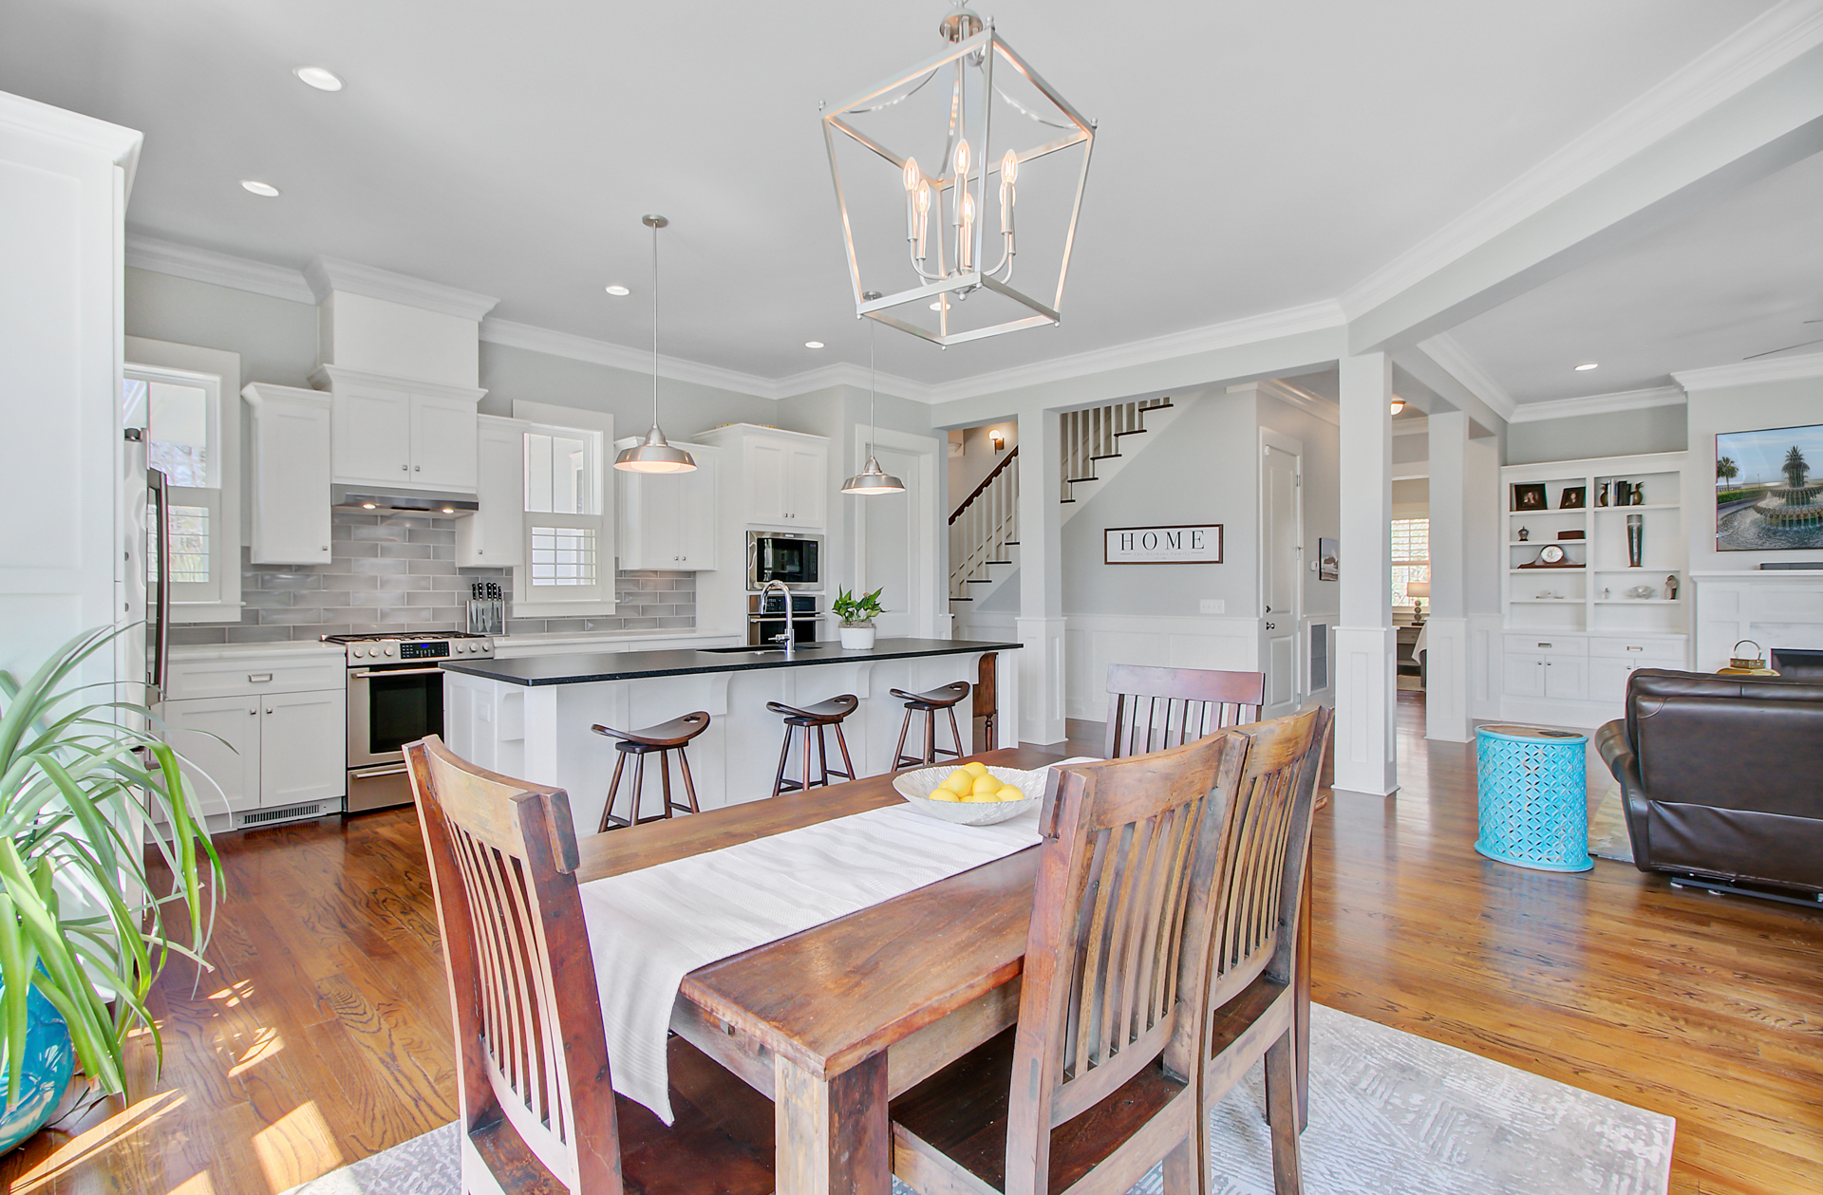
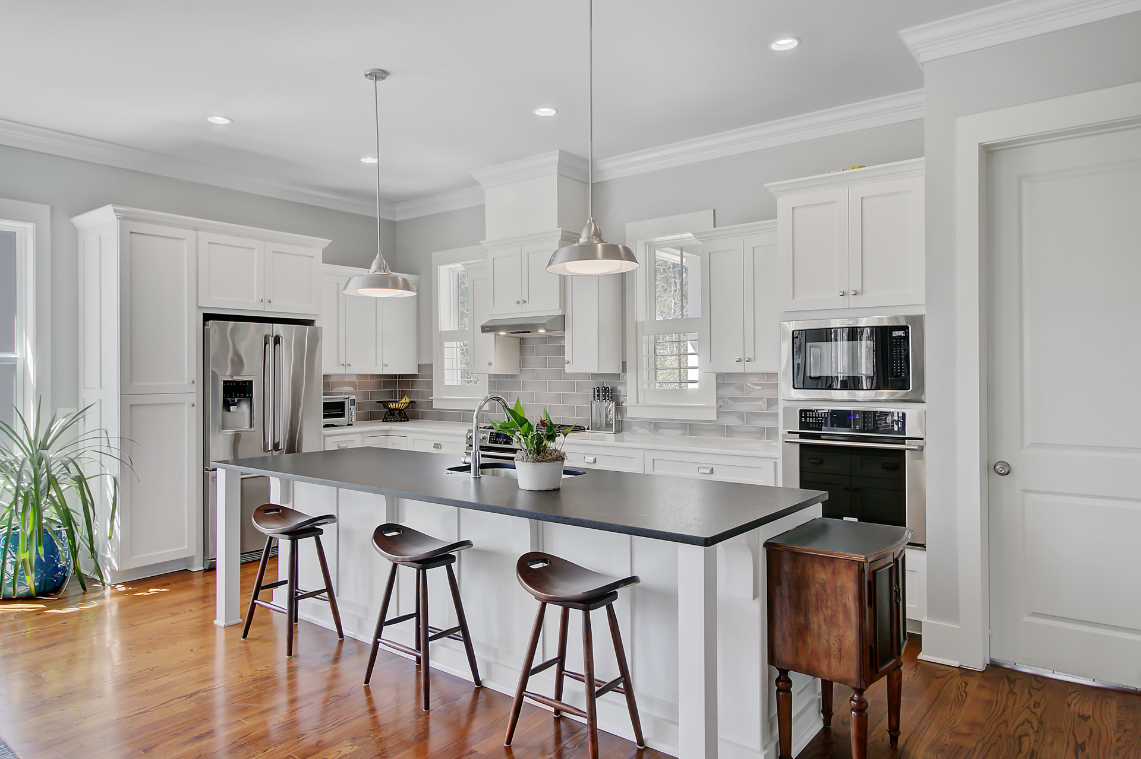
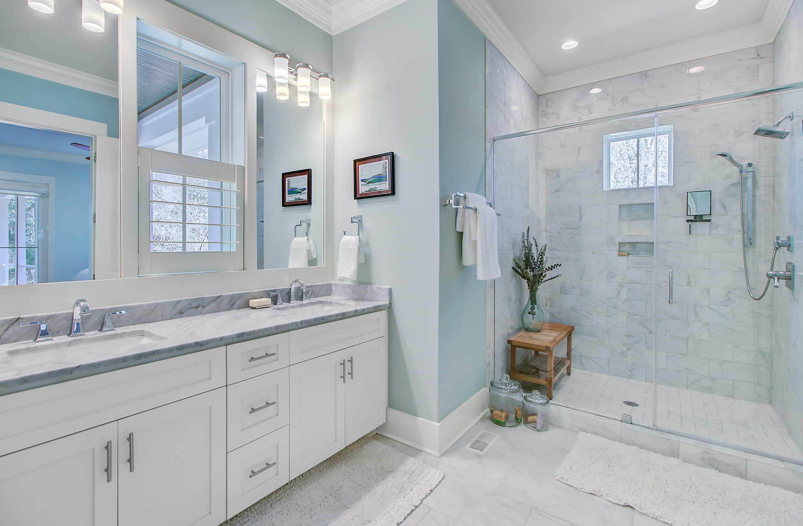
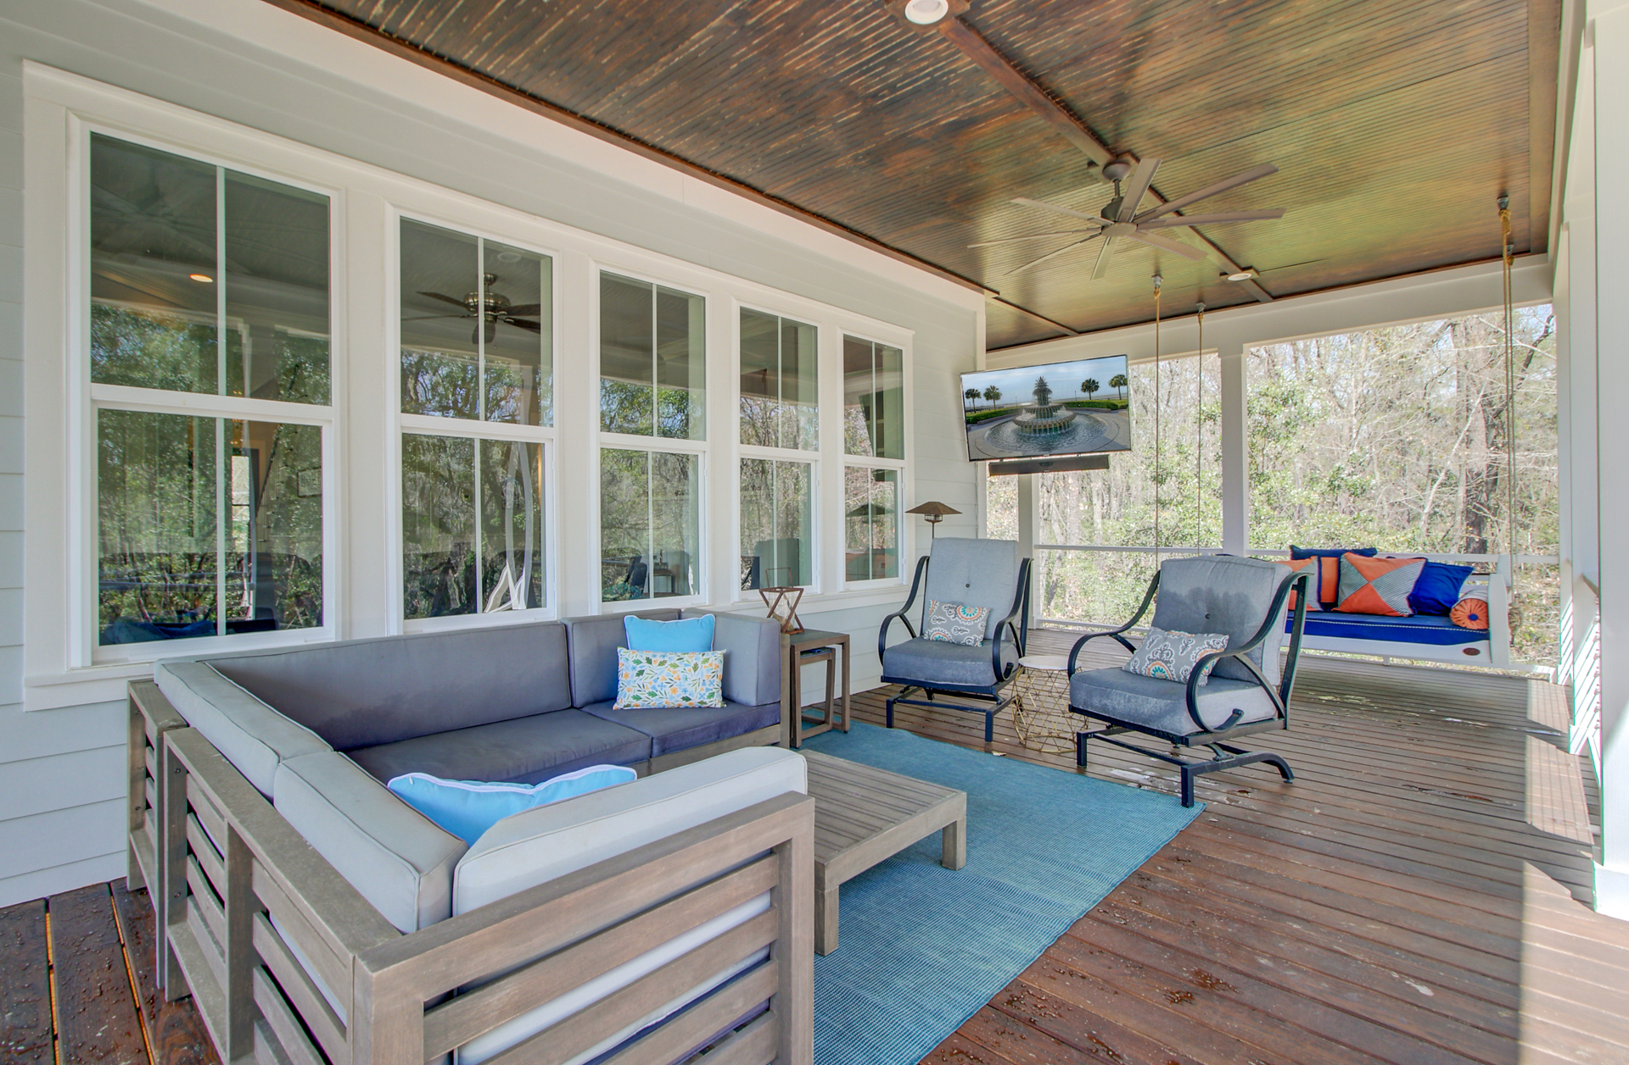
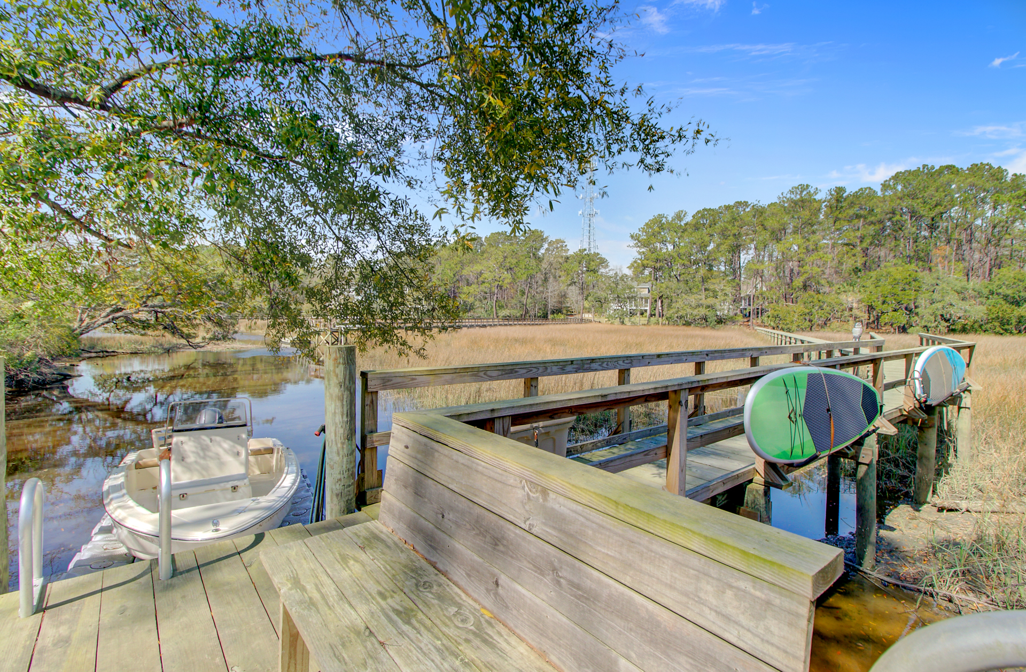



OPEN HOUSE SUNDAY 3/30 FROM 10 AM - 1 PM
1014 Bradbury Lane
Martins Creek | Charleston, SC 29492 | MLS# 25007797 | $1,395,000
Video Tour
Virtual
Tour
4 BEDROOMS | 4 ½ BATHS | 3,183 SF
SELLERS OFFERING 2% BUYER AGENT COMPENSATION
A rare find indeed. This custom built elevated home is set on 2 and 1/2 acres and has its own private dock with dock blocks in place. Meticulously maintained, this home will rival new construction while offering you the exceptionally large lot and water access so hard to find in Charleston! Every bedroom is a suite with its own full bath. The primary suite is on the main level of this open concept home and offers a spa-like retreat. Multiple porches provide the outdoor living space you crave and let you enjoy views of the expansive wooded lot and beautiful marsh. This location provides the magnificent blend of convenience and seclusion. Your slice of Charleston paradise awaits.
Video Tour
Ellen O'Neil
Broker/Owner, ABR, e-PRO, CNE
Charleston Realtor of Distinction
843-300-8530
www.EllenONeilProperties.com

