Slide 1
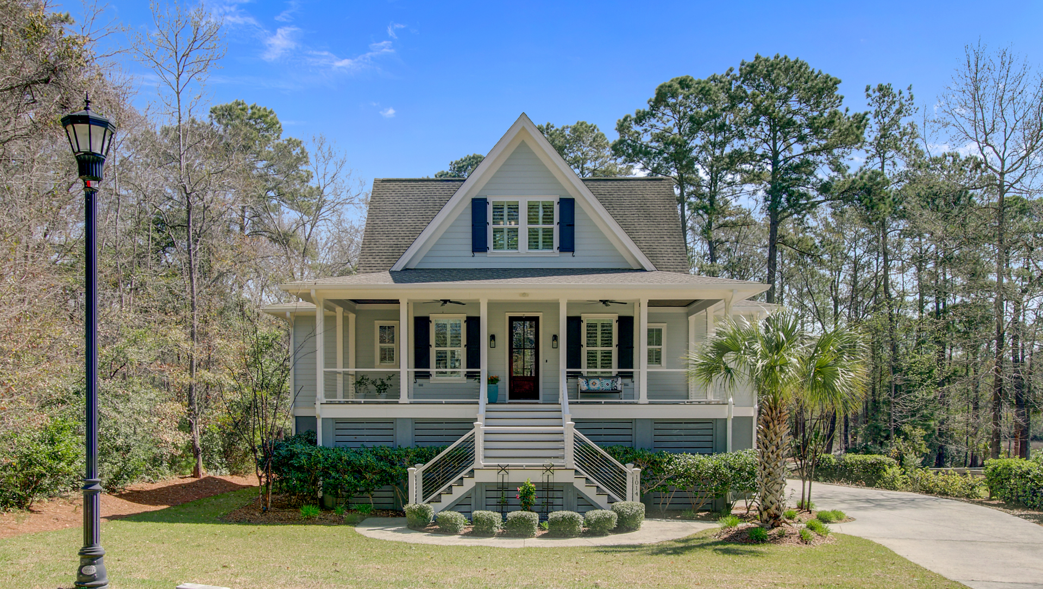






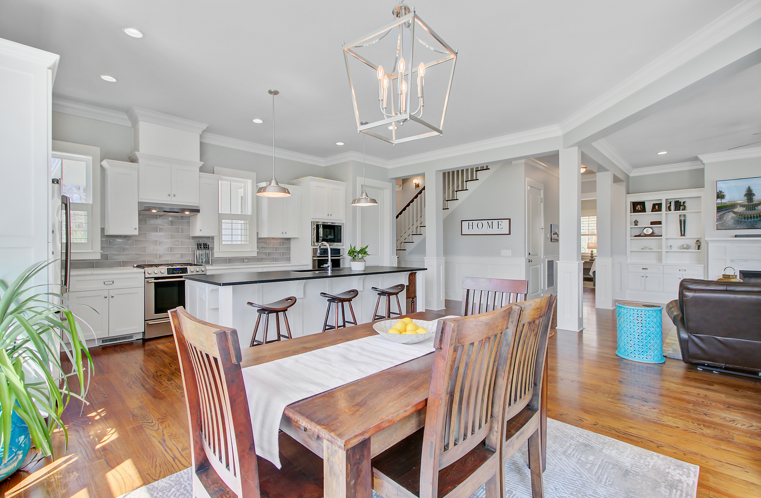
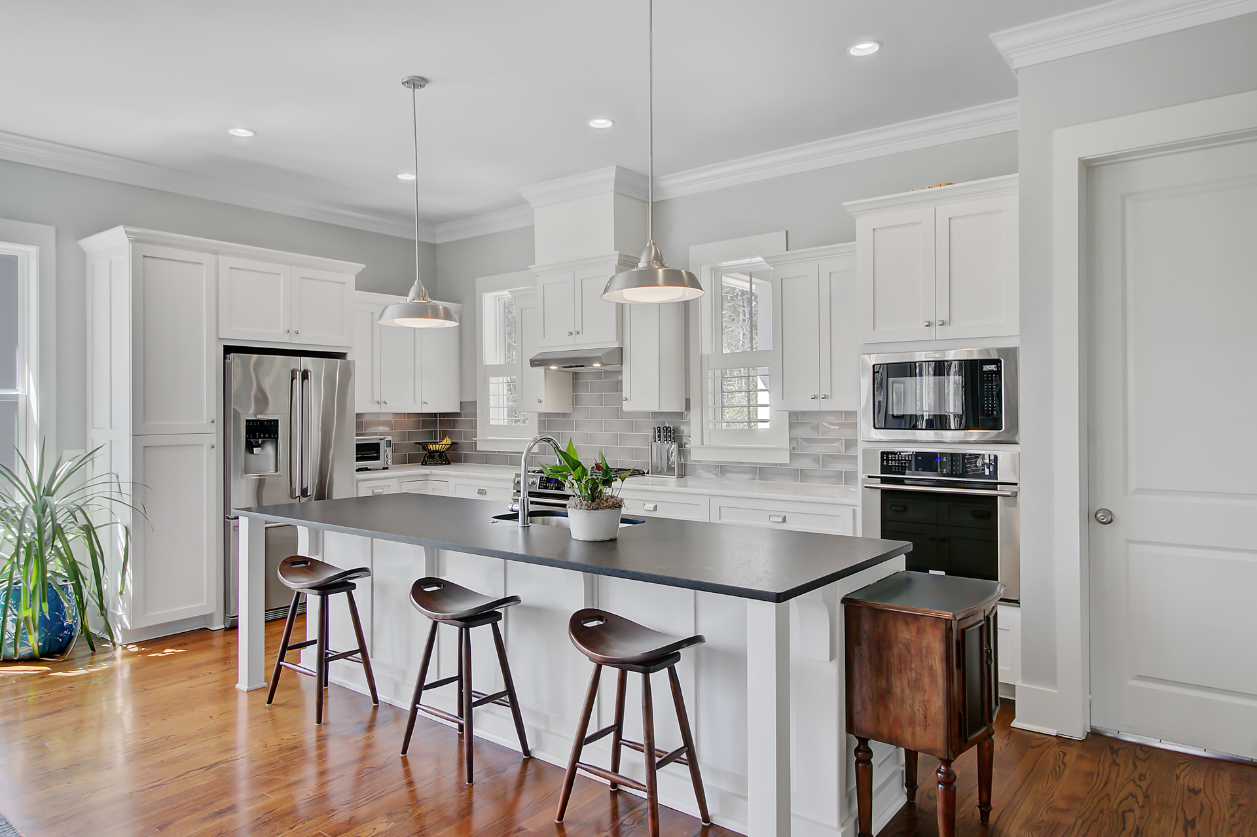
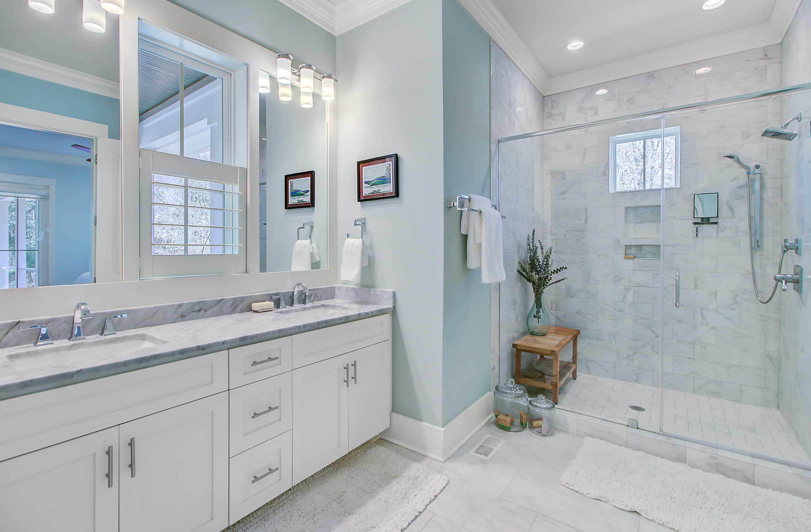
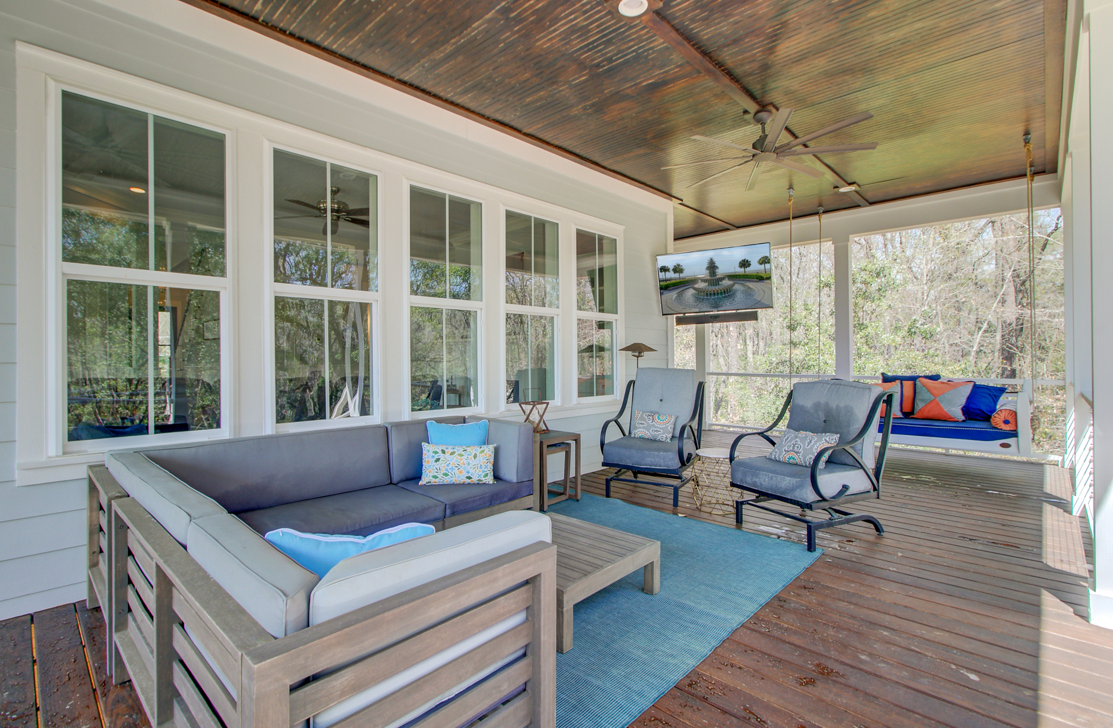
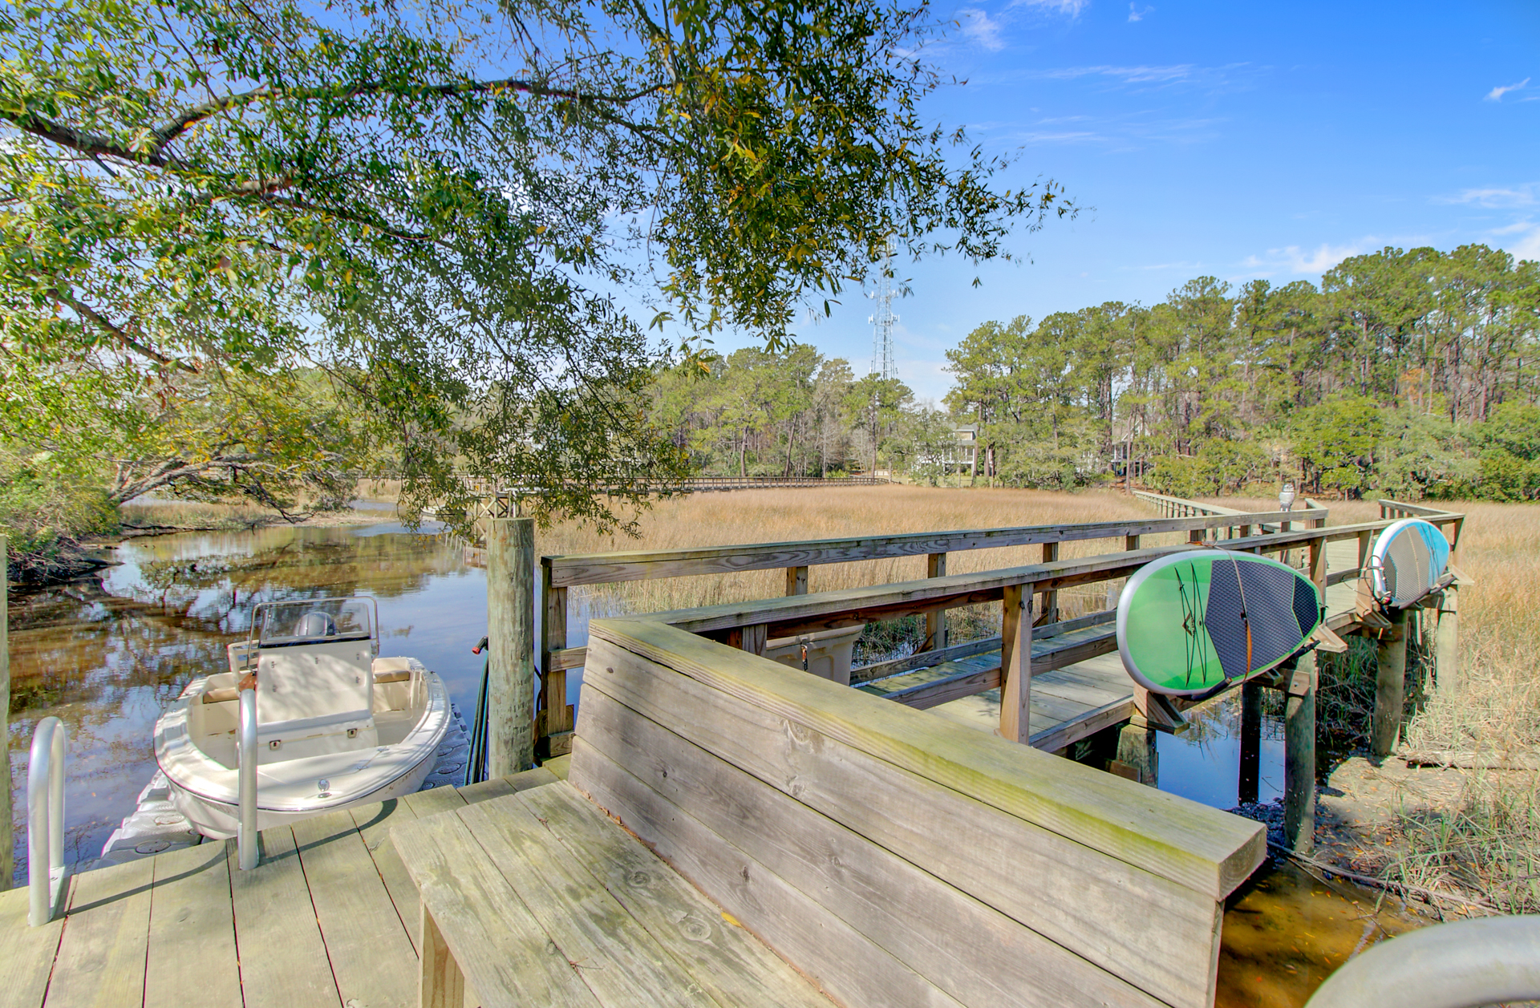



PRICE REDUCED! WATERFRONT ESTATE WITH PRIVATE DOCK
1014 Bradbury Lane
Martins Creek | Charleston, SC 29492 | MLS# 25007797 | $1,360,000
Video Tour
Virtual Tour
4 BEDROOMS | 4 ½ BATHS | 3,183 SF
SELLERS OFFERING BUYER AGENT COMPENSATION
Now offered at a reduced price, this custom-built Charleston retreat sits on 2.5 acres with its own private dock! Featuring 4 bedroom suites, an open floor plan, chef’s kitchen, multiple porches, and serene marsh views—this home is the perfect blend of luxury, privacy, and Lowcountry living. Schedule your showing today before this rare opportunity is gone!
Video Tour | Storybook
Ellen O'Neil
Broker/Owner, ABR, e-PRO, CNE
Charleston Realtor of Distinction
843-300-8530
www.EllenONeilProperties.com

