Slide 1
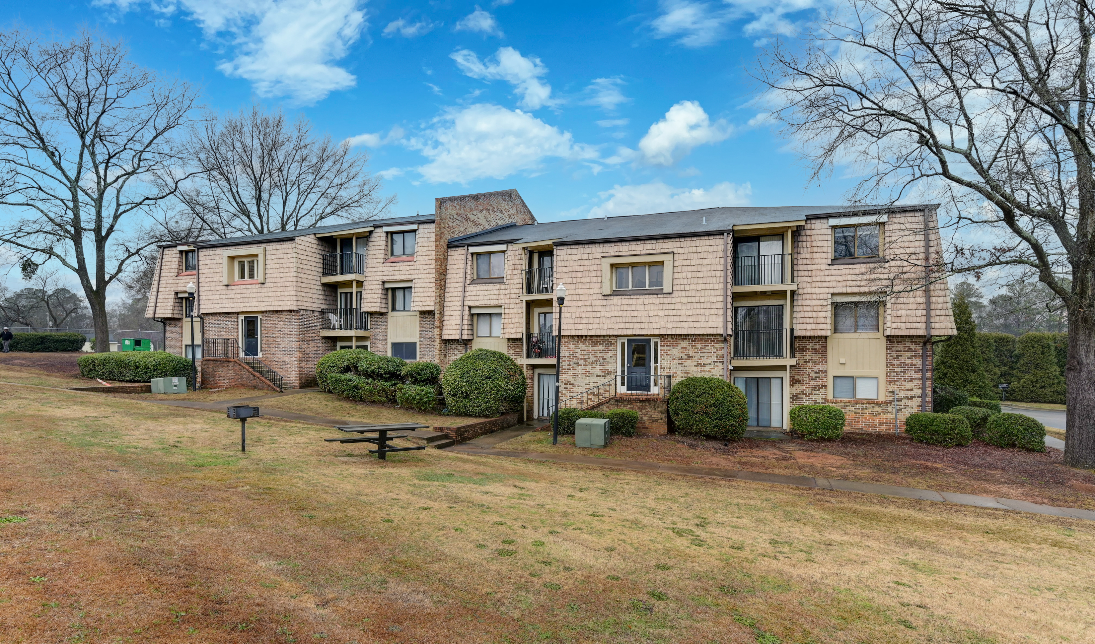
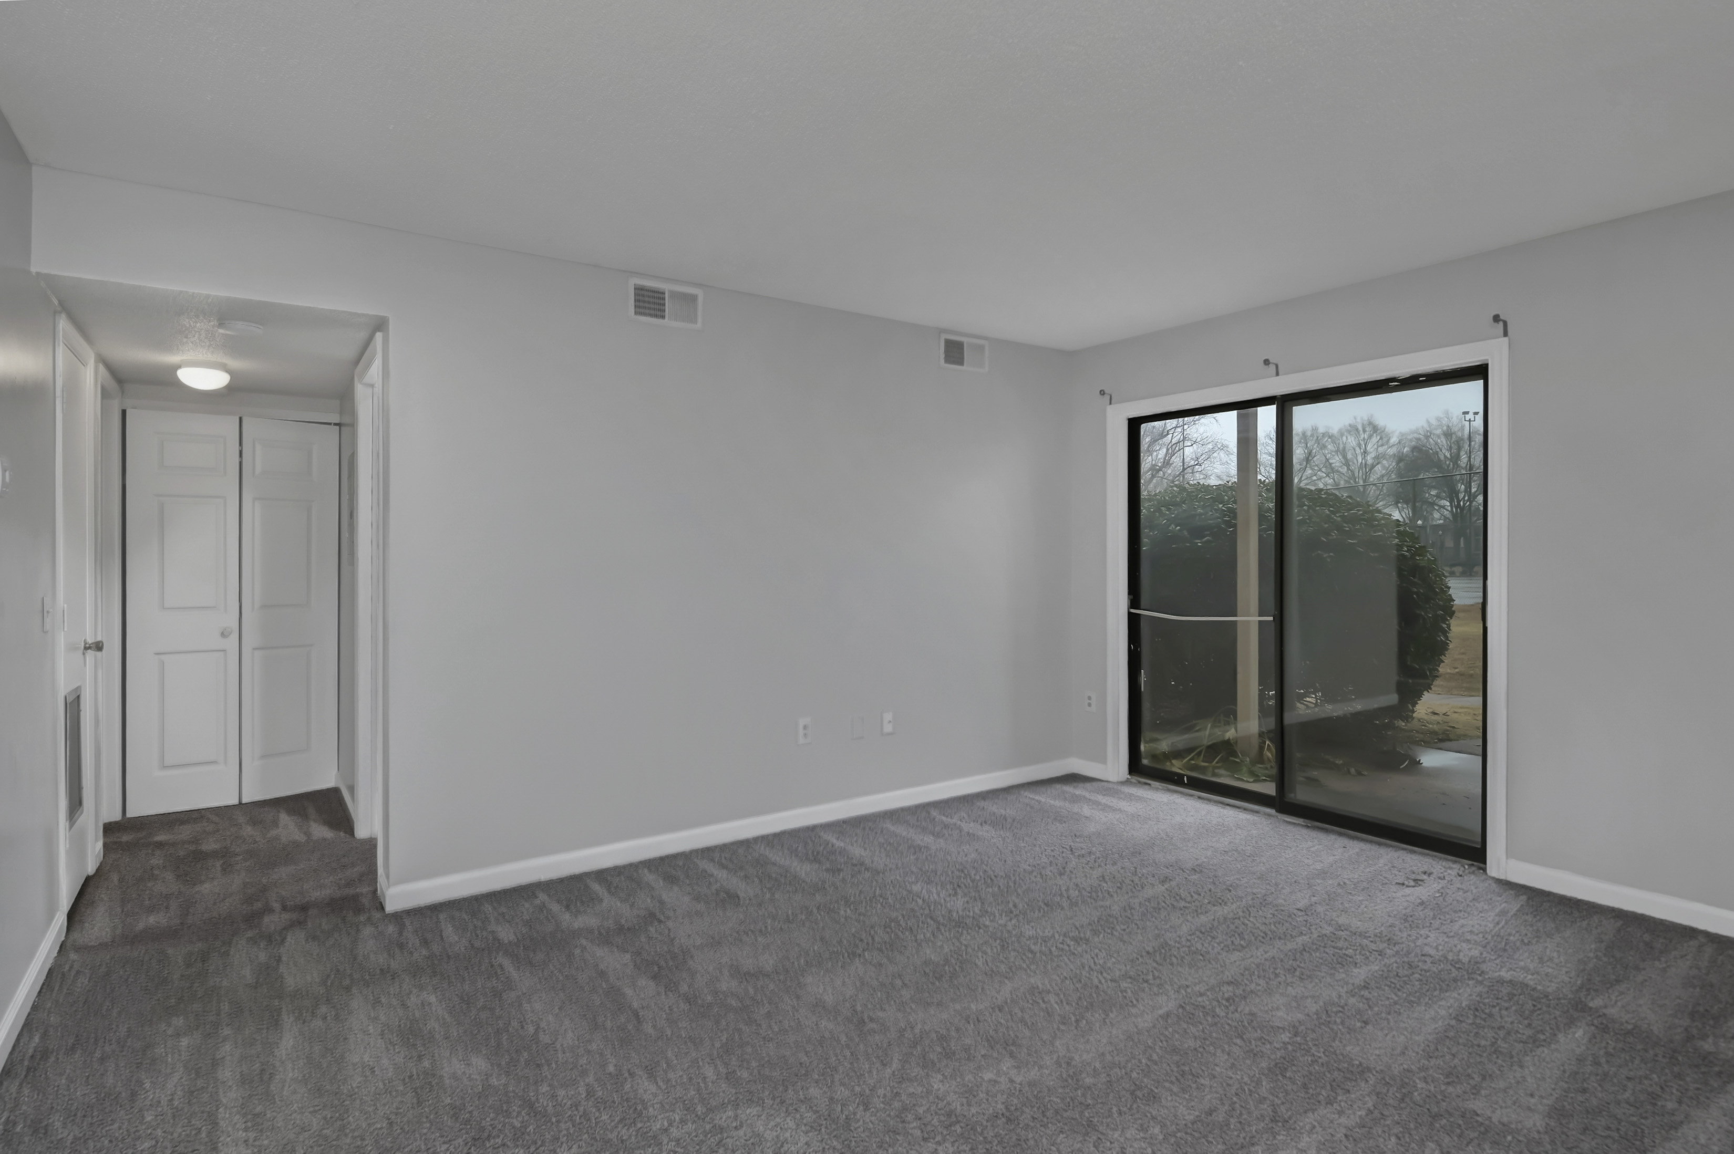
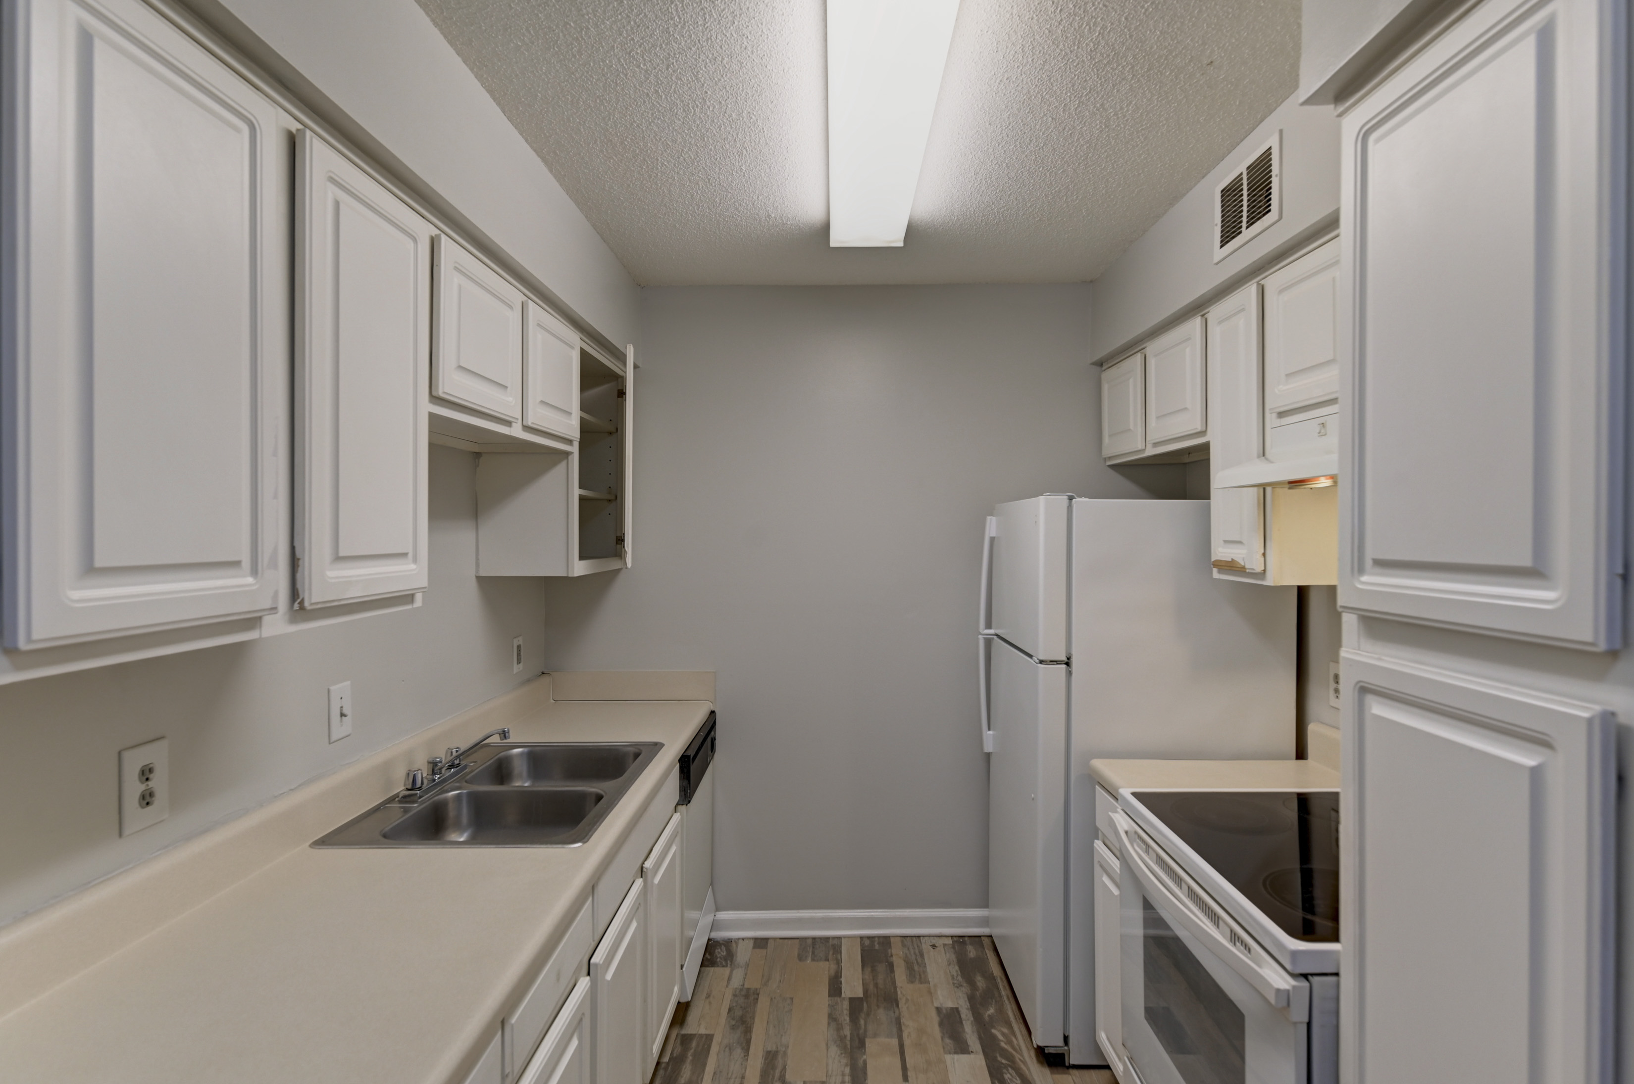
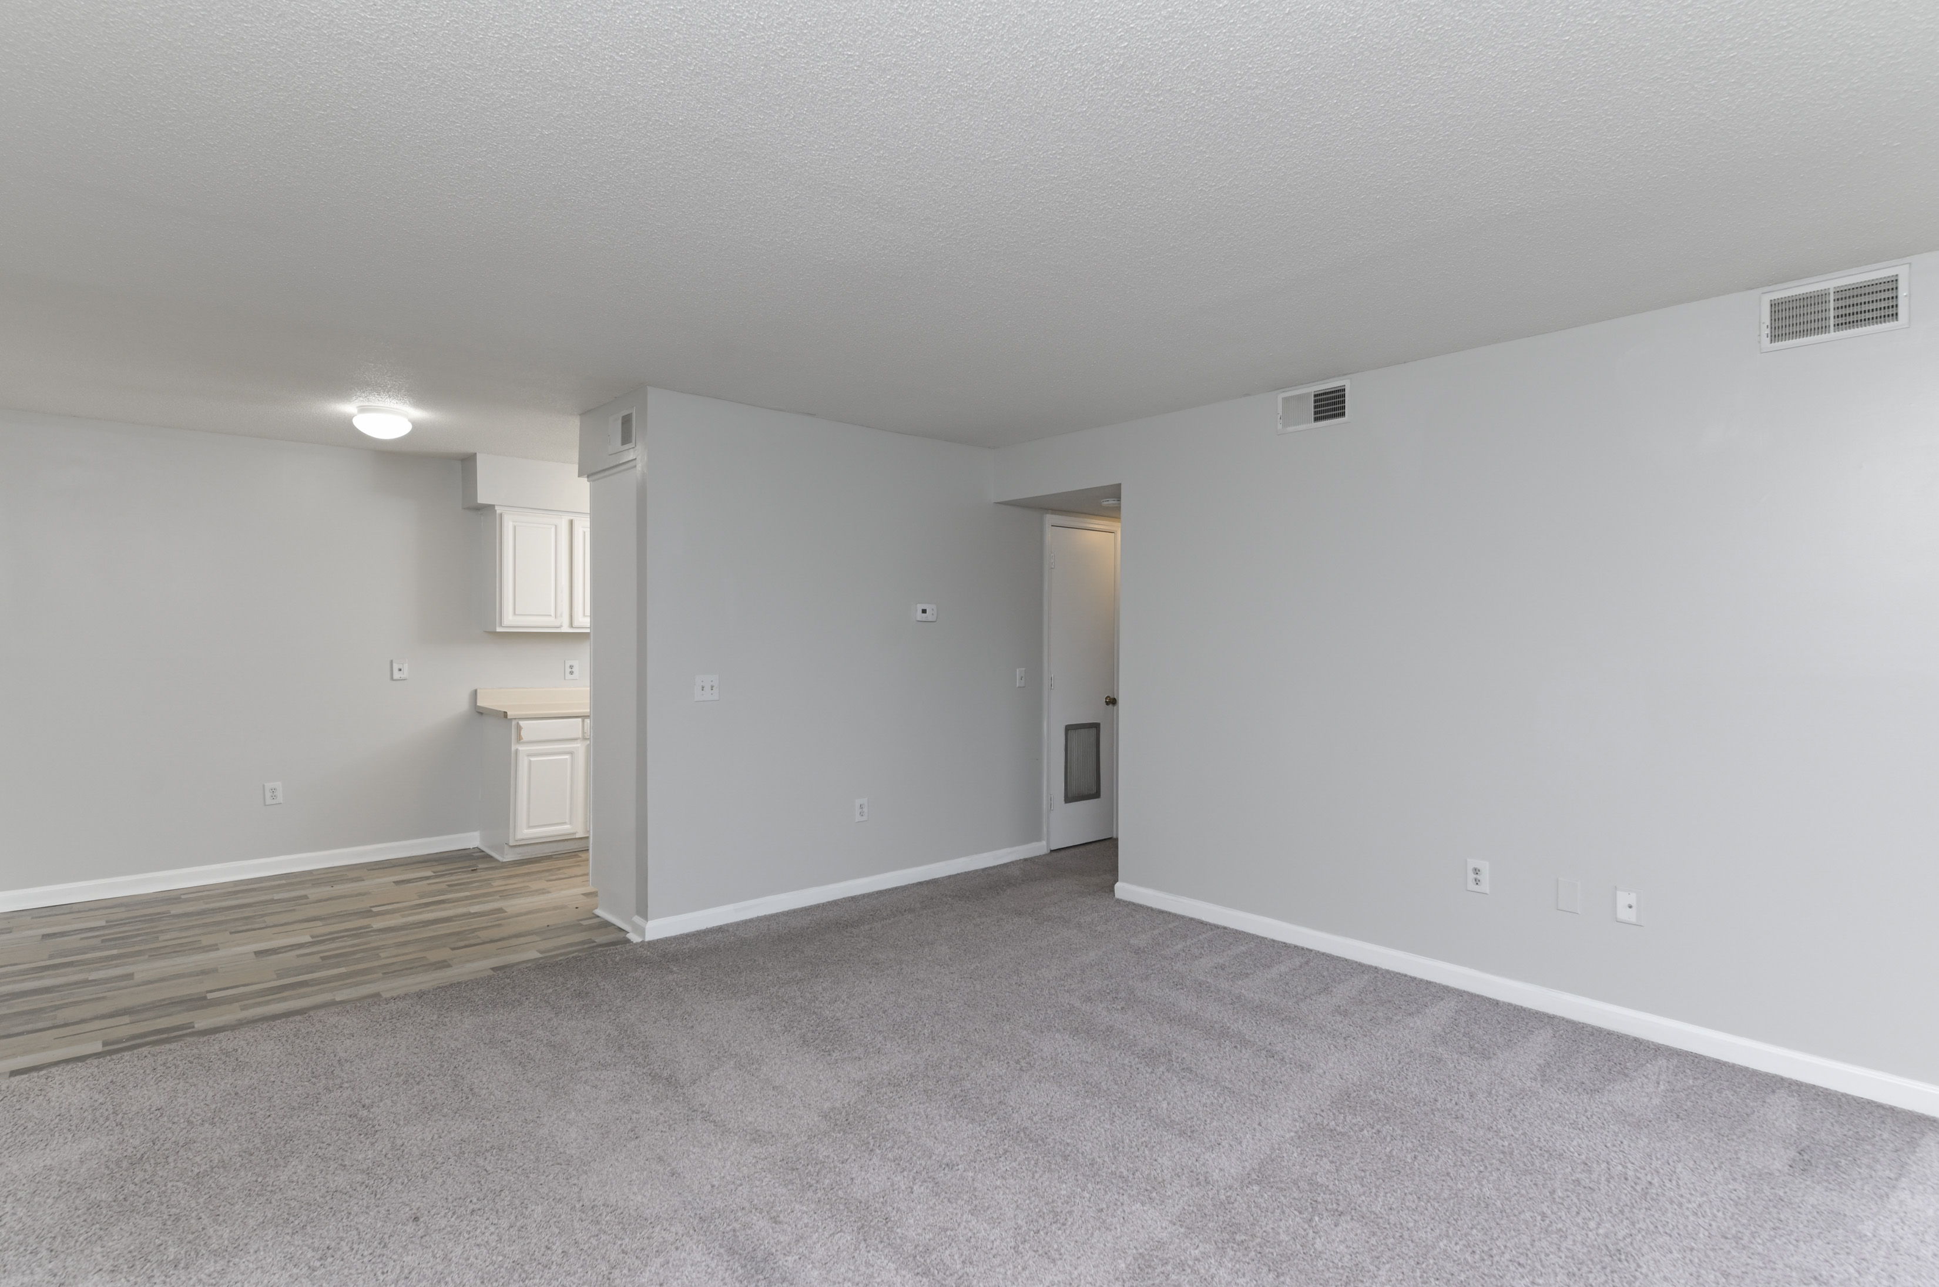
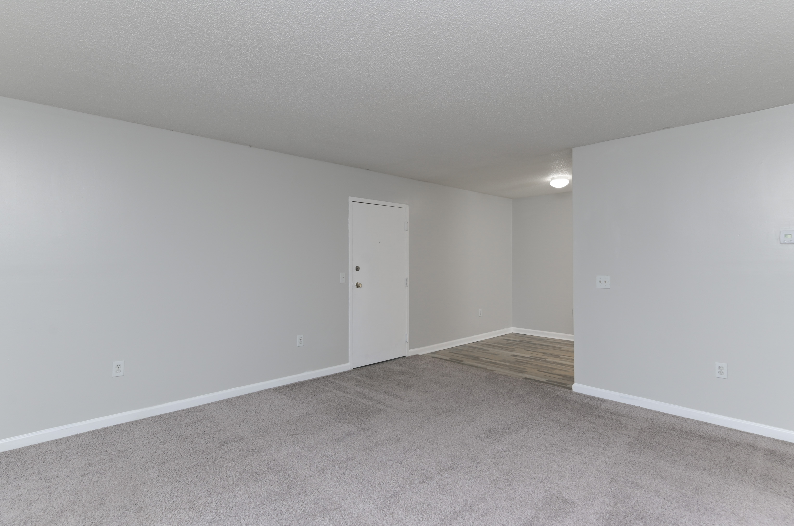
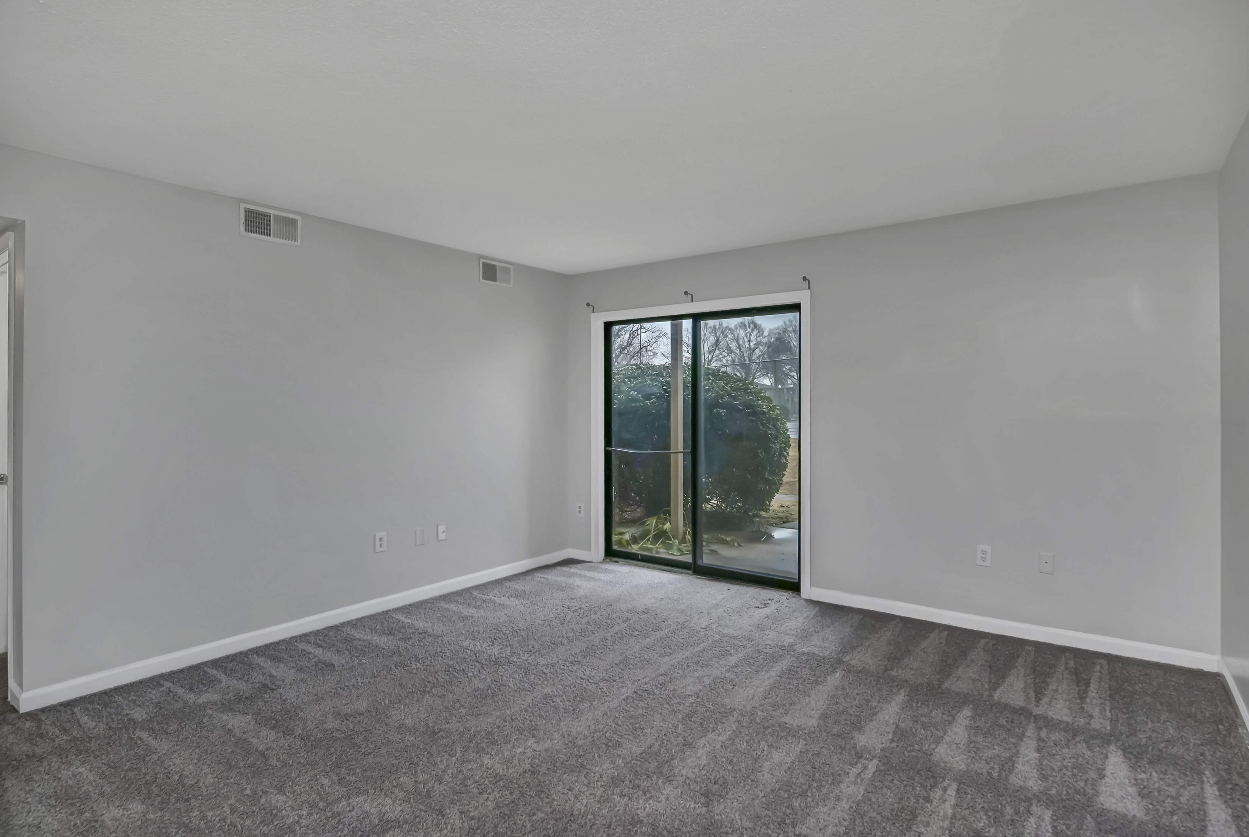
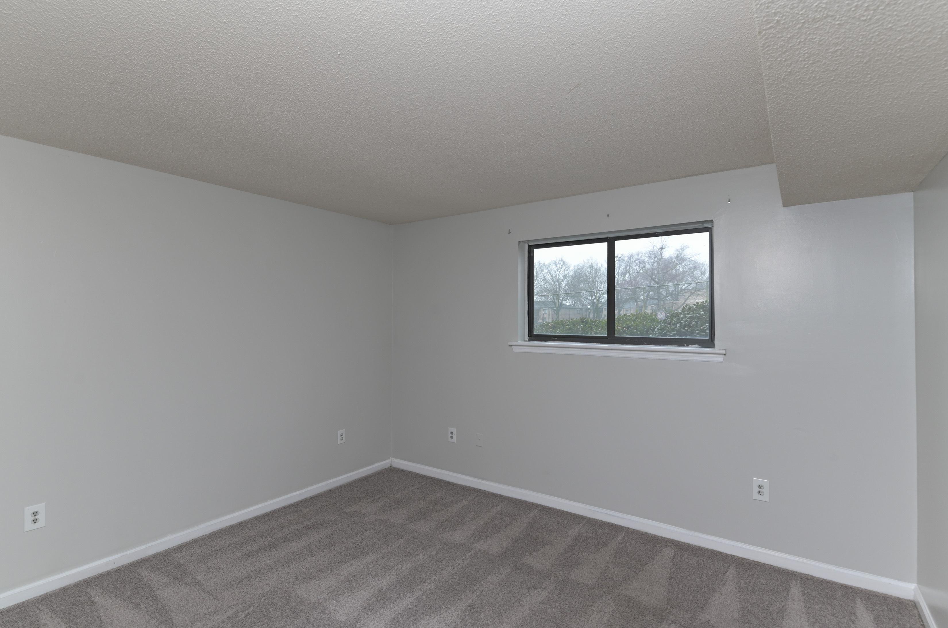
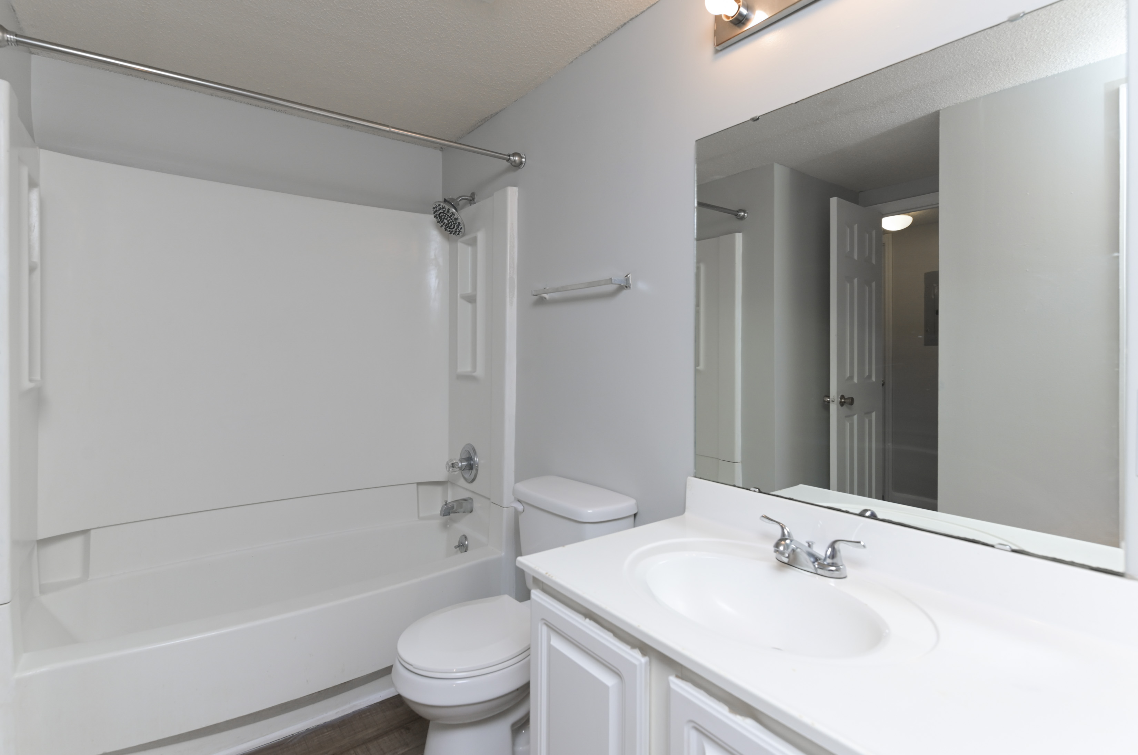



Open House Wednesday January 31st from 12-2pm
1015 Old Manor Road
Briargate | Columbia, SC 29210 | MLS# 577860 | $55,000
Welcome to your new home! This inviting 1 bedroom, 1 bath condo is situated in a secure gated community, offering a lifestyle of convenience and comfort. Prime Investment Opportunity Attention Investors! Seize the chance to add this exceptional move-in ready condo to your portfolio. Nestled in a sought-after gated community, this 1 bedroom, 1 bath gem offers an array of features designed for lucrative returns. Key Investment Highlights: Strategic Location: Positioned just minutes from I20, I26, downtown Columbia, USC, Benedict, and Allen campuses, this condo is in a prime location for attracting tenants from various demographics. Amenities Galore: The gated community provides an enticing package with two pools, a 24-hour fitness center, and a media center, ensuring high desirability for potential renters. Spacious 1st Floor Unit: This well-maintained condo boasts a 1st-floor location, featuring a generously sized living room that seamlessly extends to an outdoor patio ideal for tenants seeking comfort and convenience. Versatile Rental Potential: Suitable for various rental strategies, whether targeting long-term tenants, short-term rentals, or student housing. The HOA fee covers water, sewer, trash, pest control, all exterior maintenance, grounds, landscaping, onsite management. and insurance on the structure of the building, ensuring predictable expenses for savvy investors.
Charlise Mills
470-799-7175
charlise@chatmanrealty.com
thechatmangroupsc.com
Keller Williams Realty Charleston West Ashley
1180 Sam Rittenberg Ste 300
Charleston, SC 29407

