Slide 1
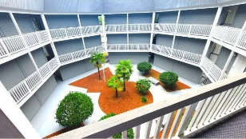
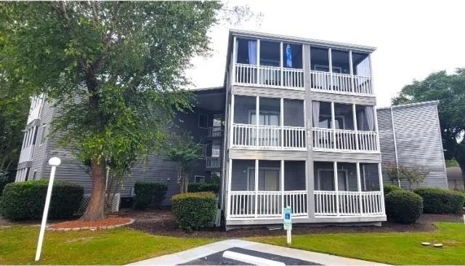
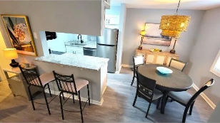
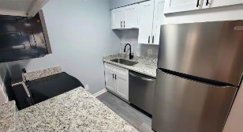
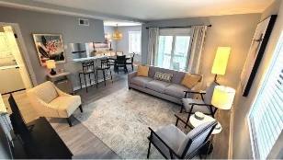
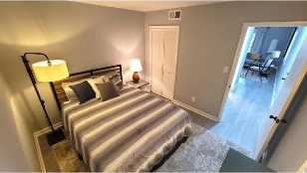
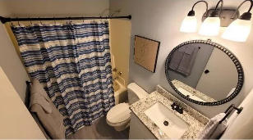
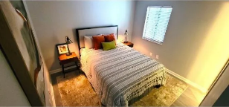
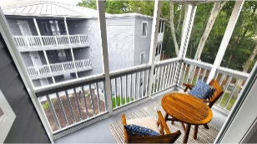
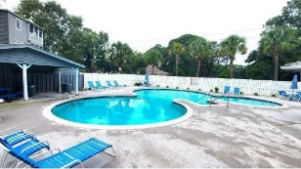
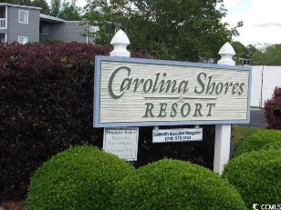


Completely Redone And Is Being Sold Turnkey Furnished
10166 Beach Drive
Carolina Shores Resort | Calabash, NC 28467 | MLS# 2422322 | $189,777
Where in Calabash can you find a WELL-LOCATED CONDO that is as pristine or thoughtful? This unit is unbelievably completely redone and is being sold TURNKEY FURNISHED! Truly, what you see is what you get, magnificent, never slept in but even fresh linens and towels are provided! So classy, paint is a soft gray with crisp white trim and with a new laminate matching floor throughout. So smart for the beach! The popcorn ceiling, likewise, has been removed. Everything is new or refreshed: Water heater, washer/dryer full-sized stack-able, sinks and counter tops/vanities, screens, receptacles, fixtures, and window covers. Did we say granite -- top of the line pattern throughout along with designer furniture throughout, too. You really need to see how this professionally decorated condo is so perfect in every way, including area rugs, furniture and linens, artwork and accessories. Accordingly, welcome to the charming condominium neighborhood of Carolina Shores Resort in the enchanting fishing town of Calabash NC, fondly known as the Seafood Capital of the World. But it is so much more, a small-town treasure trove of meandering streets full of culinary delights; crafts, singular beautiful artwork and seasonal destination shopping; antiquing trails, lovely residential homes and much more, all creativity showcasing vibrant stories of this coastal gem -- then and now! So, whether you're hitting the lush greens of a nearby renown golf course, setting sail for a fishing expedition, or simply enjoying a leisurely stroll along the picturesque river front with stops at the bars and restaurants, there's something here for everyone. This unexpectedly perfect condo is the frosting on the Calabash seafood. Architecturally pleasing Carolina Shores Resort has been the historic gateway to Calabash as it is right on the corner of Country Club Dr and Beach Dr SW.
Connie Ross
702-306-2643
conniesross@aol.com
www.donovanrealestate.biz
Donovan Realty, LLC
7485 Balmore Drive | Sunset Beach, NC 28468

