Slide 1

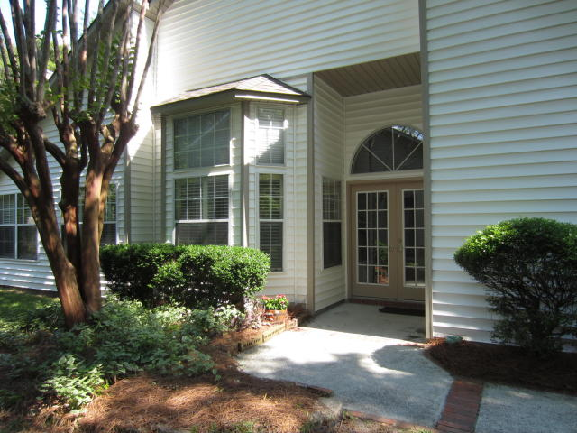
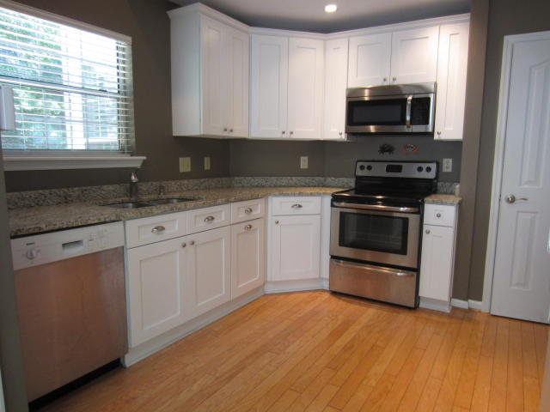
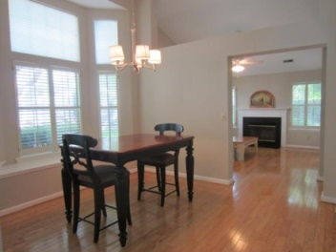
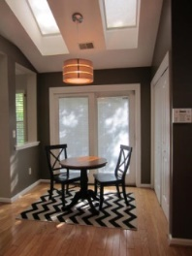
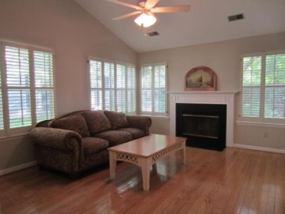
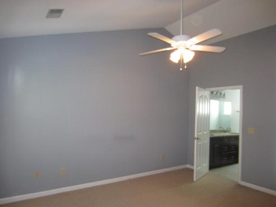
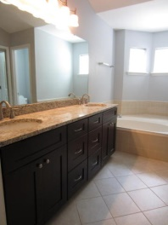
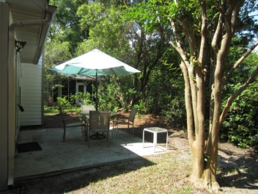

LOCATION! & RENOVATED!
1016 Provincial Circle
Patriots Province · Mount Pleasant, SC 29464 · MLS# 15011821 · $362,000
Houses in this nbhd are Hard to Come By. Close to Downtown & the Beach. Walk to Shops & Movies! Reno includes Smooth Ceilings, New Kit & Bth Cabinets, Granite Cntps, S/S Appl, Brushed Nckl Dr Hardware, New Tile Floors in Bths, & New HW Htr.
Sep FDR + EIK with Bosch D/W has Pella Sliding Glass Door that opens to Rear Patio & Nice Size Yard. Lots of Hdwd Floors, Wood Burning Frplc, Plantation Shutters, 2 Car Gar,
There is a neighborhood Pool, Tennis Courts, and Boat Storage AND the grounds and yards of the neighborhood are taken care of as part of the regime fee. The regime fee ALSO COVERS maintenance of the exterior and roofs of the houses, common areas, AND BUILDING INSURANCE!
Owner is responsible for an interior insurance policy. Owner/Agent is a Licensed SC Realtor.
Carroll Realty Inc.
103 Palm Blvd
Isle of Palms, SC 29451
1-800-845-7718
Laurie Langford
Mobile 843-224-8522
realestatecharleston@hotmail.com

