Slide 1
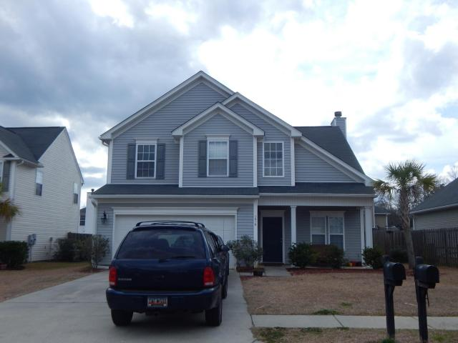
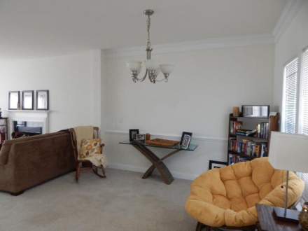
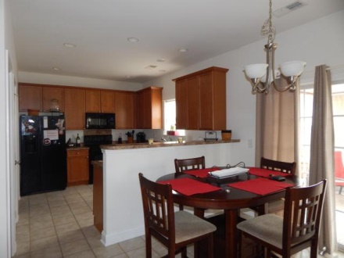
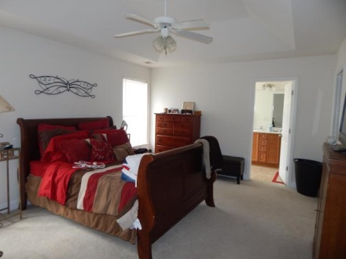
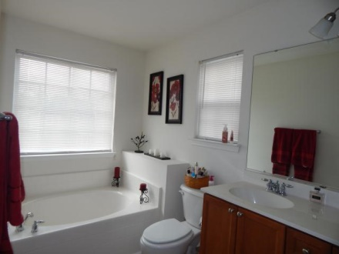
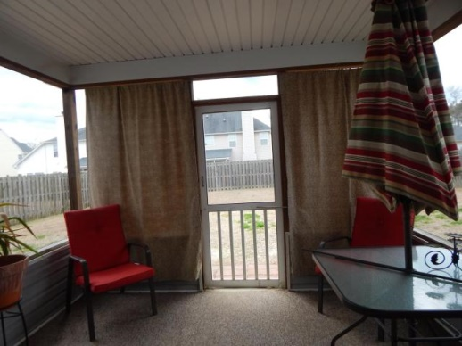
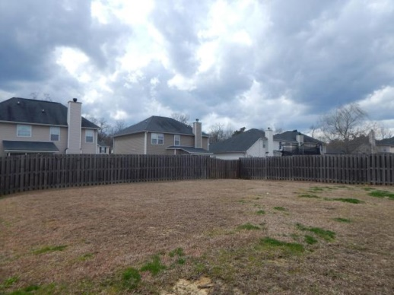
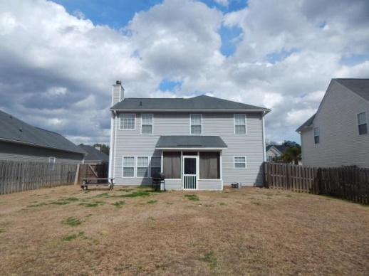
Investors! Perfect buying opportunity
1016 Sterling Lane
Glen at Summerset
Summerville
MLS# 15005698
$175,000
Amazing Floor Plan with plenty of space. Home opens up with a large ceramic tiled foyer and formal dining room. Living room offers fireplace and is open to the kitchen. HUGE kitchen with lots of cabinet space and a built in work station. Kitchen also has ceramic tile. Large Laundry room downstairs. Upstairs you will find three very spacious secondary bedrooms and a large master bedroom with tray ceilings. The master bedroom has a good size walk in closet and also offers easy access attic storage thru a full size door. Master Bathroom has his and her sinks, a garden tub and stand up shower. Enjoy your time on the full front porch or beautiful screen porch. Back yard has a 6 foot privacy fence, great for entertaining.
Jennifer Laffey-Foster, MRP
Real Estate Agent
Miler Properties
Office: 843-821-1111
Cell: 843-708-1582
jlfoster86@gmail.com
www.milerproperties.com

