Slide 1


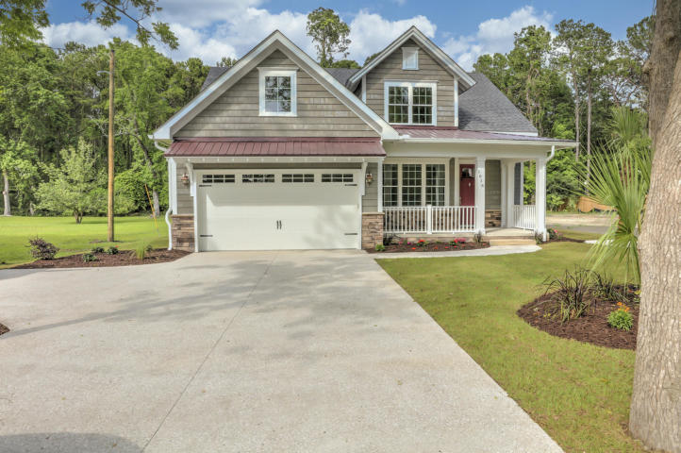
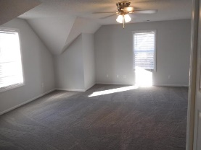
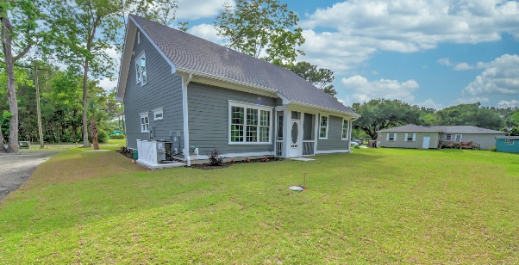
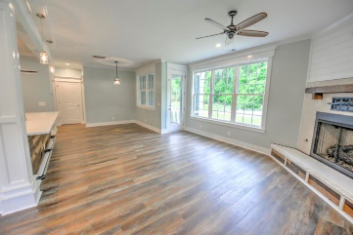
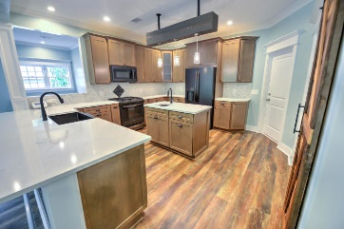
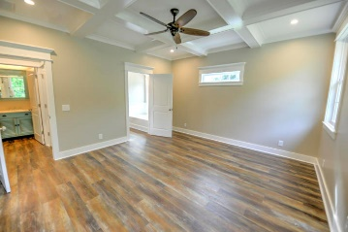
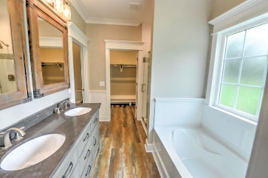
Kim Katich
(843) 754-8060
kimsellschs@gmail.com
Open House Saturday 12-2
No HOA No Flood Insurance
1016 Theodore Road
Beehive Plantation
Awendaw, SC 29429
MLS# 20014065
$479,900
STUNNING HOME BUILT CUSTOM HOME WITH QUALITY AND CHARACTER with approx $60K plus in upgrades (from coffered ceilings, wainscoting, board and batten trim, sliding barn doors, and a custom hickory staircase... this home is loaded with extra details you will not find in many homes)! No HOA and NO FLOOD INSURANCE and just minutes away from restaurants, shopping and beaches. From the moment you step inside this lovely lowcountry home, you will find that the open floor plan flows well for entertaining yet is poised to easily handle the demands of everyday life. The kitchen features shaker style custom cabinets, quartz countertops, a gas range, a beautiful black farmhouse sink to match the black slate appliances and tile backsplash. The adjoining family room showcases a cozy gas fireplace complete with shiplap and a reclaimed wood mantle out of a farmhouse in Edisto from over 150 years ago. The family room looks out to the large back yard that butts up the Sewee Preserve.
The master suite is conveniently located on the main level, as well. The master bedroom features a gorgeous coffered ceiling. Don't miss the beautiful spa like bath with separate tub and tiled shower and walk in closet! You will also find a nice sized laundry room and a powder room located on the first floor as well as an office/media room and a computer nook.
As you make your way upstairs you will find two more spacious bedrooms, and a full bath. There is also a huge bonus room approx. 23x16 that is finished and would be a great game room, second living room area or even a huge 4th bedroom. The storage space throughout this home is quite impressive, as well.
Enjoy the outdoors on the screened-in back porch! What a wonderful place to drink your morning coffee or evening cocktail!
Seller is a licensed Real Estate Agent
Real Estate Advocates LC
7613 Hwy 544 | Myrtle Beach, SC 29588
www.realestateadvocates.com

