Slide 1
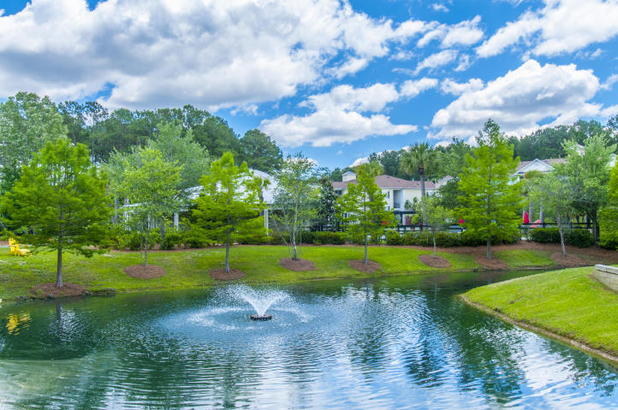
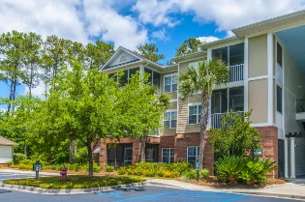
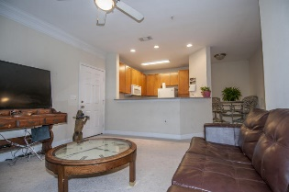
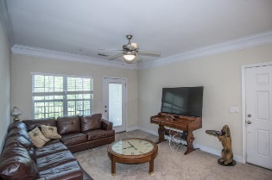
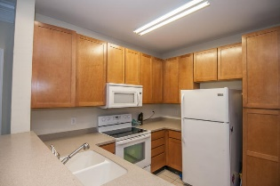
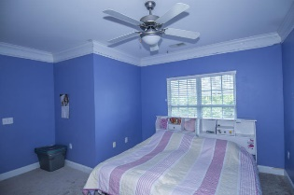
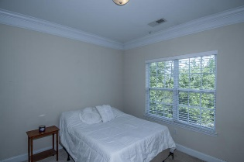
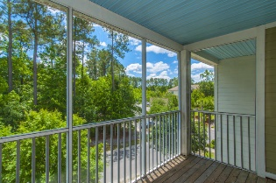
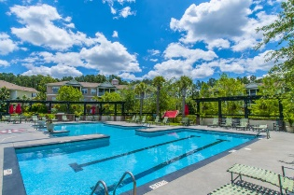


1019 Basildon Road
Mount Pleasant ~ MLS# 16012341
JUST REDUCED TO $179,900 IN PARK WEST!
Third floor end-unit with a garage and an elevator!
Condo with GARAGE AND ELEVATOR in this gated community with it's own pool! Great 3rd floor 2 bedroom, 2 bath condo! All new carpets throughout the condo as you walk into the family room that is open to the kitchen and breakfast nook. Walk out to the private screened-in porch. Master suite, secondary bedroom and full bath at the back of the unit. Garage is just down the elevator to the right (#1000E, approx. 11'x22') which offers great storage space or a home for your car! (Only 25% of the units here have garages as part of the property.)
Kristin Schatmeyer
Cell - (843) 697-7370
kristin.schatmeyer@carolinaone.com
www.KristinSchatmeyer.com
Carolina One Real Estate
2713 Highway 17 North
Mt. Pleasant, SC 29466

