Slide 1
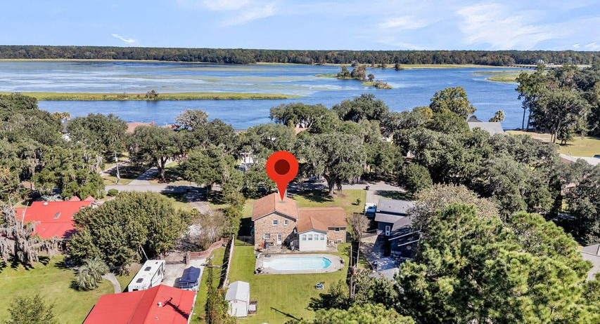
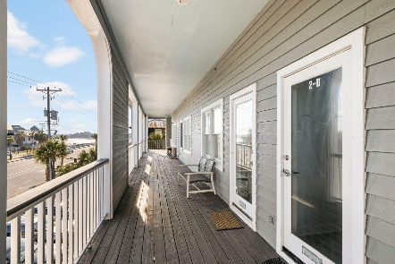
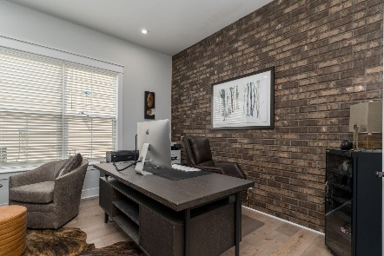
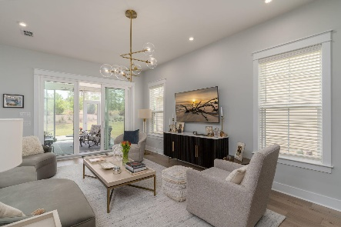

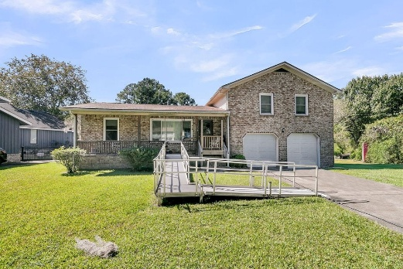
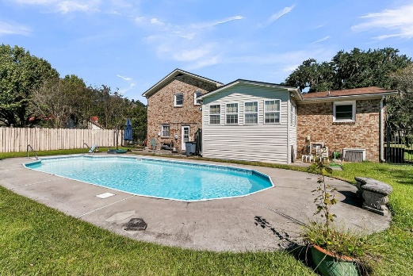
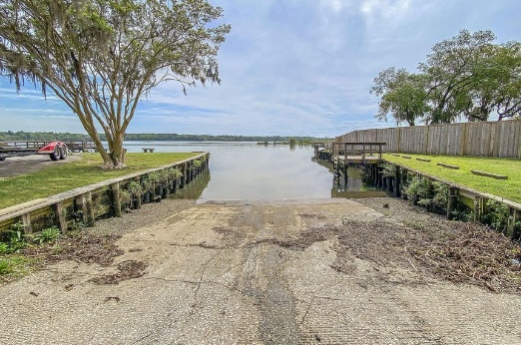
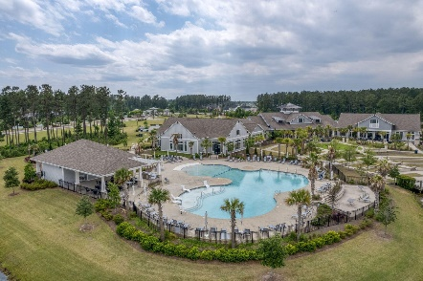
1019 Live Oak Avenue Pimlico | Moncks Corner, SC 29461 | MLS# 25028764 | $390,200
Darrell Creek Elevated Home With Elevator & Salt Pool
Peekaboo Cooper River Views
Co-sponsored by
Offering $3000
Lender Credit
Discover timeless charm in this brick residence, beautifully positioned on a spacious lot of just over a third of an acre. Offering the perfect blend of classic elegance and leisure, this home features a comfortable three-bedroom, two-and-a-half-bath layout.
The true highlight is the backyard oasis, centered around a sparkling swimming pool that promises endless summer relaxation. From the property's front porch, you can catch peek-a-boo views of the Cooper River through the mature trees, providing a constant, subtle reminder of your proximity to the water. This is a rare opportunity to secure a classic home with desirable amenities and a hint of riverside tranquility.
Rochelle Rennert
843-847-9694 | rochellesellscharleston@gmail.com | www.theunlockingdreamsteam.com
AgentOwned Premiere Group, Inc. | 219 N Highway 52 Ste A | Moncks Corner, SC 29461-3926

