Slide 1
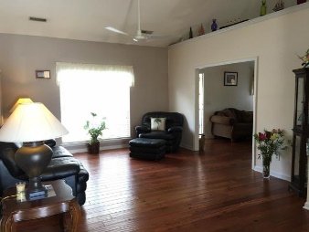
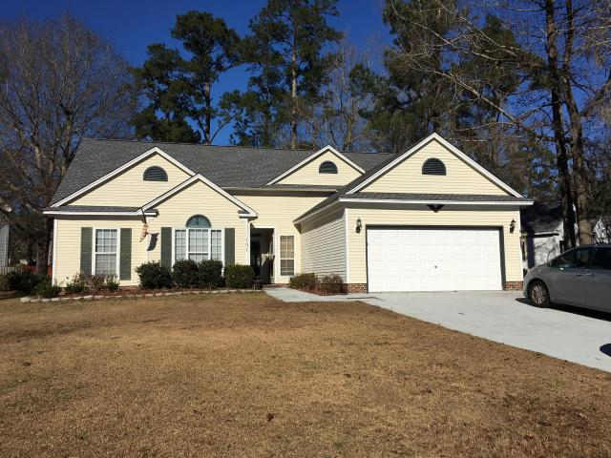
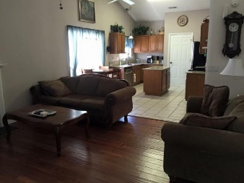
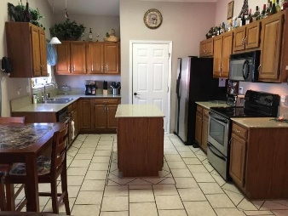
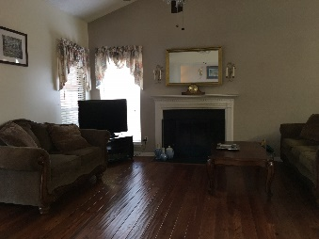
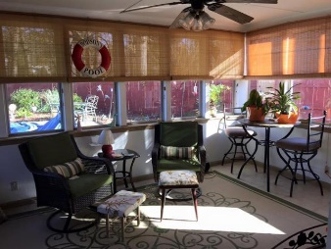
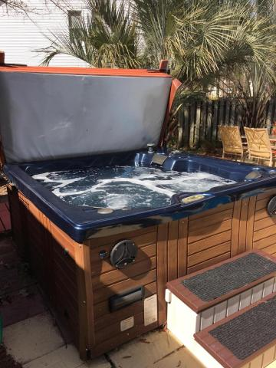
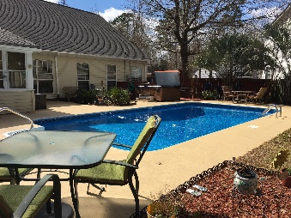


101 Annandale Court
Irongate ~ Summerville, SC 29485
MLS# 16001458 ~ $239,500
Reduced! Motivated Seller!!
Welcome Home!
101 Annandale is a beautifully appointed ranch, located on a large corner lot. Upon entering your new home you will find the wonderful open floor plan with gleaming wood flooring in the living areas and tile flooring in the kitchen. The kitchen has been updated with stainless steel appliances and granite countertops. Enjoy your private backyard oasis in the large heated and cooled (newly tiled) sunroom! Warm up in the hot tub during these cooler months and cool off in the in-ground pool during the heat of the summer. This home has been meticulously maintained. Recent maintenance includes a new hot water heater, roof (2013), pool liner and filter system (2014), freshly painted interior, exterior trim painted, trees trimmed, landscaping and much more! This home is a must see!
Brittany Soldano, REALTOR
Cell - 843-324-0183
bsoldano1217@gmail.com
Beresford Appraisals, LLC of Wando
295 Seven Farms Dr, Ste C-114 | Wando, SC 29492

