Slide 1
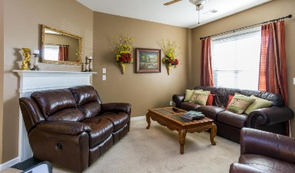
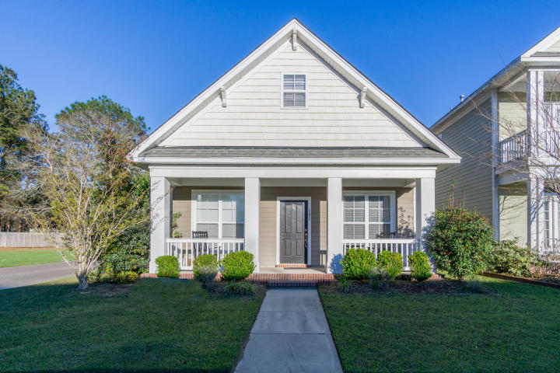
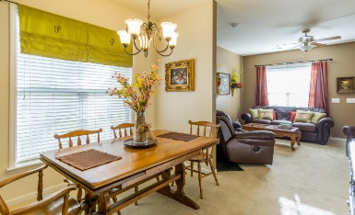
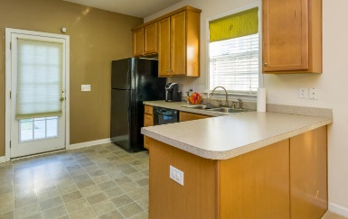
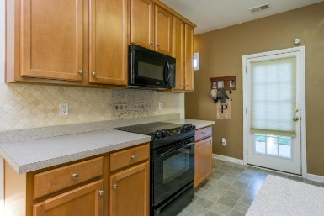
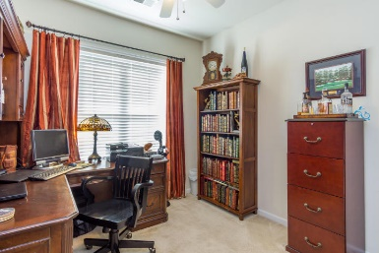
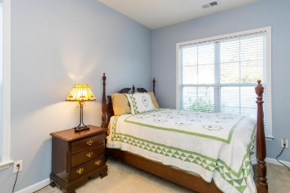
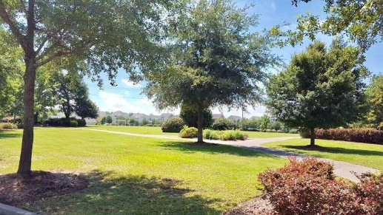
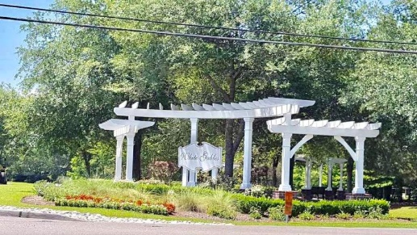
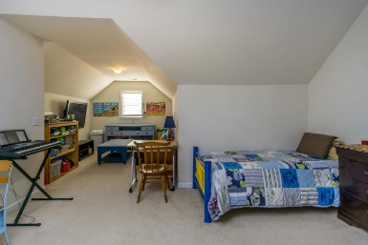


101 Blue Bonnet Street
Summerville | MLS# 17030359 | $209,100
Price Reduced in White Gables
Cute home with open floor plan in kitchen and family room. 42" cabinets, stone backsplash, and smooth top range. Gas fireplace in the family room. You will love the spacious master suite on the second floor with sitting room, two large walk-in closets, master bath with double vanity, garden tub and separate shower. Two guest bedrooms are on the first floor. Detached one car garage with parking pad and vinyl fence on great corner lot. Adorable home for your family or keep as investment property. Tenant lease expires 7/31/18.
Stephanie Deaton
(843) 743-4219
sdeaton@palmettost.com
www.palmettost.com

