Slide 1
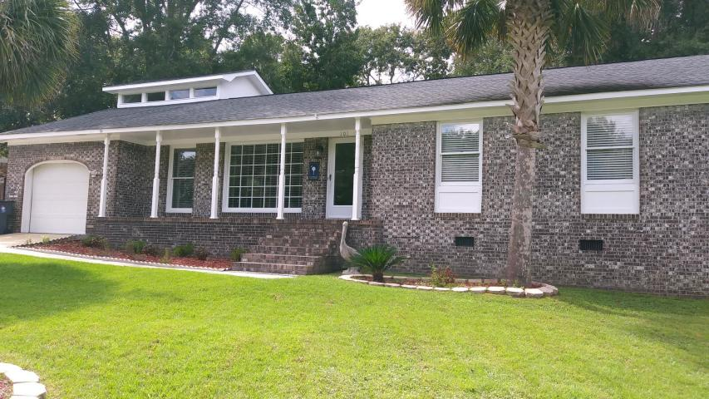
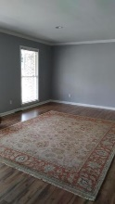
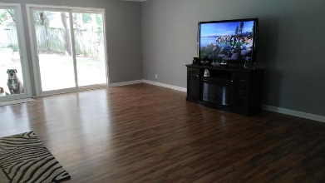
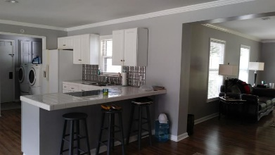
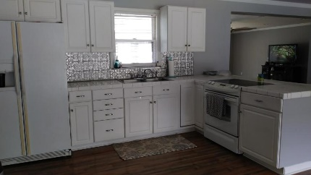
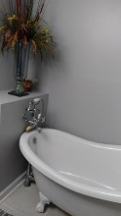
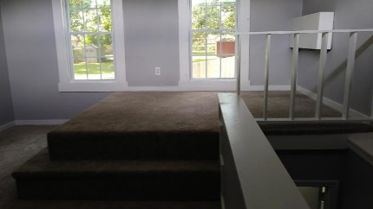
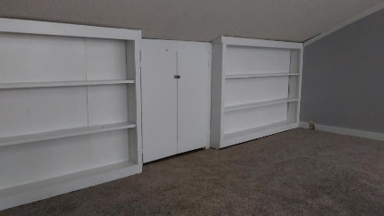
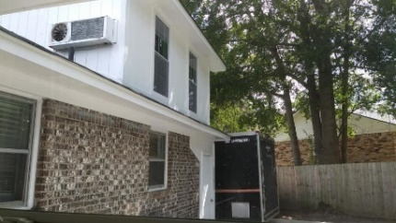
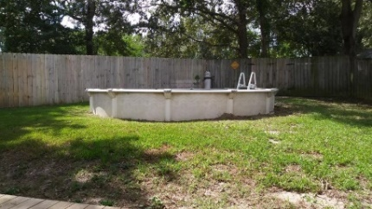


101 Cornell Drive College Park | Ladson | MLS# 18026296 | $218,000 3 Bedroom | 2 Baths | 2,014 Square Feet
Open House ~ Sunday October 28th ~ 1-4pm
Fantastic Updated Home with a Large Open Floor Plan. This home is a MUST see to appreciate this 3 bedroom 2 bath home with a finished FROG that could be a 4th bedroom, office or man cave. HVAC was replaced 5 yrs ago. Lighting is energy efficient with LED lighting. New 72" ceiling fan in Family Room and new flooring, paint, crown molding, recess lighting and moisture barrier has been added within the last 6 months. Notice the swimming pool in the backyard and visualize the family fun you can have in this wonderful backyard.
Asking $1,200,000
MLS# 17023051
3,692 SqFt
4 Bed/3½ Baths
Short Drive to Historic Downtown Charleston & Beaches
Terri Wood
Real Estate Agent
Office: (843) 821-1111
Cell: (843) 478-7020
terri@milerproperties.com
Miler Properties, Inc.
625 Old Trolley Rd
Summerville, SC 29485-5656
www.milerproperties.com

