Slide 1
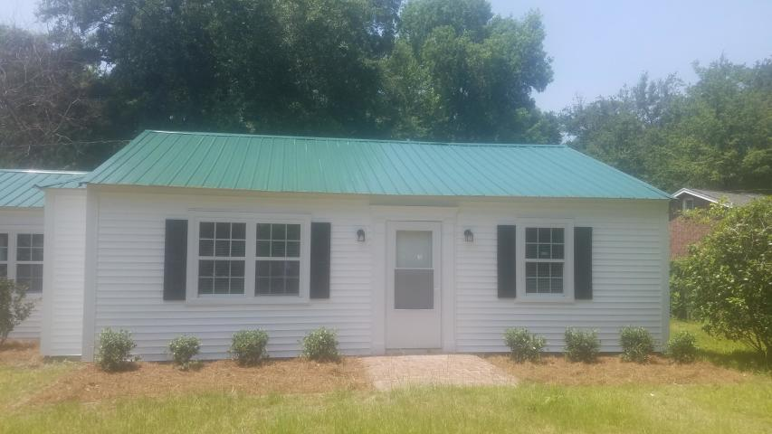
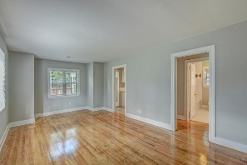
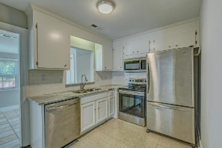
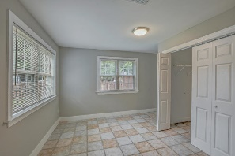
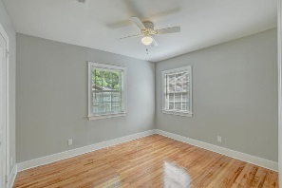
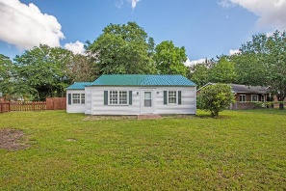
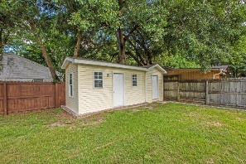



101 Paula Drive
Magnolia ~ Charleston, SC 29407 ~ MLS# 19016450 ~ $315,900
Cute Home On Large Lot Near Avondale
Adorable ranch conveniently located in desirable and much sought after Magnolia neighborhood in West Ashley. This lot is huge and fenced in. You have to see it. Just a few minutes walk or bike ride to all the shops and restaurants Avondale has to offer as well as the West Ashley greenway. This home features a new metal roof, Shutters, vinyl siding, freshly refinished wood floors, Stainless steel appliances, and marble counter tops. The sunroom has new windows as well. The yard is very large and could possibly be subdivided in the future. Out back are a storage shed and a workshop with electricity that was formerly used as a studio.
Michelle Riser
(843) 860-1229
mriser@ccim.net
Palmetto Group of AgentOwned | 597 Old Mt Holly Rd Ste 202 | Goose Creek, SC 29445

