Slide 1
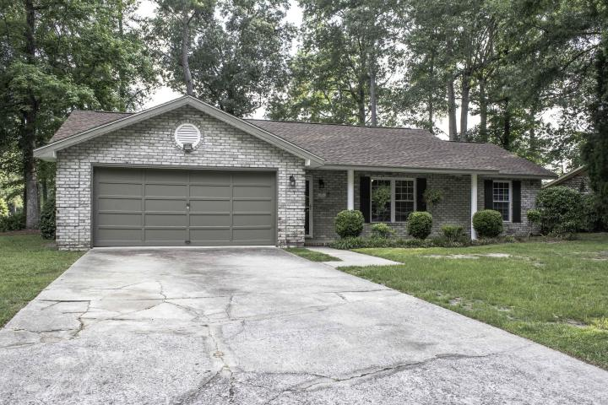
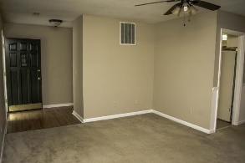
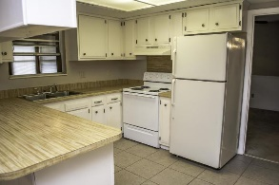
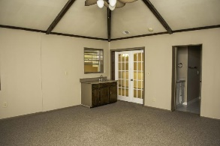
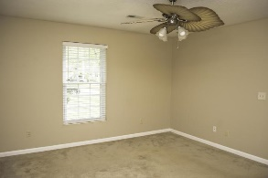
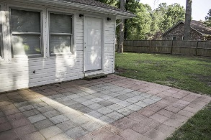
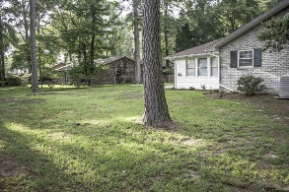
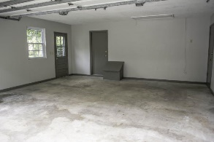
Price Reduced!
101 Sweetbriar Road
Quail Arbor V
Summerville, SC 29485
MLS# 15016472
$189,900
Extremely impressive 4 bedroom / 2 full bath brick home in Quail Arbor V. Huge corner lot with fenced in back yard! BRAND NEW roof! All new paint on the inside and out! Laminate flooring as you walk in. Open concept! Spacious kitchen with beautiful 16'' tile flooring. New hardware on gorgeous cabinets. Large pantry. Master Bedroom has a walk in closet and master bath! Other 3 bedrooms have clean carpet and bi-fold closet doors. Rec room is massive for all your entertainment needs! Laundry room is located perfectly! Ceiling fans in all rooms! Wood burning fireplace. Double pane double hung windows throughout with marble window seals. New 2'' faux blinds. Finished 2 car garage. Established and quiet neighborhood. Dorchester Schools District II. This property is turn key ready for you!
David Hickman | 843.505.0456 | davidisyouragent@gmail.com | www.omnicarolinarealestate.com
Omni Carolina Real Estate | 126 Eston Dr | Goose Creek, SC 29445

